Slide 1
Your Brand New Class

Slide 2
We are so excited to tell you all
In September you’re going to be a Bumblebee!

Slide 3
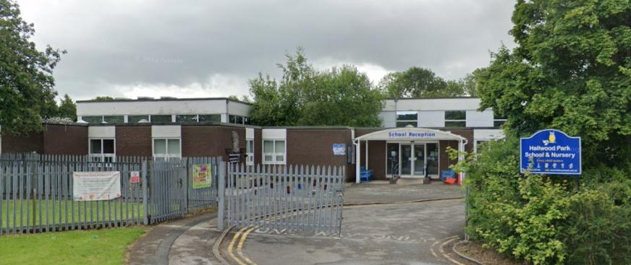
The brand new Bumblebee class will be at Hallwood Park, this is all new and exciting for us all!

Slide 4
Lets see what is behind the door!

Slide 5
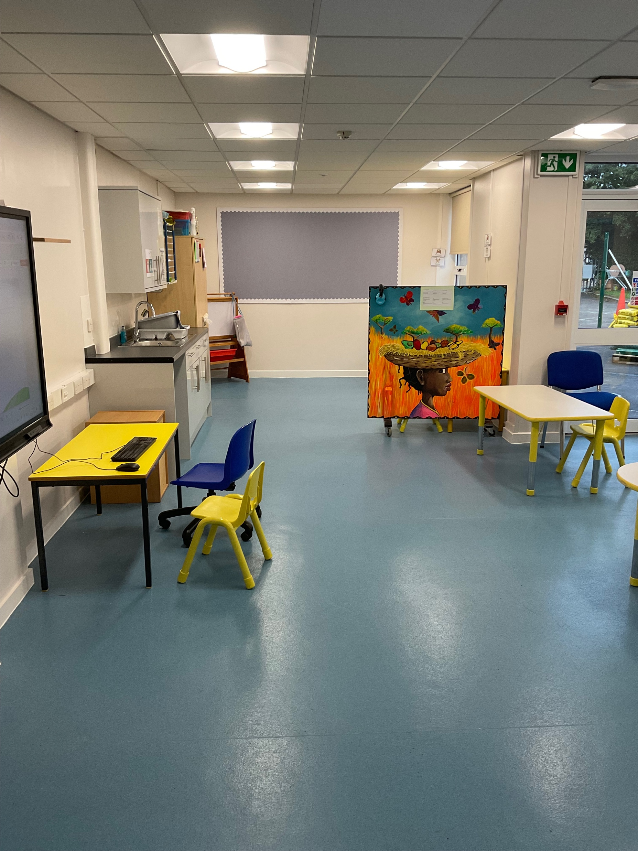
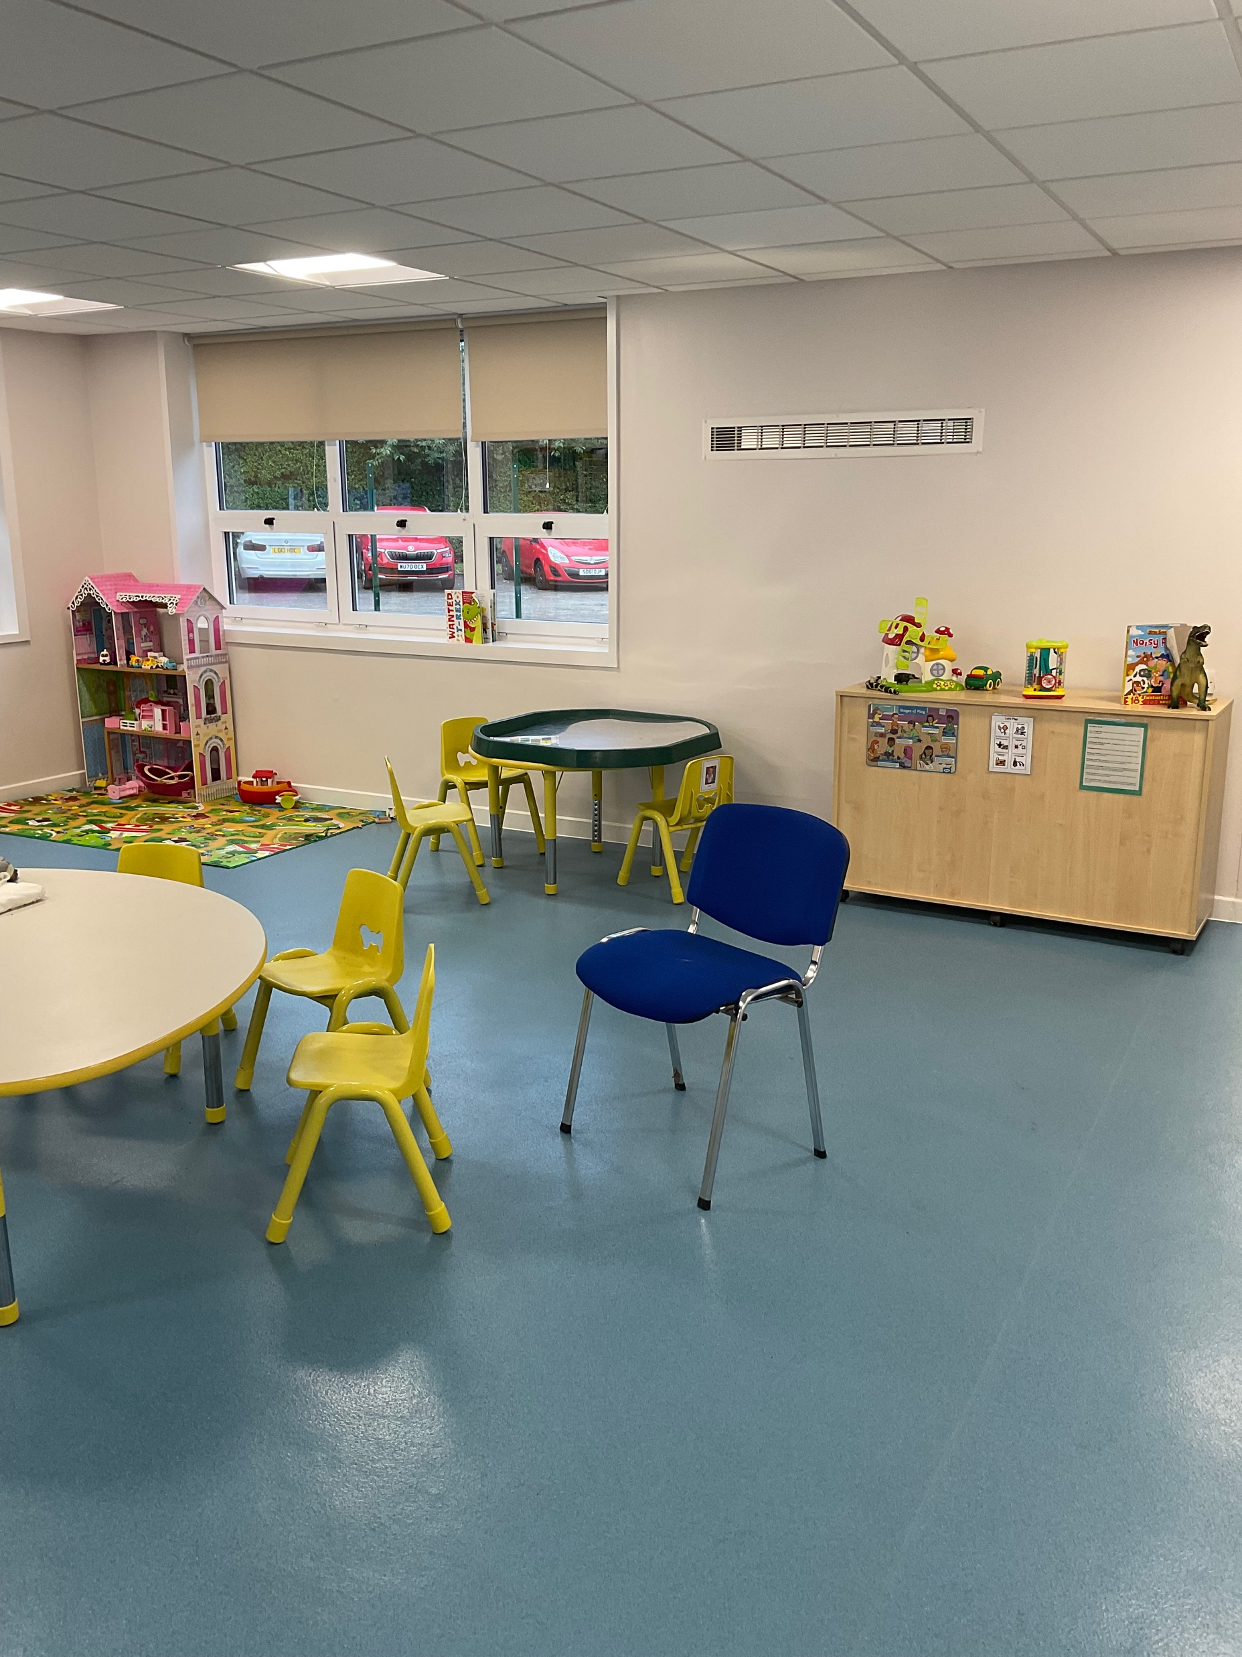
This is Bumblebees class

Slide 6
You have already met me! My name is Stacey, I am your new teacher

Slide 7
Your Teacher Assistants are
Coleen
Alice
Leanne (Monday- Wednesday)
Jess (Thursday and Friday)

Slide 8
Information Website www.brookfieldsschool.com
School day starts at 9.00am-3pm.
First day bring nappies and wipes (if applicable).
Spare clothes to be kept at school. Please ensure names are in everything even shoes, coats, hats and scarves. EVERYTHING!
For a school bag use a rucksack rather than a book bag, this holds everything and promotes independence (they can carry it themselves).

Slide 9
Just some reminders Lunch and Snack Will get free school meal (you will get vouchers for the holidays but you must ensure you have signed up via the Halton borough council site/ under free school meals.) Children on packed lunch will also get a lunch and we will place it near to them to encourage them. Snack is £3.00 per week (pay per term PAYMENTS TO BE MADE through the school gateway app) our admin department will contact you to sign you up to this service please see our website or contact school for information on how to do this.

Slide 10
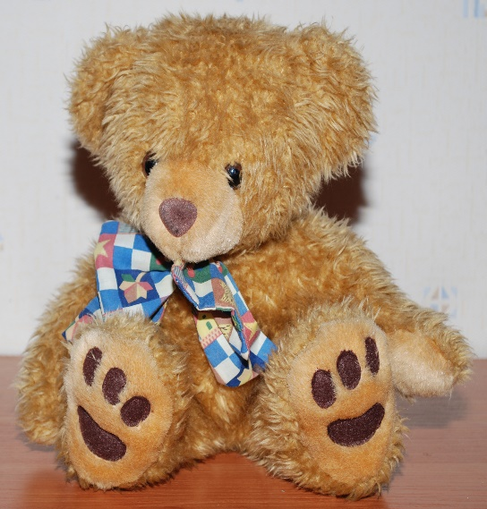
Toys from home.
We understand some children may require some toys/items as a comforter. If possible try to discourage their favourite toys as it can be difficult for the teaching teams to ensure they go home.

