Slide 1
Assembly is Starting

Slide 2
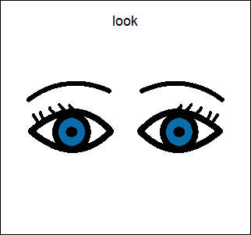
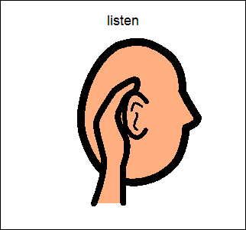
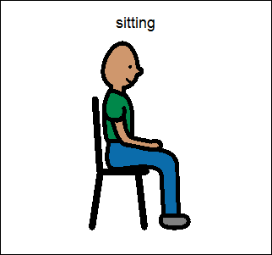

Slide 3
We are going to think about how we can stay safe on the internet.

Slide 5
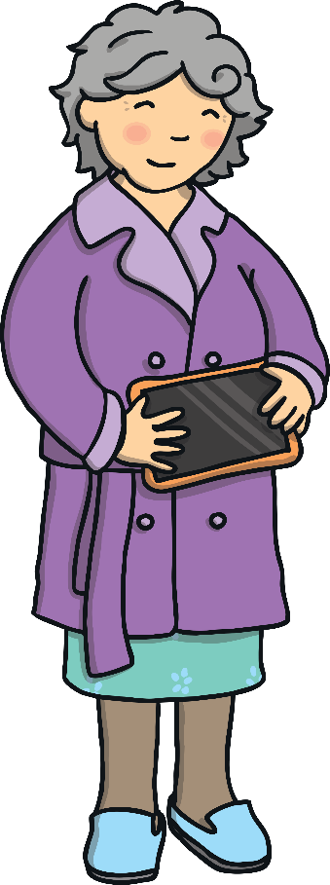
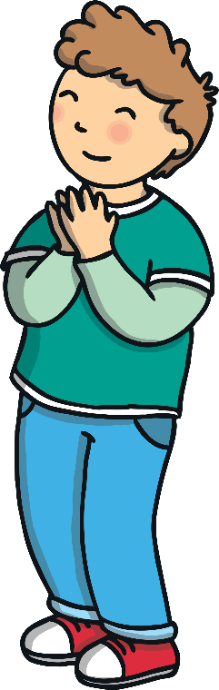

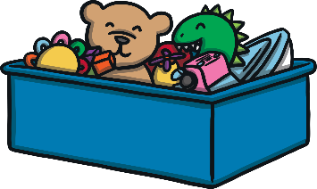

One day, Ben’s Grandma came home from the shops looking very excited and gave Ben a tablet. She told Ben that she saw the tablet on sale, she had no idea what it did, but she knew that Ben had been asking for one for ages!

Slide 6
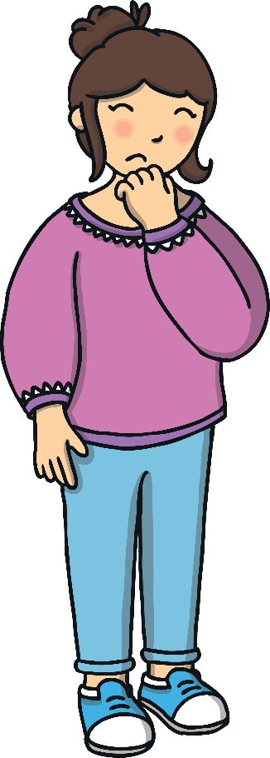

Ben’s Mum was a bit worried that Ben didn’t know how to use the internet safely.
Mummy made Ben promise that if he was ever unsure what to do with his tablet he would ask for help straight away!
I’m worried you are too young for a tablet!
I promise I will use the tablet safely, Mummy!

Slide 7

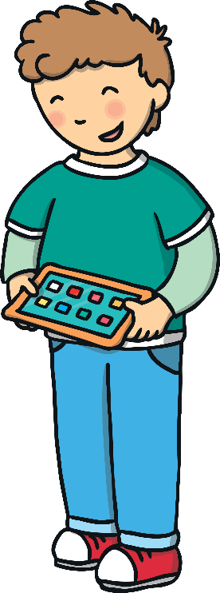
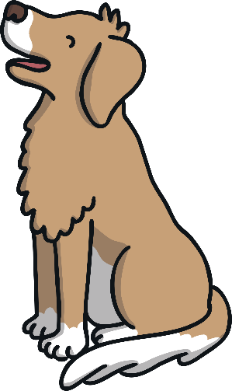
Ben’s Mummy installed lots of fun games for Ben. He was only allowed to play on these games.
Buddy the dog was going to help make sure Ben used the tablet safely.
Will you help Ben to use his tablet safely?
Woof, woof, woof!

Slide 8
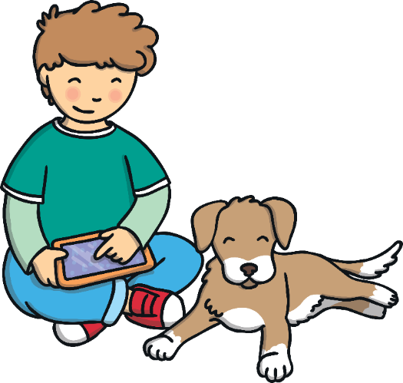
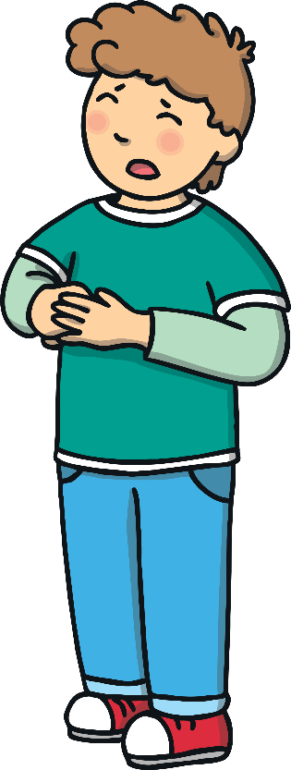
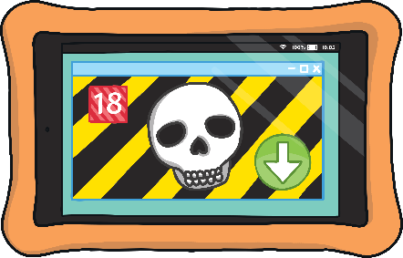
Ben had lots of fun playing on his tablet until suddenly, an advert for a new game appeared.
Do you think I should press the arrow to download the new game?

Slide 9


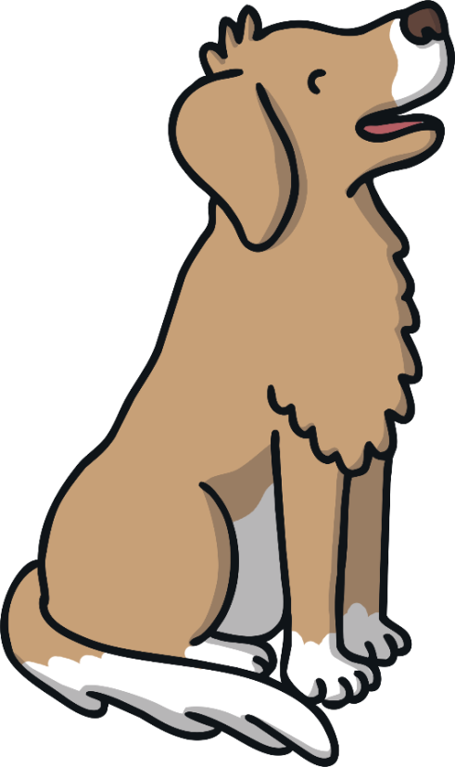


Buddy helped Ben to decide what to do by singing his helpful ‘Use Your Tablet Safely’ song!
Buddy’s ‘Use Your Tablet Safely’ Song
(Sung to the tune of Frère Jacques)
Ask your grown-up,
Ask your grown-up,
Ask for help!
Ask for help!
Use your tablet safely,
Use your tablet safely,
Woof, woof, woof!
Woof, woof, woof!

Slide 10
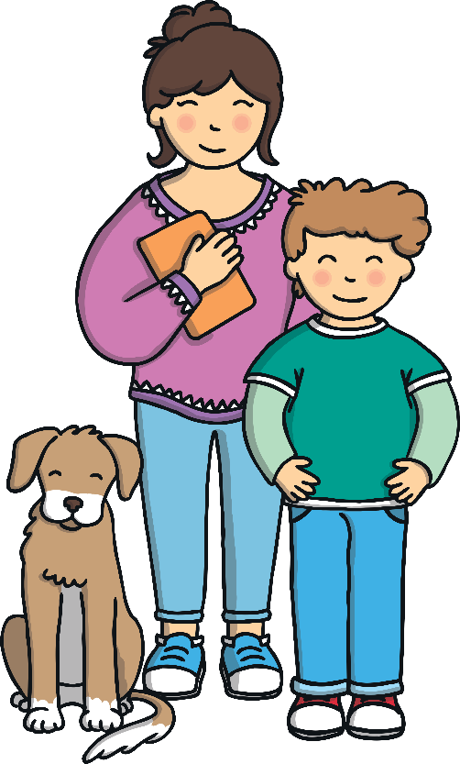
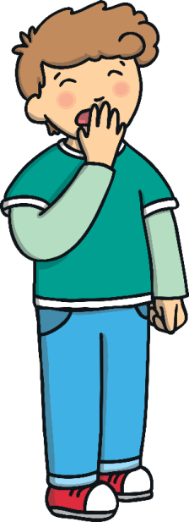
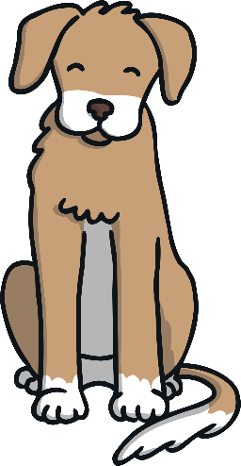
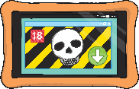
Mummy, Mummy, I need your help!
Good boy Ben, you did the right thing asking for help!

Slide 11
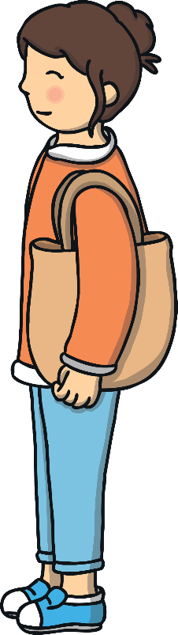
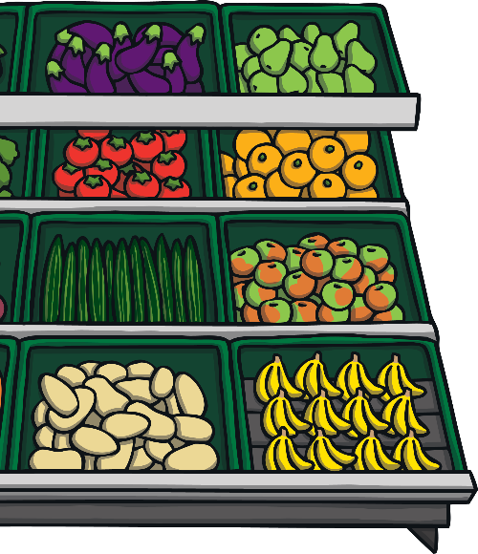
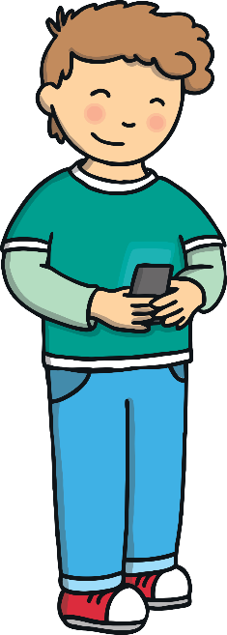
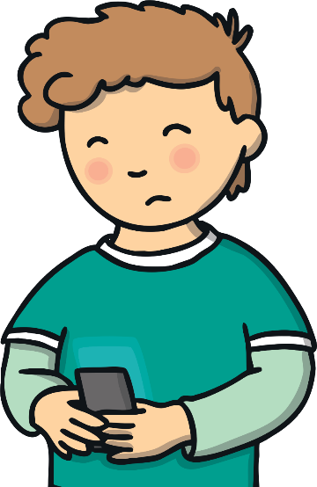
.
The next day Ben accidentally pressed something and a different video appeared.
Should I watch this video, even though I don’t know what it is?

Slide 12
Ben remembered Buddy’s song:
Buddy’s ‘Use Your Tablet Safely’ Song
(Sung to the tune of Frère Jacques)
Ask your grown-up,
Ask your grown-up,
Ask for help!
Ask for help!
Use your tablet safely,
Use your tablet safely,
Woof, woof, woof!
Woof, woof, woof!

Slide 13
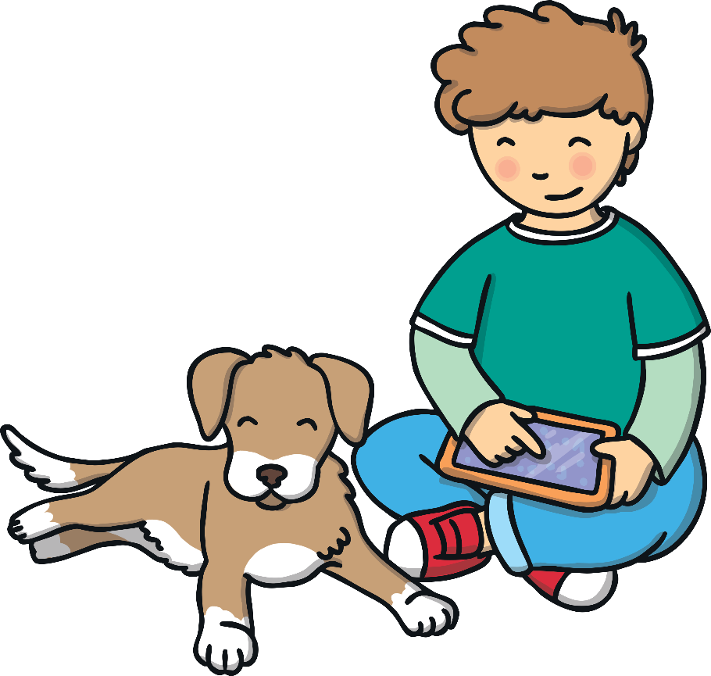
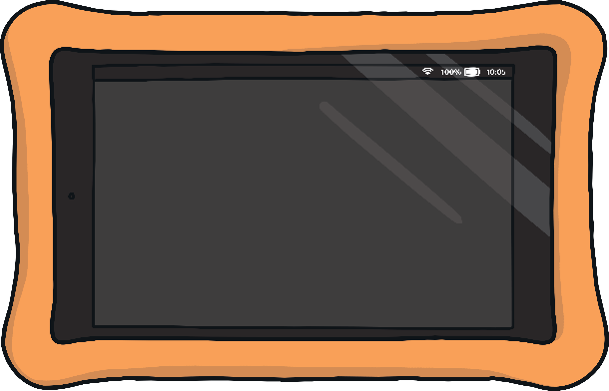
Suddenly a message from someone Ben didn’t know appeared on the screen. It said “Hello, can I play too?”
Ben asked Buddy, “Do you think I should let this person join in my game?”
Hello, can I
play too?

Slide 14
Ben remembered Buddy’s song:
Buddy’s ‘Use Your Tablet Safely’ Song
(Sung to the tune of Frère Jacques)
Ask your grown-up,
Ask your grown-up,
Ask for help!
Ask for help!
Use your tablet safely,
Use your tablet safely,
Woof, woof, woof!
Woof, woof, woof!

Slide 15

Ben was very sensible using the internet and he stayed safe! We need to know how to keep ourselves safe!
Internet Safety Rules
Always ask a grown-up for help if you see anything strange or unusual.
Don’t download or install anything without asking a grown-up first.
Remember, not all games and videos are for children.
Don’t talk to strangers online and don’t tell them where you live.
If you are ever unsure what to do, remember
Buddy’s song, and always ask for help!

Slide 16
Our story has finished!

Slide 17
Assembly has nearly finished

Slide 18
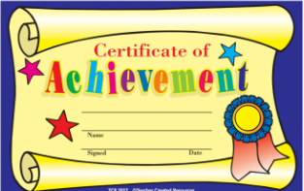
Certificates

Slide 19

Prayer
Dear God,
May we all work together to stay safe and protect ourselves.
Amen

Slide 20

Brookfields Song
We belong to a school that is special and small, and the name of it’s Brookfields enfolding us all.
Oh God give us kindness, each other to love, make us happy and caring, secure in your love.

Slide 21

Assembly Has Finished, Time for Class

