Slide 2
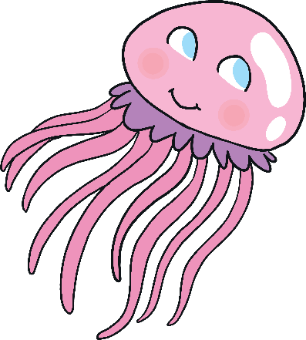
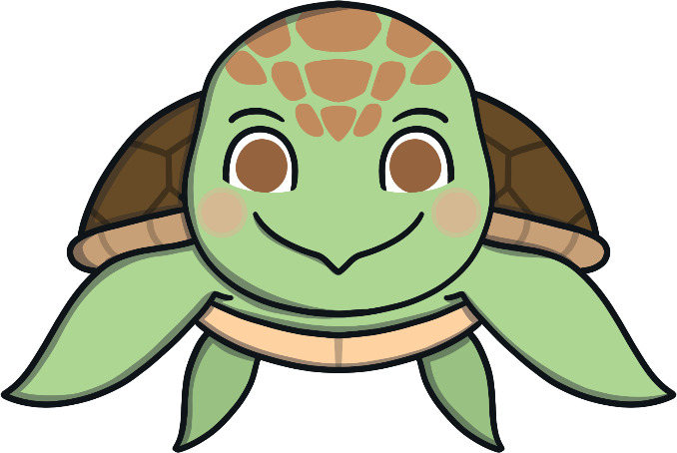
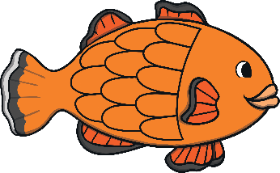
We all live under the sea. This is our special habitat.
We all live in a very special place. Can you guess where our home is?

Slide 3
You know that we live in the sea now, but I wonder if you could find the sea on a map. This is a map of the world. Do you know which parts are the sea?
On maps, the seas and oceans are shown with the colour blue.

Slide 4
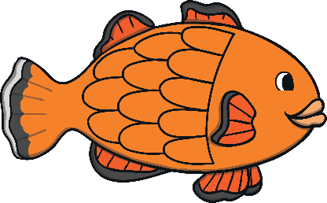
On a map, the seas and oceans are blue. What do you think the green parts are on this map?
On lots of maps, the land is green.

Slide 5
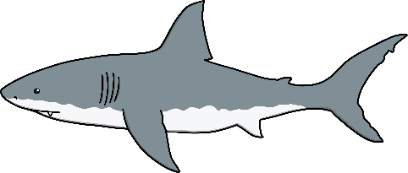
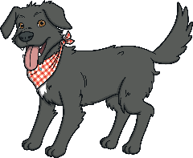
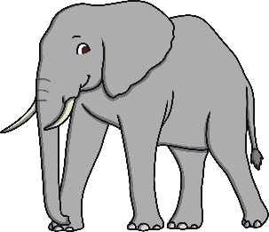
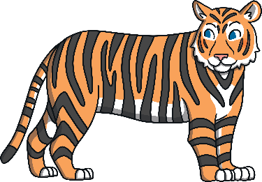
Sea creatures live in the sea, which is the blue parts of a map. Lots of my animal friends live on the land. These are often the green parts of the map.
Can you sort the creatures below? Who lives on the land and who lives in the sea?
sea
land

Slide 6
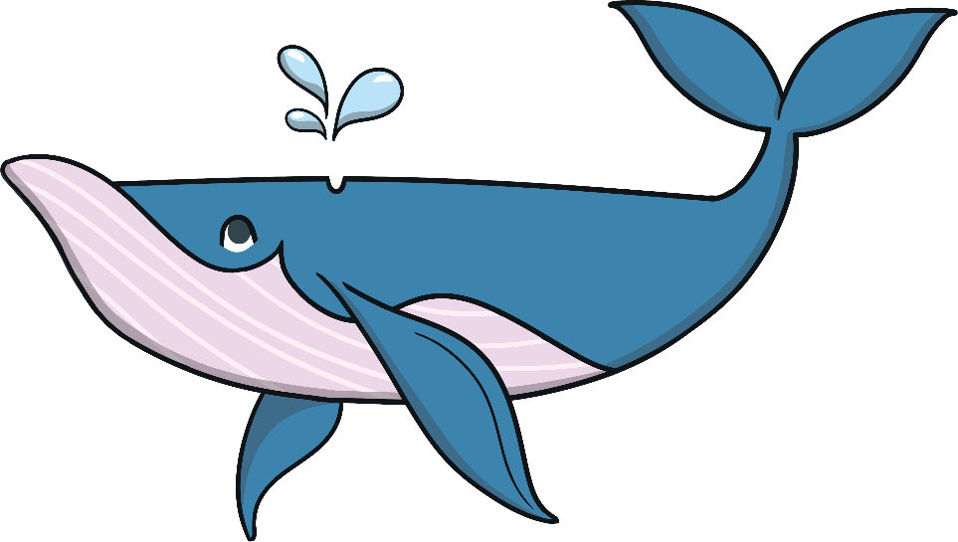
Could we live here, in this blue area?
Yes. This blue area is the sea. We could live here.
No, we could not live here. This green part is the land.
Could we live here, in this green area?
Yes, we could live here. This is the sea.
Could we live here, in this blue area?
I wonder where my sea creature friends and I could live?

Slide 7
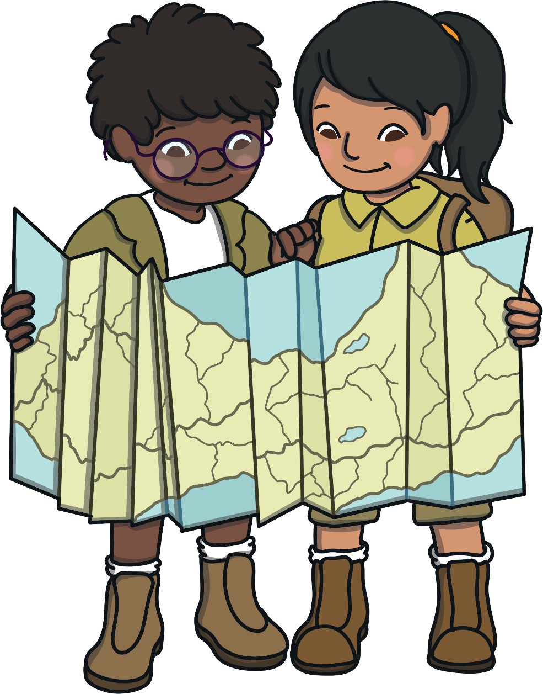
Now you know how to find the seas and oceans on a map.
Next time you look at a map, see if you can spot some blue parts that are water and imagine which creatures might be living in there!

