Slide 1
How I deal with my Anxiety
Insert picture of you here

Slide 2









How I am feeling now:

Slide 3
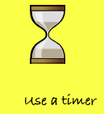
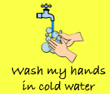

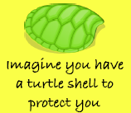

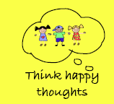
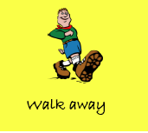
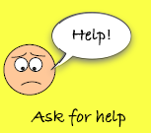
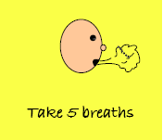
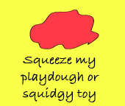
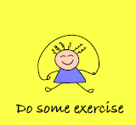
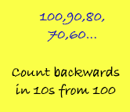
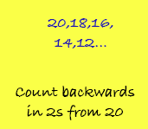
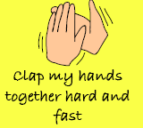

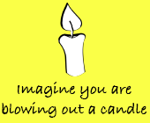


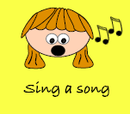
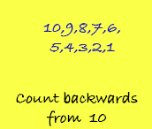
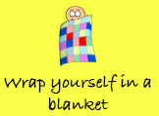
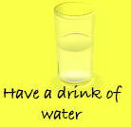
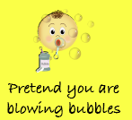
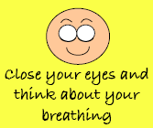
Possible Strategies

Slide 4
5
My anxiety has 5 stages and I have a way to deal with each of these.
5 is my RED ALERT, this is when I am too upset and my anxiety feels too much.
4 is when I can become really upset.
3 is when I can feel myself becoming really anxious.
2 is when I am able to manage myself.
1 is when I am calm.
4
3
2
1

Slide 5
Insert picture here of you and what makes you happy.
1
Sometimes I don’t feel anxious and I have lots of happy feelings, I feel like this when …
EXAMPLE
EXAMPLE
EXAMPLE

Slide 6
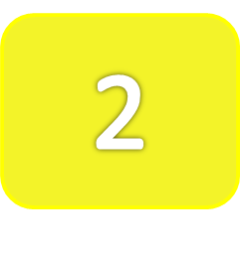

Insert a picture of you
here using a breaking
technique.
Sometimes I feel a little worried and a little bit anxious, but I still have control over my anxiety, so I am able to calm myself down by …
EXAMPLE
EXAMPLE
EXAMPLE

Slide 7

3
Insert picture
of what
makes you
happy.
Insert picture of
you here
Sometimes I can feel ________________. Sometimes my heart feels like its beating quicker or _____________________. When this happens I don’t feel like I have good control over my anxiety. When this happens I can …
EXAMPLE
EXAMPLE
EXAMPLE

Slide 8
4
Insert picture of you here when you are upset or angry.
Sometimes I can get really upset and angry. This is because I am feeling REALLY anxious and this is when I have little control over my anxiety. I might start to __________________. To help me calm down I will need encouragement to…
EXAMPLE
EXAMPLE
EXAMPLE

Slide 9
Insert picture of you here
5
Then there are times when I have NO control over my anxiety, this is when it is REALLY, REALLY bad. I am unable to make the right choices in these situations and may be a danger of hurting others. In order to help me calm down I need to …
EXAMPLE
EXAMPLE
EXAMPLE
I need to carry on doing these until I am calm.

Slide 10
This is how I have dealt with my anxiety and
I know I can learn other new strategies if I need to.
Insert your SMILING face here.

