Slide 1
Communication Brookfields School
Jude Inman
(Independent Speech and Language Practitioner)
E-mail me:
Jude@chatterjacks.co.uk
Talk to me: I'm in school every Wednesday in the Louise's room or around school

Slide 2
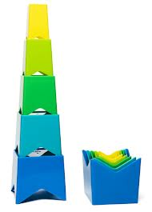
Components of Communication
Speech sounds
Spoken Language
Comprehension of Language
Attention and Listening skills
Social Communication

Slide 3
Speech, Language, Communication What’s the difference?
Communication – This is the exchanging of messages and incorporates both verbal and non-verbal communication.
Language – This can be separated into two areas:
- Receptive skills: our understanding of words and sentences
- Expressive skills:the words and sentences we use
Speech – This is the sounds that we use to form our words.

Slide 4
BLANKS levels of questioning
Background Information
Devised by Blank, Rose & Berlin in 1978.
Different types of questions ask for different types of information
Simple questions ask for concrete answers whereas more complex questions ask for abstract answers
Questions require both receptive and expressive language
Level 1: NAMING: Look at it…
Focuses on the whole of an object.
Typically the language maps directly on to the resources in front of you.
There is limited processing needed.
Level 2: DESCRIBING: Talk about it…
Focuses on part of the object.
Typically the language maps directly on to the resources in front of you but is about colour, shape, size or use.
Level 3: RETELLING: Think about it…
Focuses on the context around the object.
Typically the resources are still needed to help organise the language but it is more about how the object interacts with the environment.
Level 4: JUSTIFYING: Reason about it…
Focuses on inferences, problem solving and abstract concepts.
The resources are now there to act as a focal point for discussion.

Slide 5
Alternative, Augmentative Communication
This is the term used to describe various methods of communication that can ‘add-on’ to speech and are used to get around problems with ordinary speech.
AAC includes simple systems such as pictures, gestures and pointing, as well as more complex techniques involving powerful computer technology.
Within Brookfield's there are a variety of different types and levels off AAC being used.

Slide 6
Signing BSL or Makaton and gestures
Some children within school use Sign language to support their communication.
BSL (British Sign Language) is a complete signing language, used by the deaf community. It has its on unique sentence structure and is a stand-alone language system. If supporting children who use BSL It would be suggested to do some further training. Free courses can be found online Alison.com, or centre of excellence.
Makaton is a language programme using signs and symbols to help people to communicate. It is designed to support spoken language and the signs and symbols are used with speech, in spoken word order. www.makaton.org/aboutMakaton/ for more information and training dates
Don’t worry if you don’t know the correct signs gestures or signs you think up will aid understanding so don’t be afraid to just have a go or gesture along with your speech

Slide 7
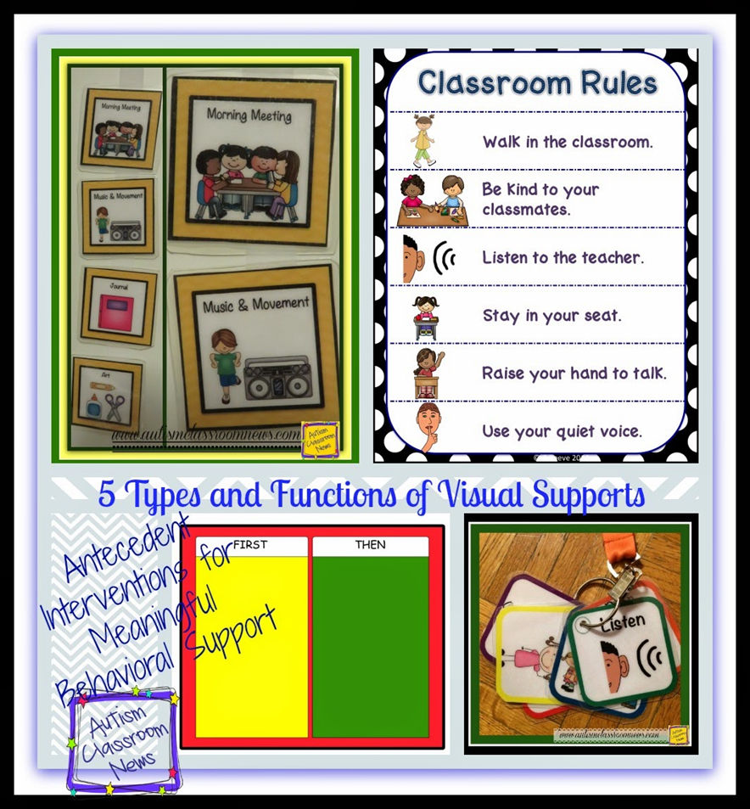
Visual supports
We all use visual supports, road signs, shopping lists, calendars etc.
Visual supports are pictures or symbols used to help understand words that are being used.
Many people with an ASD are thought to be visual learners, so presenting information in a visual way can help to encourage and support people's communication, language development and ability to process information. It can also promote independence, build confidence and raise self-esteem.
Not to be confused with PECS which is a communication system where they give the pictures to communicate
Visual supports is you communicating something to them with a picture.

Slide 8
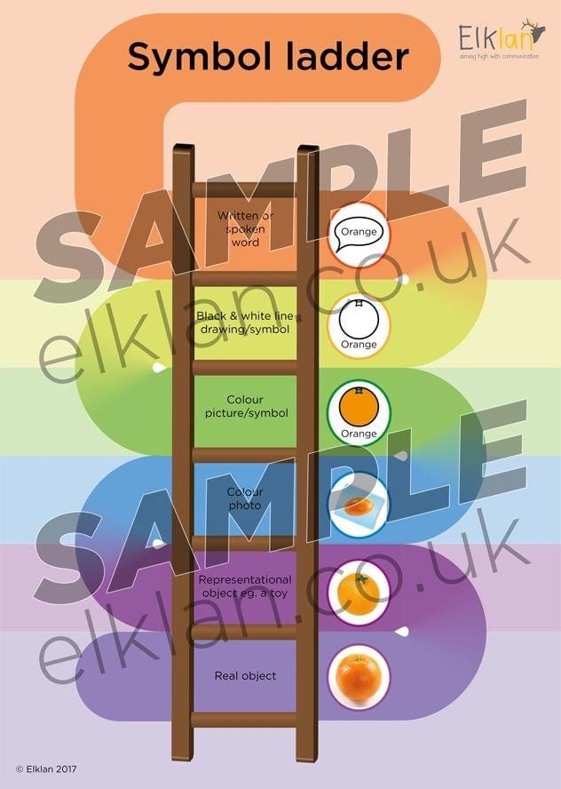
Symbolic Understanding
Generally, objects are considered the easiest form of visual communication to understand
followed by miniatures,
photos,
line drawings
symbols
writing,
Although this hierarchical understanding is held true for many people on the spectrum, there can be exceptions. Some individuals find line drawings easier to understand than photographs.(See Elklan sample document)

Slide 9
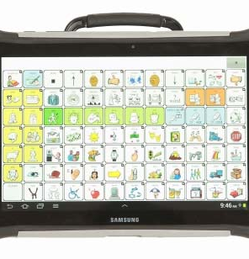
LAMP (Language Acquisition Motor Planning)
This is a communication system based on button location rather than category based system what have been traditionally used in communication devices
The students learn the unique locations of the buttons to create words and phrases independently.
The student starts with simple commands like ‘stop’ and ‘go’ and use of the device will be in highly structured time. As the child develops they begin to use the core words they have learned in many different situations. They learn flexibility of words such. ‘go’ could be start an activity, it could be to leave the room, it could be to tell you to stop and go away. By learning words in this way helps them to develop a vocabulary that is flexible regardless of the topic and situation. These single words quickly become more complex phrases as the student progresses.
Check out videos on you tube (Liberator.co.uk) to see competent students in action (Its amazing)

Slide 10
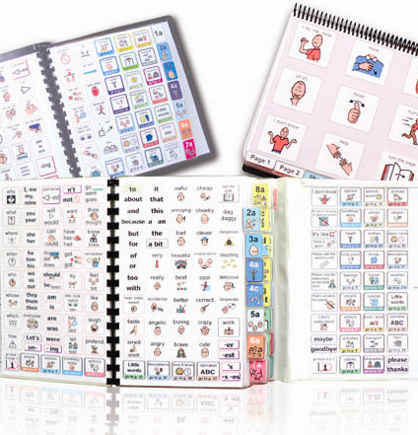
PODD (Pragmatic Organisation Dynamic Display)
PODD books are large communication books that look really large at first sight but they work on the principle that all words should be available instead of a restricted number as were once used in communication books so the user has the potential to talk about whatever they wish. It involves turning pages to get to categories.
The PODD communication system is taught through a focus on natural language stimulation, where visual language is modelled alongside verbal.
The adult language partner points to the symbols representing the key words of her sentence while speaking. The children therefore see picture symbols used for an entire range of functions by capable communication partners, and in doing so learn how to use this communication method within natural settings. This way of communicating echoes how typically developing children learn language.
The consistent use of picture information alongside verbal also plays to the visual strengths of ASD learners, and helps with their understanding of instructions, information and questions as well as showing them a means of expressing themselves

Slide 11
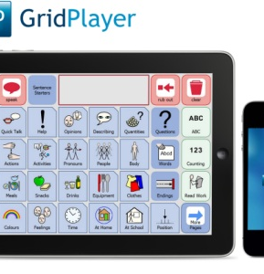
The Grid (an example of a dynamic speech device)
This is a programme which can be used on Ipad or computer or a designated device to create a dynamic communication device.
It has pre-programmed set phrases and words in there and when you press a button it will automatically switch to a connected page and predict what you want to say then speak it for you.
These devices are useful when the understanding of language is good and they student can categorise but there is no speech or unclear speech.

Slide 12
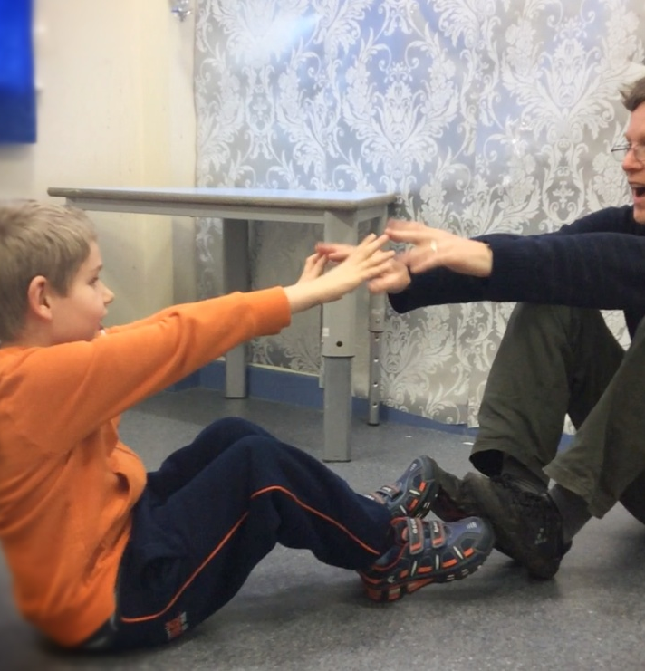
Intensive interaction
This is an approach created by Dave Hewitt it works by developing enjoyable and relaxed interaction sequences between an adult and a child. E.g copying a noise or a movement. It is in these sequences of turn taking that the basics of communication are gradually rehearsed and learnt
The adult simply watches observes and joins in with a behaviour.
This simple principle is the one used by adults in interaction with babies during the first year. The first year is the period of development when a baby carries out intense and very rapid learning of the fundamentals of communication.
Intensive interaction needs to be done often, it can be quite intense, but also fun-filled, playful and enjoyable. Both participants should be at ease with enjoyment of the activity as the main motivation.
For more information and training dates http://www.intensiveinteraction.co.uk/

Slide 13
Words (You)
How you talk to your students can have a big impact on how and if they respond. How many pieces of information are you including in your sentences.
John go get your coat and bag and put your shoes on. (7 key words need to be understood here)
Think about how complicated is your language?
Could you use different words?
Could you change your sentence structure (grammar)?
Could you ‘chunk’ your information into smaller instructions?
Repeat as often as needed
Give the students plenty of time to process language this may feel uncomfortably long to you (Remember it is you that is uncomfortable with the wait not them), try counting to 10 while you wait for a response.

Slide 14
Behaviour
Don’t forget all behaviours are a form of communication to understand what a child is trying to tell us we need to be detectives and explore everything we can think of from the environment, what is being asked of them, the home environment, their sensory needs to even the weather.

