Slide 1
Sensory Processing Difficulties
Catherine Glynn
Occupational Therapist
Notes:
I

Slide 2
What will be covered?
What are Sensory Processing Difficulties?
What do Sensory Processing Difficulties look like?
What can help?

Slide 3
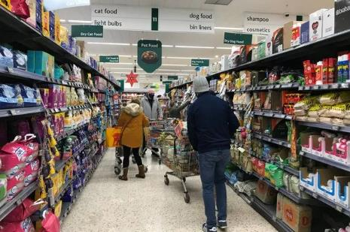
SENSORY EXPOSURE
SOUNDS
SMELLS
VISUAL
MOVEMENT
Notes:
Consider sensory exposure in a trip to a supermarket
Discuss all of the different sensory input linked to being in a supermarket
What do we see when our sensory systems are working well e.g.
Being able to negotiate up and down the isles
Find the things you want on the shelves
Investigate different products
Make choices
What do we see when our sensory systems are not working well e.g.
Moving down the wrong aisles
Struggling to negotiate the trolley through the aisles
Poor orientation
Not finding the products you need on the shelves
MELTDOWNS

Slide 4
Sensory Detective
“People often use the word behaviour to mean bad behaviour. Often a child does not know any other way to tell us. It is our business to find out what the behaviour is communicating”
Lorna Jean King (OT) 1996
What is your child trying to tell you?

Slide 5
VISUAL
SMELL
TACTILE
AUDITORY
SENSES
TASTE
VESTIBULAR
PROPRIOCEPTION
INTEROCEPTION
Notes:
Sensory processing describes the way the body receives and interprets incoming stimuli through our senses.
Each sensory system informs our brain on how to react and interact with our environment.
For example, sitting still and paying attention in the classroom for an hour is a common expectation in the life of an eight year old.
However, for the child to achieve this, they must be able to take in all the sensory information around them including noises outside the window, colourful wall displays, teacher’s voice, smells from the canteen, awareness of their body movement and the feel of the desk beneath their hands. They must use the important information to help them stay still and upright in their chair, listen to the teacher and maintain their attention.
This can be a great challenge to integrate all this information and use it to help us make sense of our world and behave in the right way in a certain situation.

Slide 6
Pyramid of Learning
Academic Learning
Activities of daily living
Senses
Physical Development

Slide 7
VESTIBULAR (MOVEMENT)
WHAT IS IT?
WHAT DO WE SEE?
Located in our inner ear
Detects our movement – side to side – up and down – round and round
Linear movements are calming/organizing
Rotational movements are alerting
Balance
Difficulties sitting on a chair
Always on the move
Loves to spin
Difficulty walking over uneven surfaces
Seeking out heights
Afraid of heights
Dislikes having feet off the ground
Does not like PE

Slide 8
VESTIBULAR - What can we do to help?
Types of Movement and Positions
Fast Irregular Movements can be alerting or excitatory
Slow Rhythmical Rocking can be calming
Bouncing up and down can be calming and organising
Body Flexion(being curled up into a ball) can be very soothing and calming
Using movement and body positions as a way of changing your state is a very powerful tool

Slide 9
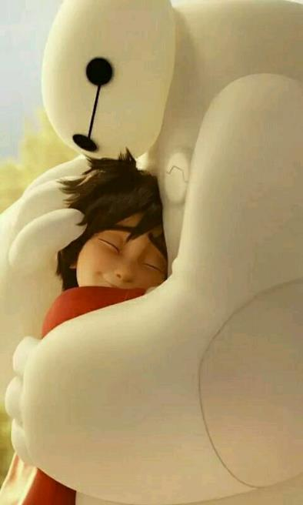
PROPRIOCEPTION
WHAT IS IT?
Sensory feedback from our muscles and joints.
Activities which place stretch on muscles and work against gravity e.g. pushing, pulling, lifting, carrying.
Allows us to apply appropriate pressure in tasks
Tells us where our bodies are in space
WHAT DO WE SEE?
Seeking – pushing – pulling – jumping
Chewing on things
Touching everything
Applying too much pressure – breaking things
Overly rough in play
Pets animals too hard

Slide 10
PROPRIOCEPTION - What can we do to help?
Physical activities are great to add intensity to a ‘sensory diet’
‘Heavy work’ activities using a lot of muscle power may improve attention and support a more centred, organised and confident feeling
If over excited, heavy work calms
Feeling ‘sluggish’, heavy work alerts
Try these activities:
Walking/Running
Stretching – using a resistance band
Wearing a heavy Back Pack (no more than 10% body weight)
Pushing Shopping Trolley
Carrying the shopping
Weighted Items

Slide 11
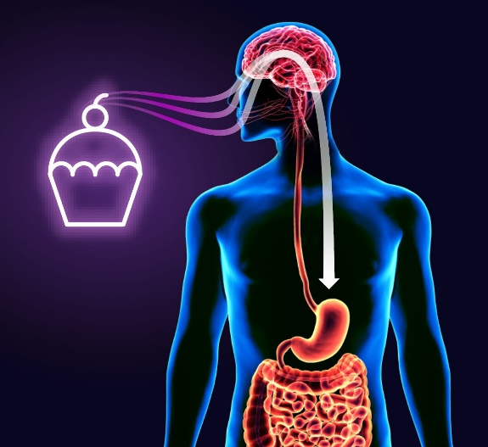
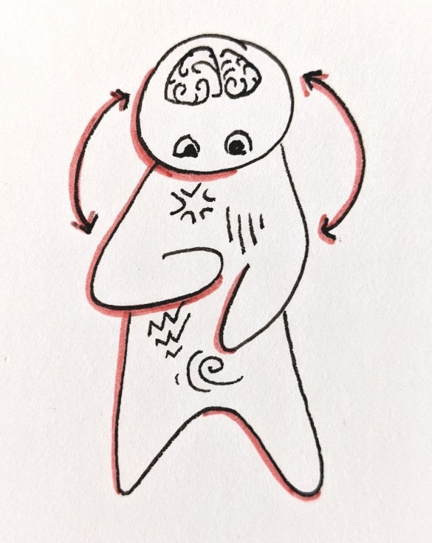
INTEROCEPTION
WHAT IS IT?
Internal messages to inform us of:
Temperature
Hunger
Thirst
Toileting
WHAT DO WE SEE?
Not knowing when we are hungry
Not knowing when we are full
Not knowing when we are thirsty
Not knowing when we need the toilet
Not knowing when we are too hot or too cold

Slide 12
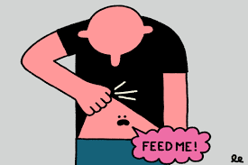
INTEROCEPTION- What can we do to help?
Draw attention to and describe how your own body is feeling e.g. “I feel hungry because I can feel my tummy rumbling” and point to your tummy
Use activities that cause a change in body state to intensify interoceptive feelings and then discuss it as it is happening. E.g before and during a PE lesson
Mindfulness sessions focusing on body functions – breathing exercises, heart rate

Slide 13
TACTILE (TOUCH)
WHAT IS IT?
Skin receptors covering our skin
Light and firm touch – Pressure
Pain
Temperature
Finding objects by touch alone
WHAT DO WE SEE?
Touch Sensitivity
Bathing – Showering difficulties
Clothes feel uncomfortable
Fear of unexpected Touch
Child lashing out and pushing others without apparent reason
Unable to tolerate personal care – hair brushing – nail cutting
Touching people and objects constantly
Difficulty finding things in your pocket without looking

Slide 14
TOUCH - What can we do to help?
Calming:
Some people have a need for a little more space
Body Brushing
Tactile adventure bins – rice, water, sand, lentils
Walk barefoot on sand, grass or textured carpets
Smear glue and peel off when dry
Heavy pressure options- weighted lap pad
Focusing:
Many people have found it is helpful to have their hands engaged while concentrating
Fidgeting with an object can help to stay focussed and quiet

Slide 15
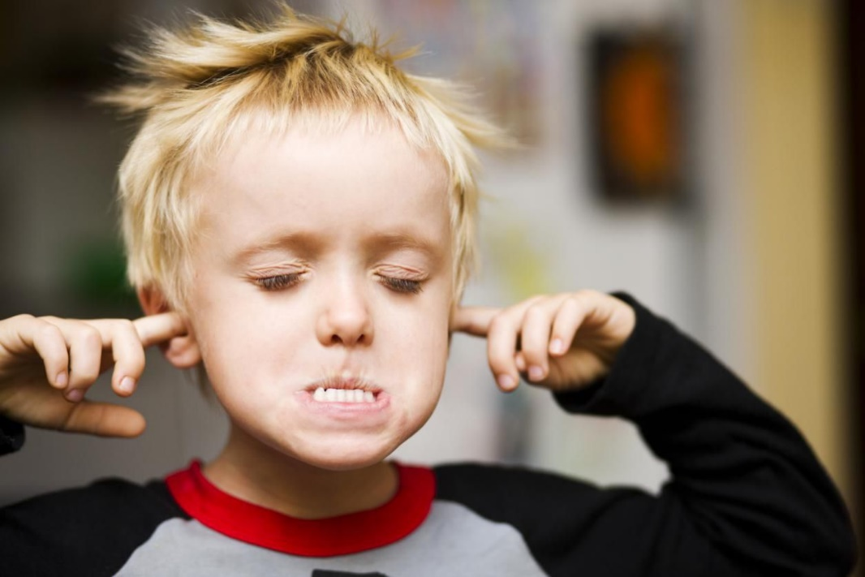
AUDITORY (HEARING)
WHAT IS IT?
Hearing
Filters out background noise
Noise levels
Noise differentiation
WHAT DO WE SEE?
Oversensitive to loud noises
Unable to filter out back ground noises
Difficult to concentrate
Difficult to access noisy environments
Does not respond to own name being called
Making noise for themselves
Refusing to enter noisy environments

Slide 16
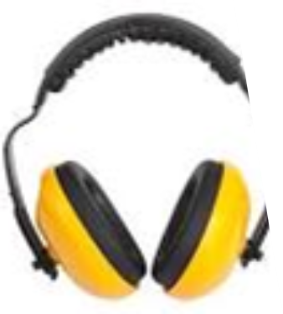
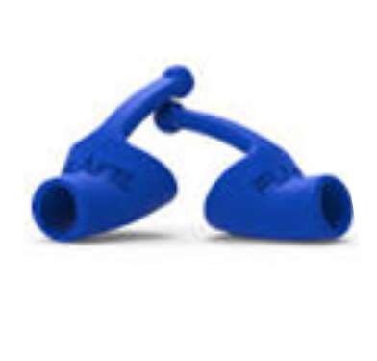
HEARING - What can we do to help?
Ear defenders, flare in ear buds, headphones
Warn the child when entering a noisy environment ie supermarket. Quieter environments may be better tolerated
Avoid speaking to the child from across a busy room. Get their attention first before giving verbal instructions
Speak calmly
Let the children know if a loud noise is expected
Identify irritating noise such as ticking clock -can the batteries be removed?
Consider playing calming music, no fast beats, they can be too alerting!

Slide 17
SMELL AND TASTE
WHAT IS IT?
Taste is one of the first senses to come alive
Memory and smell work together to protect us from danger
The sense of smell is connected to emotion and memory
WHAT DO WE SEE?
Picky eater
Smells everything
Reacts negatively to smells e.g.in a canteen
Seeks out strong flavours – cold foods
Seeks out bland flavours

Slide 18
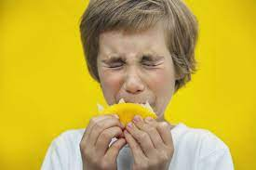
SMELL AND TASTE - What can we do to help?
Smells
It doesn’t have to be an unpleasant smell for some children to find it distracting
Reduce strong smells, if possible – air fresheners, cleaning products etc.
Perfume - this can be distracting for some children
Allow the child to have a favourite smell or comforting scent on a tissue
Taste
Messy play with food
Food exploration activities – encouraging touching food and tasting
Getting involved with meal preparation

Slide 19
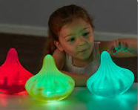
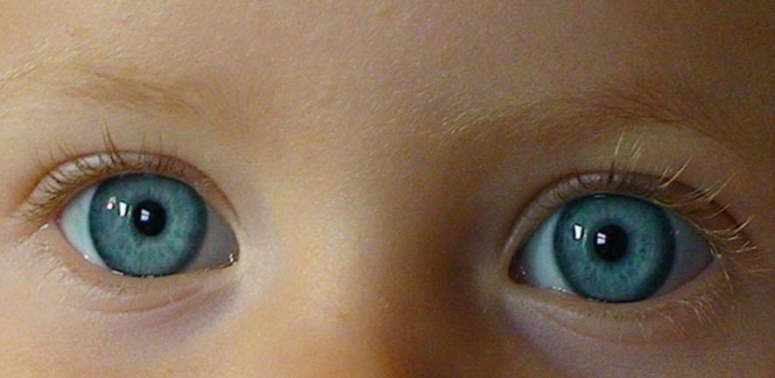
VISUAL
WHAT IS IT
Gives us information about
Light / Darkness / Colour / direction / Location /Edges / Boundaries / speed / distance.
WHAT DO WE SEE
Struggle to find items amongst a group of others
Sensitive to bright light
Distracted in busy environments
Seek out bright flashing lights
Love to watch objects spin

Slide 20
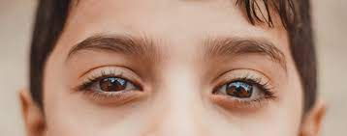
VISION- What can we do to help?
Natural light, if possible.
Have the lights off if the room is bright enough without, or only have some of them on.
Wear sunglasses or hat indoors/outdoors.
Declutter the environment where possible.
Use soft colours
Avoid screen time at least one hour before bedtime

Slide 21
Sensory Regulation
Notes:
You can be under of over responsive to any of these sensory systems. Might not take much sensory input for a child to be over aroused, or could take a lot of input.

Slide 22
Sensory input – important things to think about
DURATION of activity
INTENSITY of input
FREQUENCY of input
BE CONSISTENT !

Slide 23
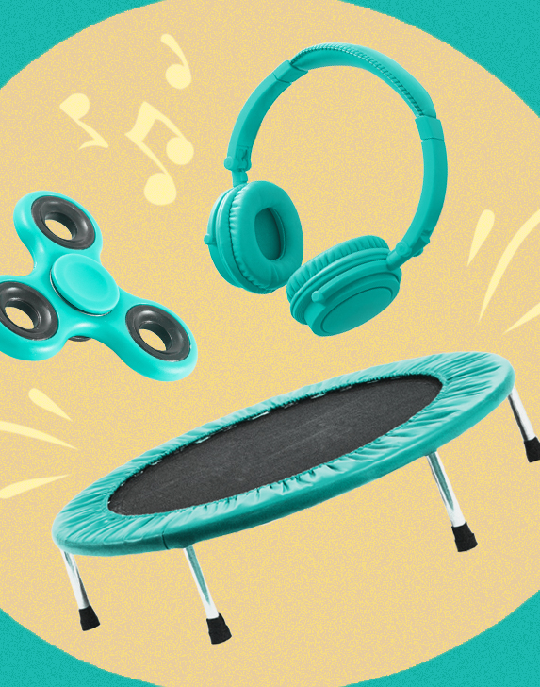
SENSORY DIET
An individualised plan of physical activities
Not a prescriptive list of exercises
Should be embedded into everyday activities
You are the best placed to decide what works for your child and for YOU

Slide 24
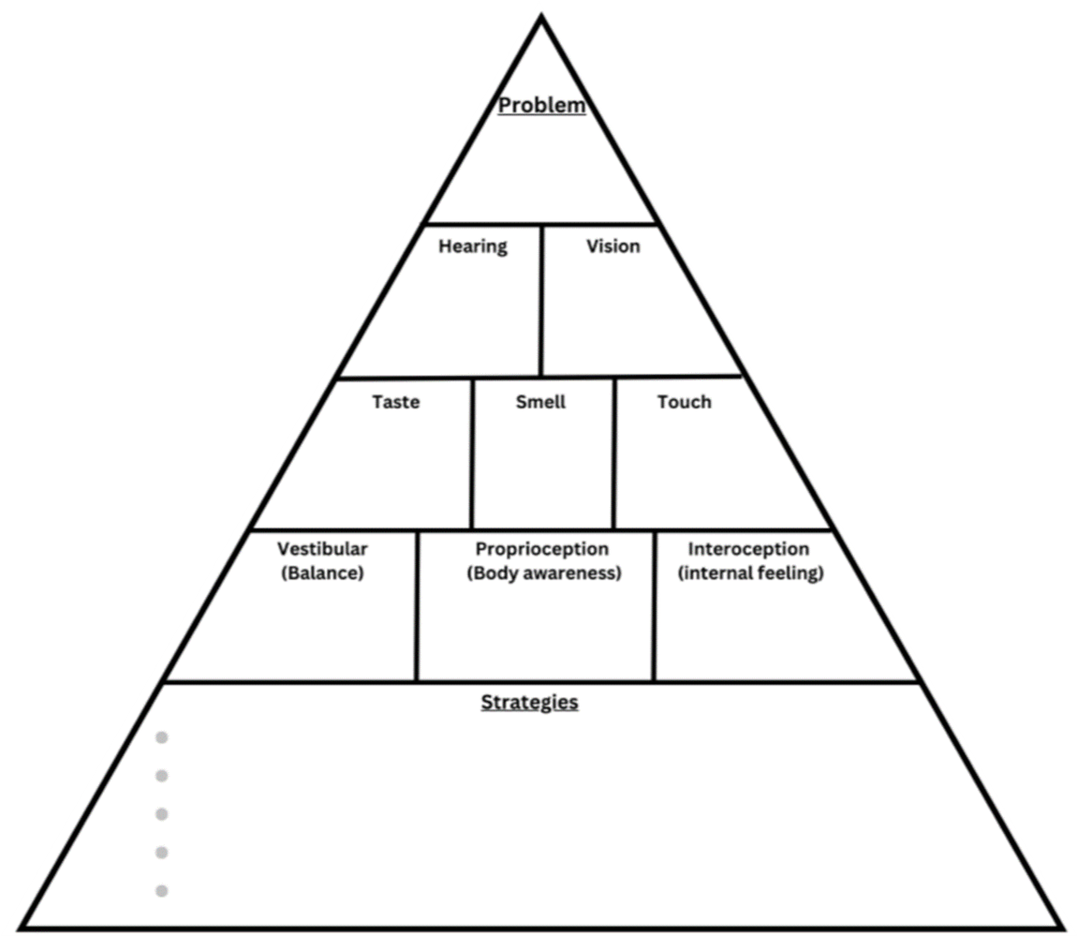
Problem solving tool

Slide 25
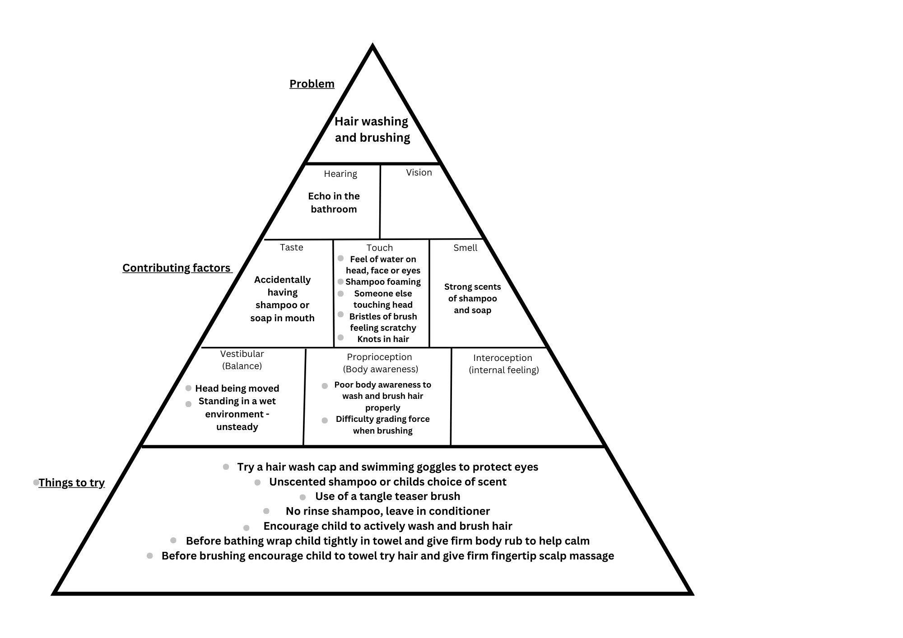
Strategies for common sensory issues

Slide 26
Bathing/showering – ideas to try
Do heavy work activities before bath/shower time
Try a non-slip mat Have toys that encourage ‘heavy work’ whilst in the bath such as pouring
Having things they can squeeze – sponges etc
A straw to blow bubbles in the bath
Use firm, maintained pressure when washing and drying
Wrap your child firmly in a bath towel before and after the bath/shower
Use calming scents such as lavender or unscented products
Use a visual timer
If your child struggles with a shower try a bath or vice versa

Slide 27
Eating – ideas to try
Encourage heavy work activities before sitting for meals
Minimise visual and sound distractions during meal times
Place a heavy lapbag on your childs knee at mealtimes
Use a placemat to define the child’s food space – this can be transferred to other environments
Eat together at the table – this encourages interaction and modelling
If needed allow your child movement breaks during mealtimes or use an air filled cushion
Involve the child in meal preparation to increase exposure to foods
Use a non-slip mat under the plate to hold it still

Slide 28
Teeth Brushing – ideas to try
Heavy work before teeth brushing
Try massaging your child’s jawline and face with firm pressure before brushing
Use a mirror so child can see where they are brushing
Soft bristels may be easier to tolerate than hard
Warm water is more calming than cold water
Brush your teeth together to model this
Use brushing songs or a timer so child knows when activity will end

Slide 29
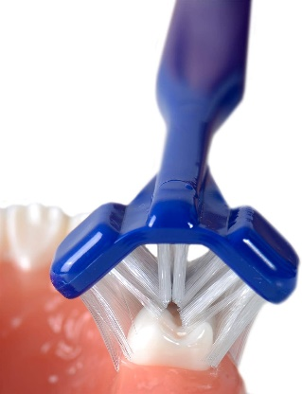
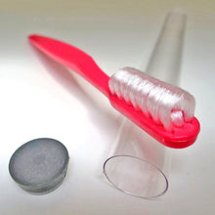
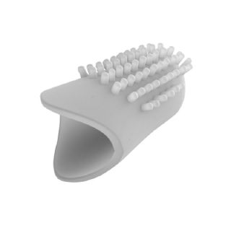
Teeth Brushing – ideas to try
Different toothbrushes
Dr. Barman
Collis Curve
iKo finger toothbrush
Electric toothbrush
Different toothpaste
OraNurse – non flavoured and non foaming toothpaste
Flavoured or mild mint toothpaste

Slide 30
Sleep – ideas to try
Develop a calming routine before bedtime. Encourage quiet activities.
Use a heavy/weighted blanket, lycra or flannel sheets to provide deep-pressure and a calming environment.
Check visually all bedspreads for too much detail or colour.
Check all bed linen for texture and smell i.e. conditioners, washing powder etc. may irritate.
Visual – turn off big lights; try lava lamps, bubble tube, projectors, limit use of devices (iPad etc)
Auditory – white noise machine or app, slow and quiet music, a fan to reduce temperature and provide white noise. Reduce noise and speak in a soft low voice.
Linear movement (rocking), rocking over an exercise ball. Try a rocking horse, rocking chair or chair swing. Before bed
Try a sleeping bag
Avoid anything too stimulating before bedtime
Warmth – Wheat bags, sleeping bags, warm comforter or sheets in the dryer, warm drinks, sheepskin blankets, warm bath
Essential oils such as Lavender
Make a sleep diary of which strategies helped

Slide 31
Nail cutting strategies
Use sand timers
Attempt to cut nails after a bath so the nails are softer and easier to cut.
Use nail clippers rather than scissors
Give a firm hand massage first, squeezing each fingertip firmly before cutting.
Hold the child on your knee and give him a bear hug using deep pressure – alternatively try a weighted blanket or lap pad.

Slide 32
Hair cut – ideas to try
Think about timing – when is it quiet? Or when is your child most regulated
Try and complete proprioceptive (heavy work) activities with your child before the appointment so they are calmer
Practice visiting so they are familiar with the environment and hairdresser/barber
Have something to stretch pull or squeeze when sitting down
Use a weighted lappad when sitting down
Have something to chew or suck on during the cut
Some children may tolerate scissors better than clippers
Ask for the music to be turned off/ lights dimmed
Use a visual timer

Slide 33
Did you know?
The Family Fund will contribute to the purchase of sensory equipment, you can apply every 24 months – even if you are in employment
“A Stitch Different” makes bespoke weighted items as a non-profit organisation with flexible payment plans

Slide 34
Newlife offers the free loan of specialist toys to families who have disabled and terminally ill children.
The Play Therapy Pods are self-contained and are delivered direct to the family’s door. We don’t means test, so specialist play pods are always provided on the basis of need.

Slide 35
Thank you for Listening
This Photo by Unknown Author is licensed under CC BY-SA

