Slide 1
Autism and Anxiety
Rebecca Ratcliffe | Senior Mental Health Practitioner

Slide 2
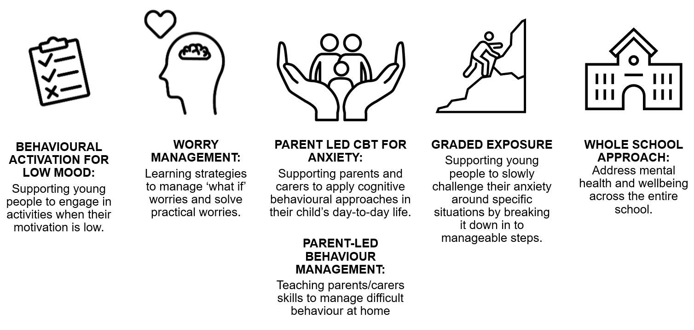
Who are we?
Halton Mental Health Support Team (MHST) is an NHS service providing mental health support to 52 schools across Widnes and Runcorn.
We aim to help young people to learn strategies and new ways of taking care for their mental wellbeing.
We provide interventions to pupils struggling with anxiety, low mood or behavioural difficulties.
..and deliver talks like these!

Slide 3
What are we going to cover today?
Understanding anxiety in autistic young people
Supporting anxious autistic young people

Slide 4
Understanding anxiety in autistic young people
What is anxiety and the science behind it
Getting stuck in a cycle of anxiety
How anxiety presents in autistic young people

Slide 5
What is Anxiety?
Anxiety is an emotion that everyone experiences.
It is a feeling of worry or fear about future situations, and what could go wrong. For example, someone may feel anxious before an exam, starting a job or meeting new people.
Usually our anxiety disappears in time, however for some people, feelings of anxiety can creep into everyday situations, become overwhelming and impact their ability to live their day-to-day lives.

Slide 6
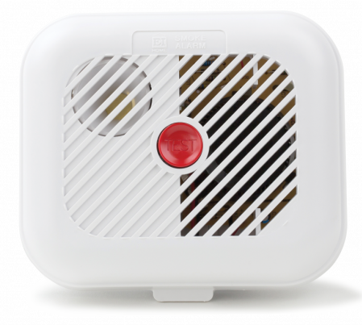
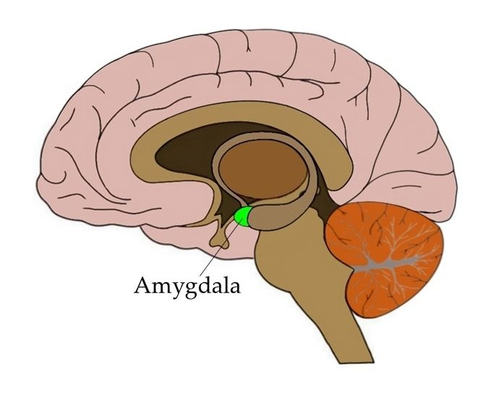
The Amygdala acts like a smoke alarm, warning us of impending danger. It’s one job is to sense danger for us to survive.
The brain cells within the Amygdala will determine whether a sound, image or body sensation is a threat.
If a threat is sensed, It sends a message to the Hypothalamus who will release cortisol (stress hormone) and adrenaline into the body to get us ready to fight, flight or freeze!
All brain functions which are not related to survival are “temporarily offline”, with the survival brain taking over.
This is an automatic response that happens very quickly.

Slide 7
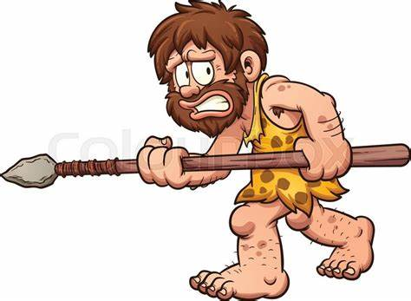
Our brains are still wired the same as our caveman ancestors.
Although in caveman times this was essential for survival, our brains now will treat any threat in the same way it would a tiger.
Flight
Pleading to leave a situation or walking/running away
Feigning illness to avoid leaving home
Escaping to a perceived safe place e.g. the bathroom, bedroom, to a caregiver
Fight
Hitting out
Throwing things
Shouting
Swearing
Hurting self
Fighting with peers
Freeze
Refusing to answer questions/participate in family activities
Stuttering
Hiding under/behind furniture
Refusing to get out of the car
Refusing to leave caregivers

Slide 8
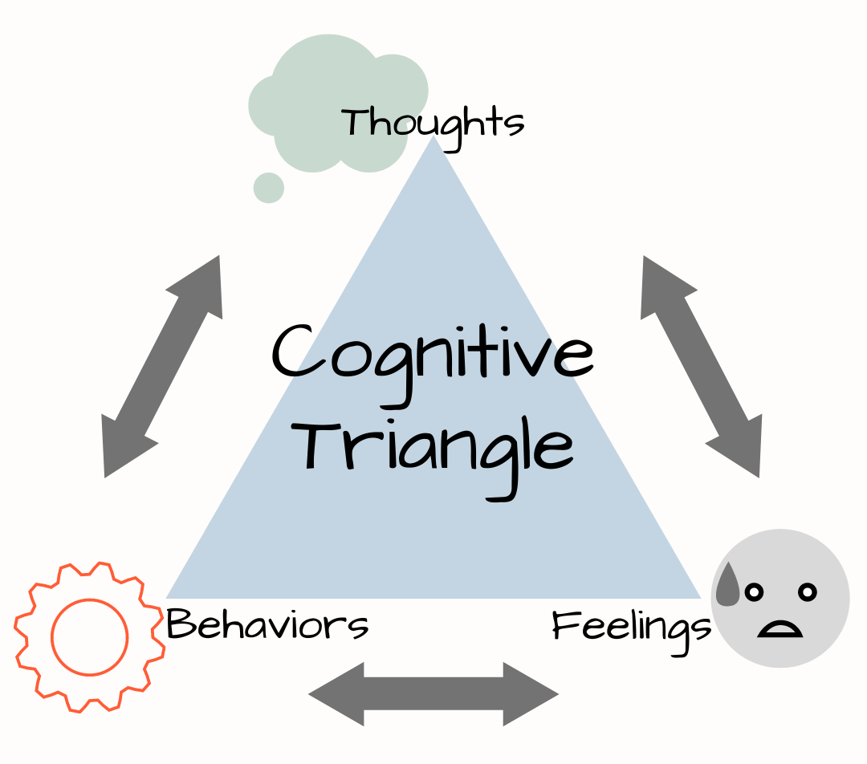
Over-estimate the “danger”
Under-estimate their ability to cope
Negative Automatic Thoughts e.g. “today is the worst day ever!”, “It’s all my fault”, “No one likes me”
Any behaviours which make the person feel “safe” e.g.
Avoidance
Excessive Worrying
Seeking reassurance
Safety behaviours e.g. checking the doors locked, researching menus
Anxious/Overwhelmed/Upset etc.
Physical sensations in our body e.g. sweating, heart beating faster, shaking, “butterflies”

Slide 9
So how does anxiety present in Autism?
There is a lot in the world to be anxious about if you are autistic, more than just exams. Our children get anxious about things that neurotypical (not autistic) children may take in their stride.
It can be harder to tell with autistic children and young adults, as they may not even recognise themselves that what they are feeling is anxiety or may not be able to communicate what they are feeling to their caregiver as well as neurotypical children can.
Anxiety affects over 40% of autistic children compared with just 3% of nonautistic children

Slide 10
So how does anxiety present in Autism?
Everyone experiences anxiety differently, but some stressors may contribute towards anxiety in autistic people including:
Lack of predictability or sudden, unexpected changes in routine
Sensory differences; certain environments are more stressful
Communication differences between ASC and non-ASC can fuel social anxiety and make ASC people feel as though they need to “mask”
Difficulties in understanding emotions known as alexithymia
Anxiety about specific distressing situations, such as crowds

Slide 11
Over-estimate the “danger”
Under-estimate their ability to cope
Thoughts getting “stuck”
Any behaviours which make the person feel “safe” e.g.
Avoidance
Excessive Worrying
Seeking reassurance
Increased stimming
Seeking certainty incl. hyper fixating on routines or to their specific interests
Alexithymia – May not be understand how they are feeling?
Physical sensations are felt significantly more due to sensory needs.
Meltdowns

Slide 12
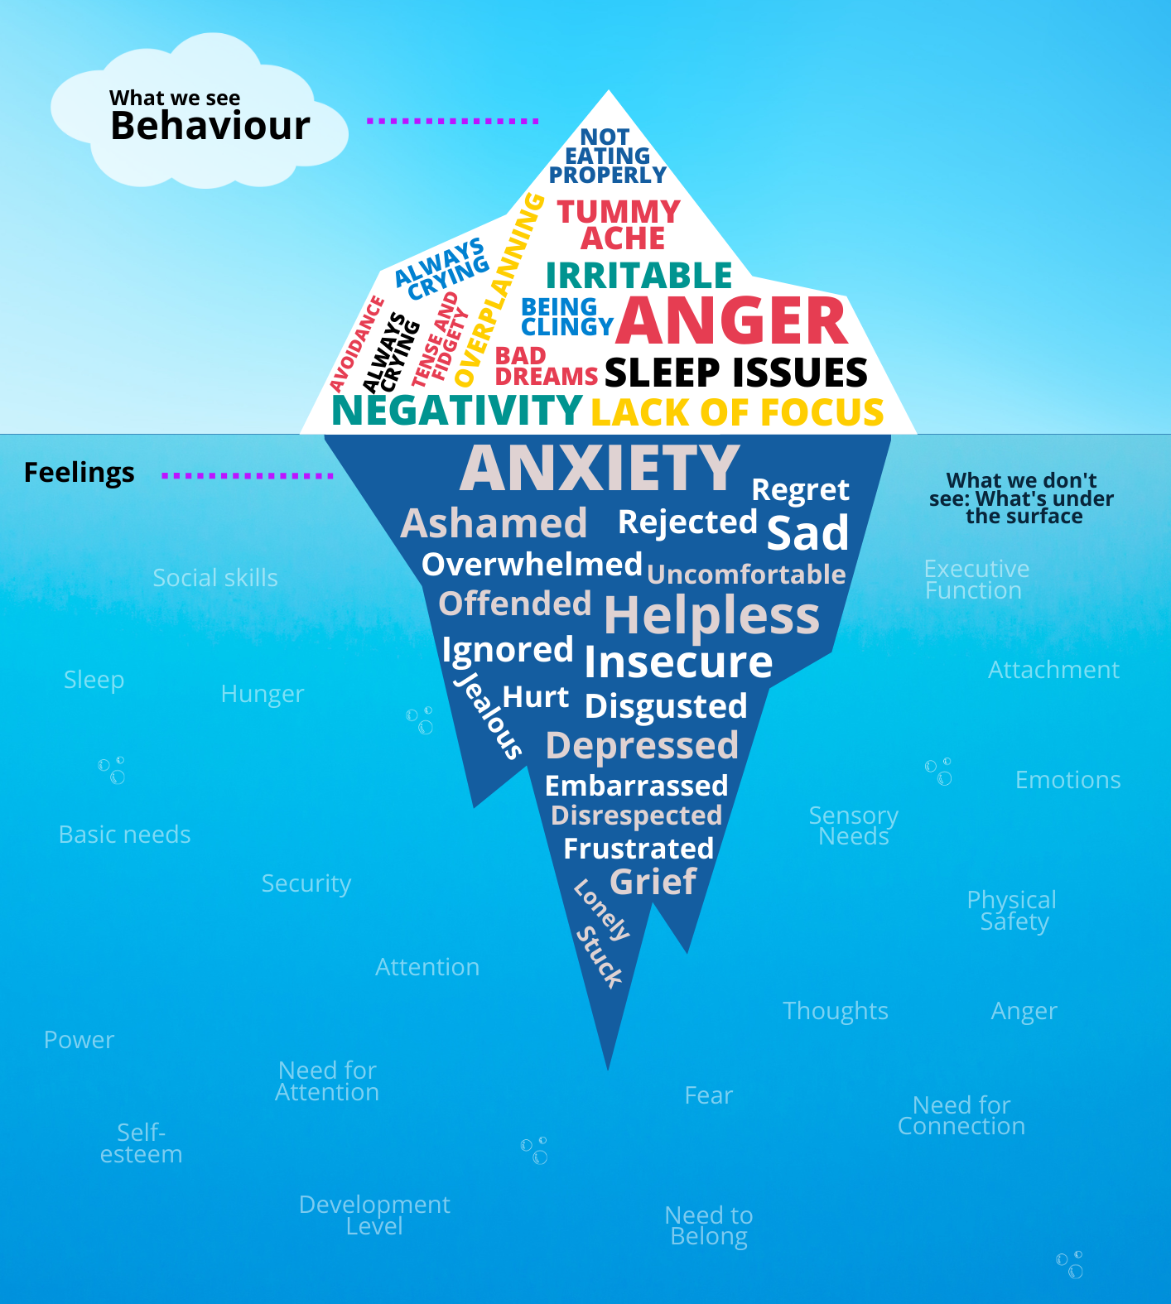
Your child may act the same, or they may shut down completely, stim more to soothe themselves, become more rigid in their routines, or become oppositional.
You know your child better than anyone else, and once you start getting an idea of what makes your child anxious and how they react to anxiety-inducing situations, you will start recognising their behaviour for what it is; their way of communicating their difficult feelings.
How does anxiety present in your children?

Slide 13
“
When my son feels anxious, his first response is to hide away. Under a table, behind a curtain, under the duvet, or to go online and game where it is safer, and he is in control. If I try to force him out of his safe places, he becomes verbally or physically aggressive. It is only after the anxiety has passed that he can identify that he acted that way because something made him anxious. But he will never say “Mum, I felt worried about eating the sandwich you have never given me before” or “My teacher isn’t in on Wednesday
”

Slide 14
Two types of anxiety
Rational Anxiety
Anxiety that is a result of real difficulties e.g. a space being too loud or too bright
Irrational Anxiety
Anxiety where your brain is telling your something is threatening when it isn’t e.g. a phobia
Sometimes a rational difficulty makes you struggle so much that you develop irrational anxiety
Sometimes what looks like an irrational anxiety can have a very real and rational anxiety behind it

Slide 15
How to support an anxious autistic young person?
Taking care of yourself
Supporting rational anxiety
Understanding and communicating emotions incl. Anxiety
Autism specific strategies that align with their diagnosis
Energy accounting
Irrational Anxiety – Step by step graded exposure

Slide 16
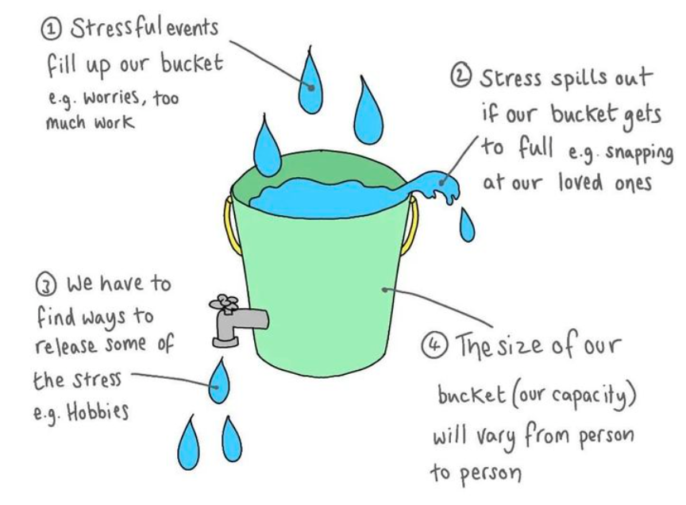
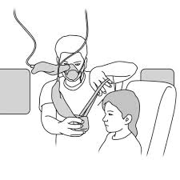
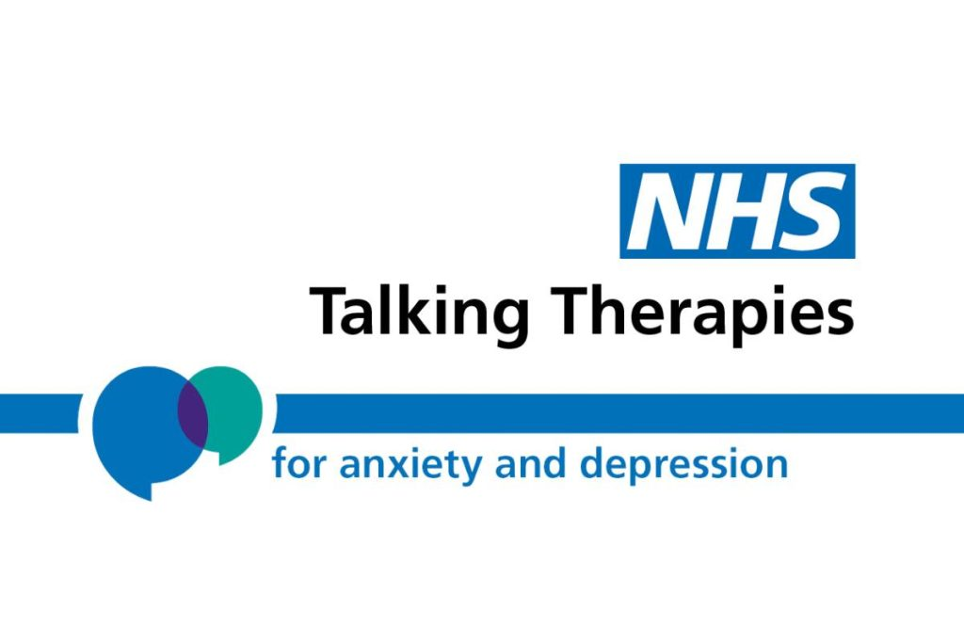
Taking care of yourself!
Find ways to relax and de-stress yourself:
It will help you to clear your mind
Think creatively
Make it easier to manage difficult situations
In emergency situations, parents are told to help themselves before helping their child
Emotional emergencies work in the same way
Looking after yourself will enable you to continue supporting your child

Slide 17
Supporting with rational Anxiety
To support with this, it’s important to educate young people about their diagnosis.
Rational Anxieties are often linked to their Autism, their social communication needs, their sensory needs etc.
If your autistic child has sensory needs and they are very sensitive to loud noises, no amount of willpower or traditional CBT therapy is going to make them less sensitive to noise.
As a therapist, if I was to work with someone on trying to exposure them to this noise to get them more used it to all I would be doing is reinforcing that something is wrong with them, when this is part of their autism diagnosis.
This can lead to them feeling overwhelmed, increasing of anxiety, low self-esteem and increased masking.
Alongside increasing support around the child and making environmental changes

Slide 18
ABC diary
What occurs immediately before the behaviour or anxiety incl. triggers, environment information etc
What was the outcome of this?
Where and when | Antecedent | Behaviour | Consequence
28/10/24: At the supermarket on Monday around 6pm. | The tills weren’t working, bigger queues built up. | Started to shout escalated to crying and lying on the floor. | Had to leave the shop and go home without our shopping. Fell asleep as soon as we got home
Where were you? What day/time was it?
What behaviour was displayed/observed?

Slide 19
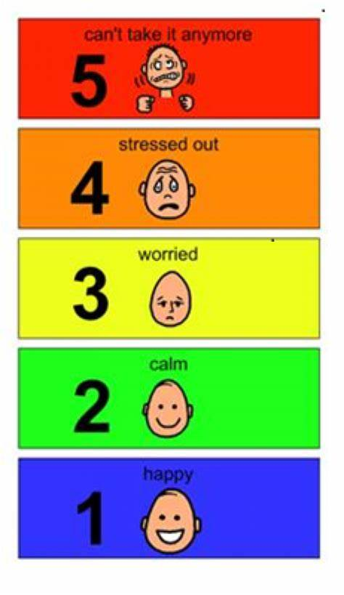
Communication: Double Empathy
Autistic people experience the world and express emotions differently, it makes it difficult for non-autistic people to understand and to empathise with them. And them with us.
A common myth about autism is that autistic people lack empathy - autistic people can be very empathic, they can act like emotional sponges and be quickly dysregulated by others' emotions
We need to find a way for the whole house to communicate and understand each other.

Slide 20
Imagine you had a hard day at work, you come home, ring a friend and tell them about your day. You tell them about how the boss has changed some rules at work meaning you must stay an hour later than usual; the lunch menu at work is supposed to change in the future but they haven’t told you with what and the person at the desk next to you chewed their food so loudly today that you just want to hit them.
They respond with… “don’t be silly, that would never happen”, “it’s not a big deal”, “don’t’ worry about it”.
How would this make you feel in the moment? Would you be more or less likely to tell them about your problems in the future?

Slide 21
Communication is key
“Autistic people are working within a world which is not designed for them. A world which ultimately encourages masking”
We need to validate all their feelings, showing them that it is okay to feel the way they do – there is nothing wrong with them or their feelings.
Take a breath yourself, be mindful of your own thoughts and feelings
Name the feeling – “You look frustrated and upset with the teacher being off”
Accept the feeling – “It makes sense that your teacher being off would be upsetting, that sounds really hard”
Validate – “It’s okay to feel this way, thank you for showing me how you feel. Or “I would feel like that too if it happened to me”
Connect – “You are not alone, I’m here with you”

Slide 22
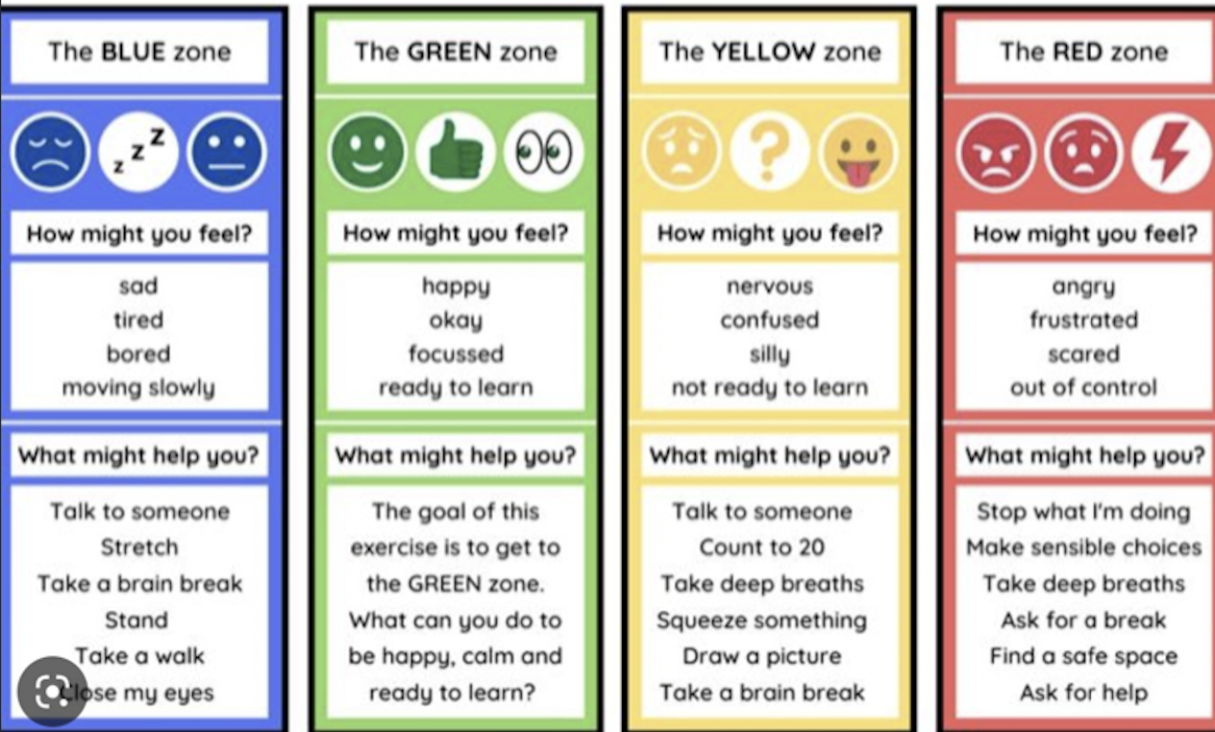
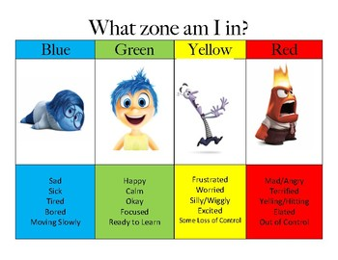
Zones of Regulation
This is best used as a whole family approach to support understanding emotions.

Slide 23
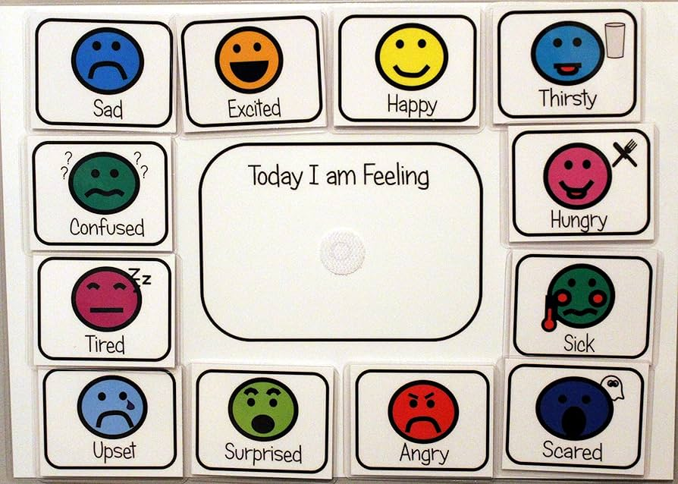
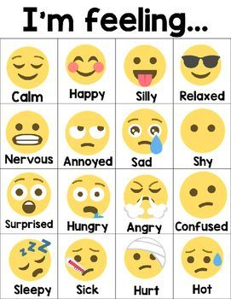
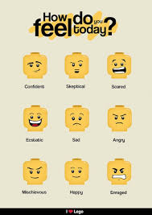
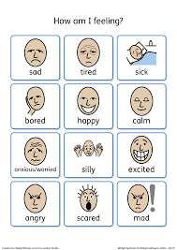
Feelings check in charts can be a great way for everyone to understand each others' feelings
They can be tailored to special interests
They provide a chance for you to model to your child

Slide 24
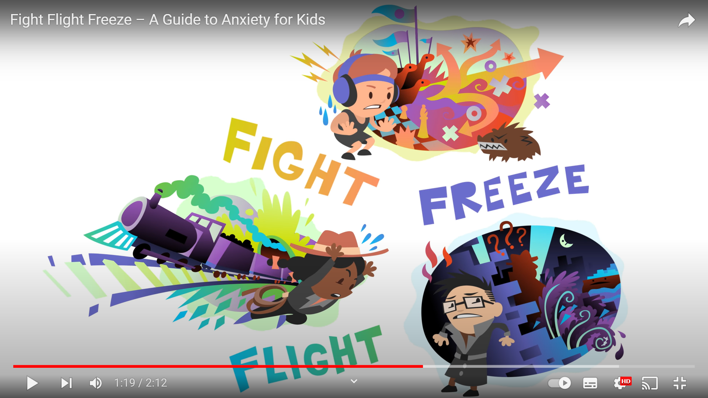
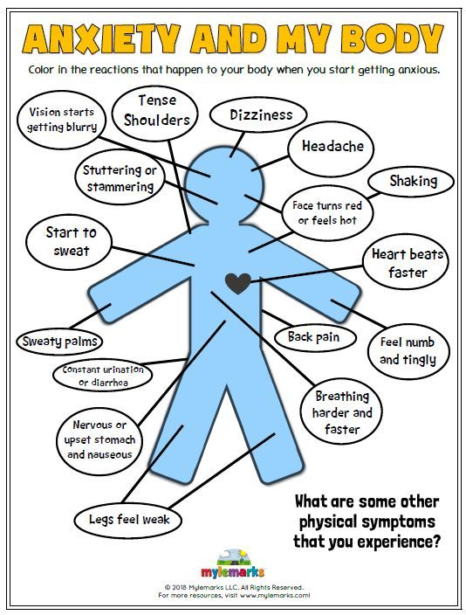
Teach them about anxiety
Learning about anxiety helps autistic people to understand this very complex emotion and normalises that we all experience this; that it’s okay to be worried.

Slide 25
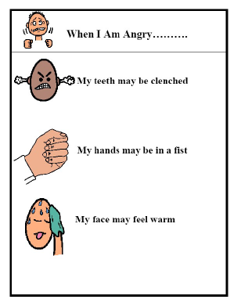
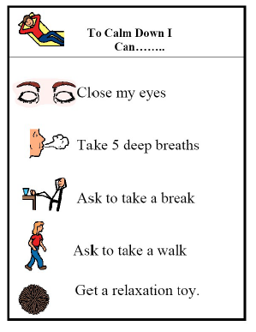
Expect it
Anxiety is something we all experience
If they can, give them to time to talk about their worries.
Use social stories and choice boards to support them when they anxious

Slide 26
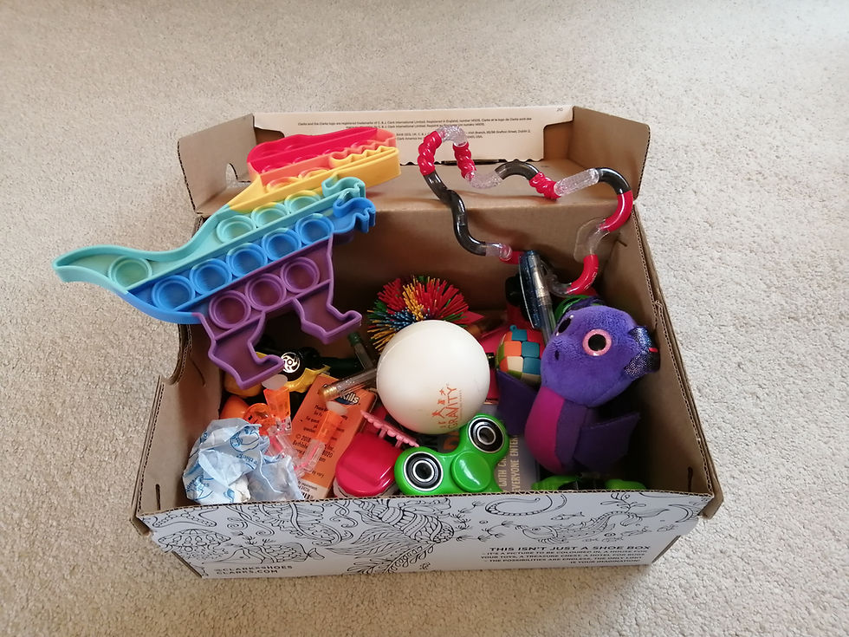
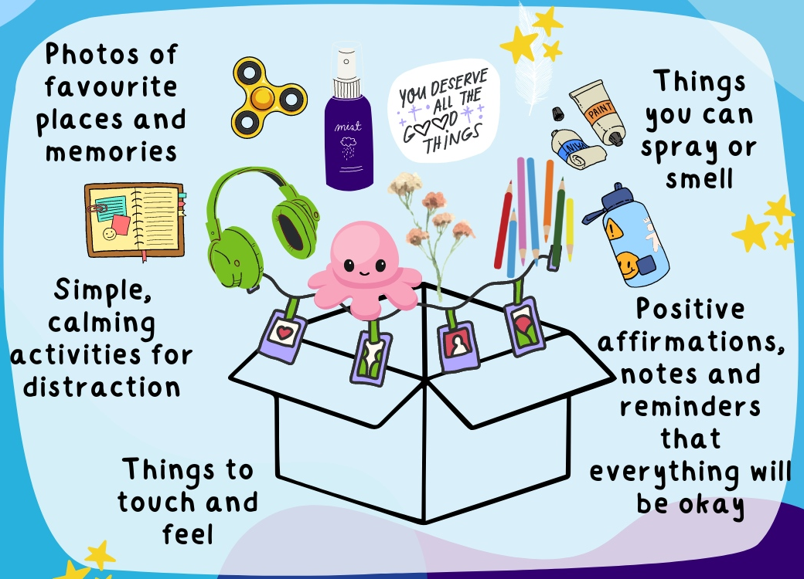
Sensory self-soothe boxes
Create sensory self-soothe boxes in advance of them becoming anxious.
These boxes can be kept in a safe place to promote regulation.

Slide 27
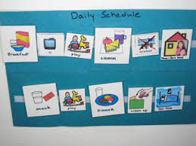
Create certainty
Make use of visual timetables to show them what they are doing that day.
If they experience separation anxiety, consider making a separate schedule for you so they can see where you are.

Slide 28
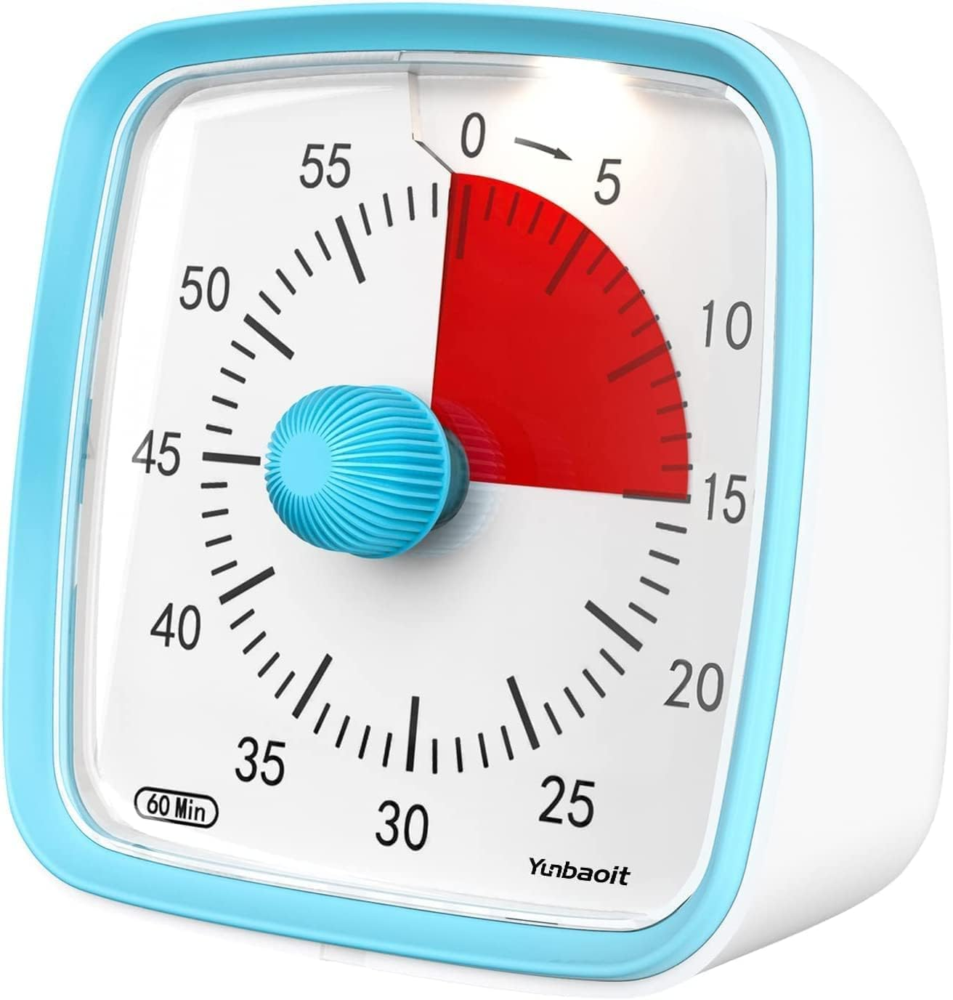
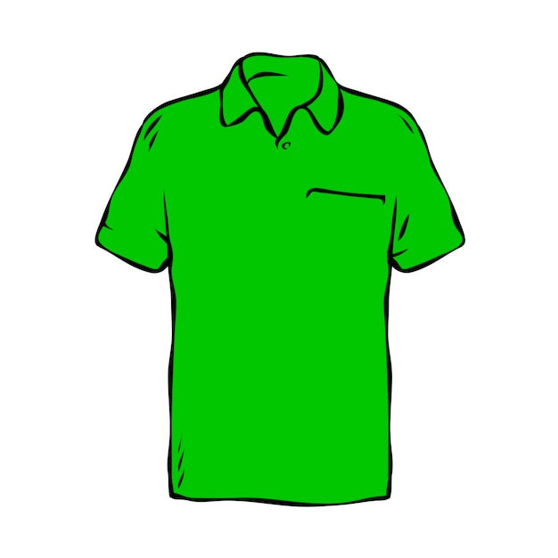
Create certainty and a sense of control
If you are discussing certainty verbally, reduce language and use sentences such as
“now and next”
“when and then”
“first and then”
Visual timers – shall we go bed now or in five minutes?
Let's imagine they are going to a party as this anxiety builds, their amygdala is firing alarms and their fight, flight, freeze will start to appear.
Rather than “do you want to put your top on for the party” (which gives an option to say no)
Give a sense of control by asking “Do you want to wear your red top or your green top”

Slide 29
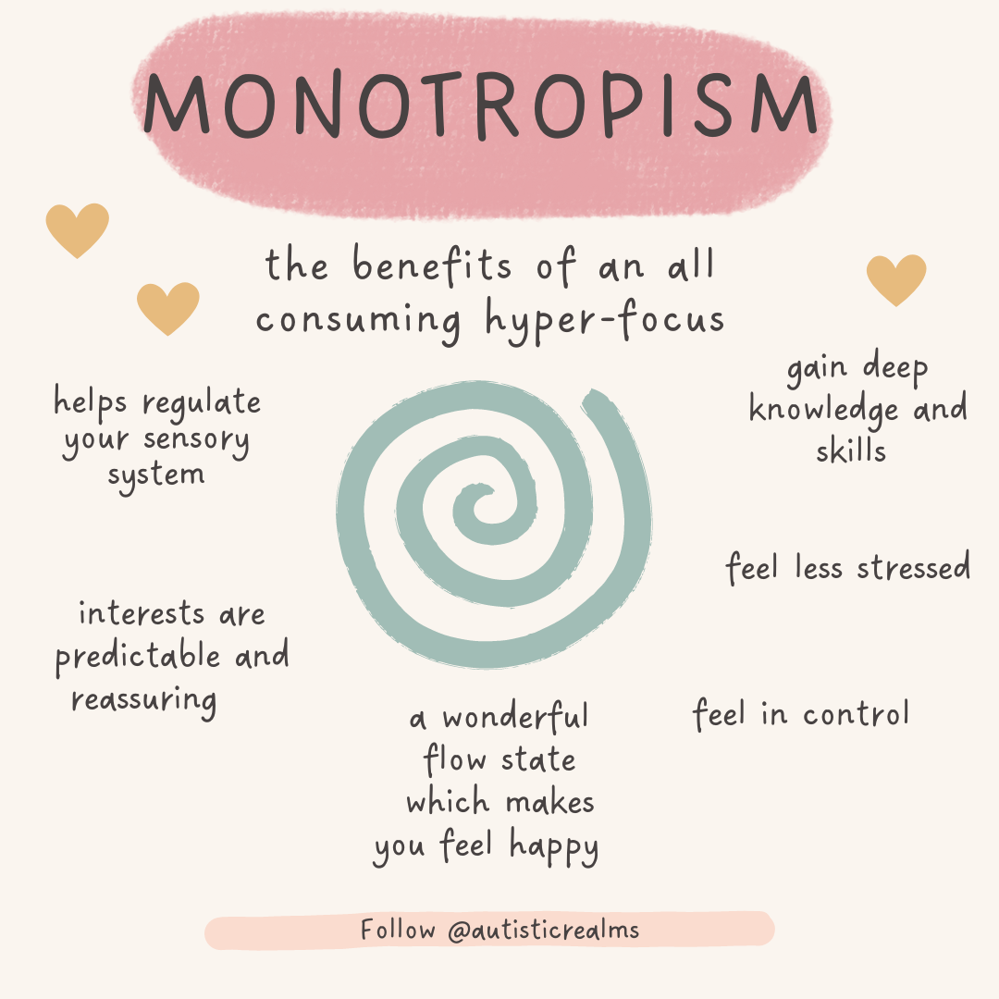
Encourage autistic behaviours
Monotropism or “hyper focusing” does not apply just to specific interests, but absolutely anything that requires an autistic person to focus their attention.
Once their attention is focused, it builds up what the autism community have called autism inertia. This terms refers to a difficulty starting or stopping tasks.
This hyper focusing and difficulty transition from one thing to another is often seen as a difficulty that Autistic people face as if they are pulled too quickly out of the hyper fixation it can lead to meltdowns… but there are lots of benefits and should be encouraged for regulation and reduced anxiety.

Slide 30
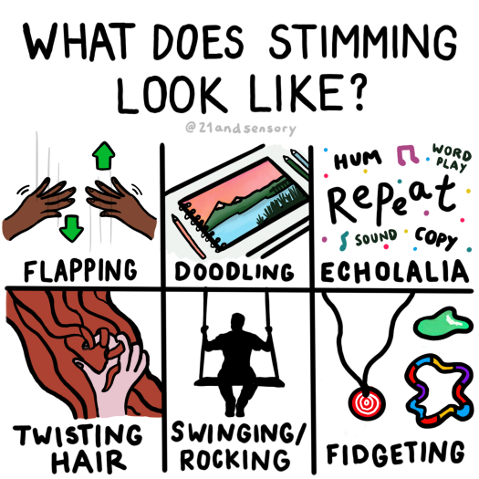
Encourage autistic behaviours
Stimming is something that everyone does
Stimming behaviours, particularly for autistic people, help to calm themselves down in situations of stress, whether positive or negative e.g. overly excited or overly anxious
The process of stimming can also help an Autistic person process information.
Too often, autistic people are prevented from stimming which implies something is wrong and encourages masking.

Slide 31
Energy Accounting

Slide 32
Energy Accounting

Slide 33
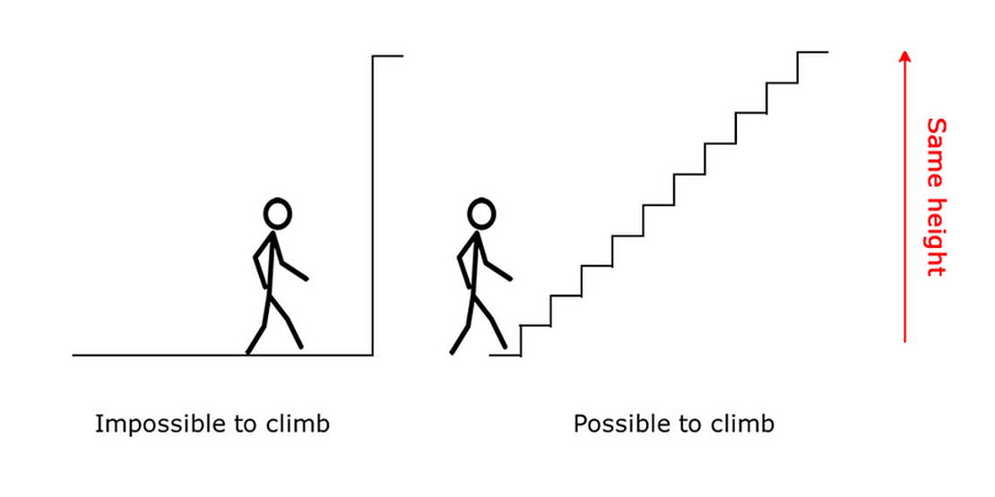
Supporting irrational anxiety
The only way to overcome irrational anxiety is to challenge it, proving to your anxiety that there isn’t anything to worry about, but to be able to challenge your phobia, your reason to face the anxiety must outweigh the anxiety caused by it.
Remember: If anxiety is irrational, you still need environmental adaptations put into place before challenging the anxiety, because if your anxiety is too high, small steps will feel much bigger.
It is REALLY important they can do it at a pace that works for them, as too much of a push can trigger a survival response, which will make the anxiety more intense.

Slide 34
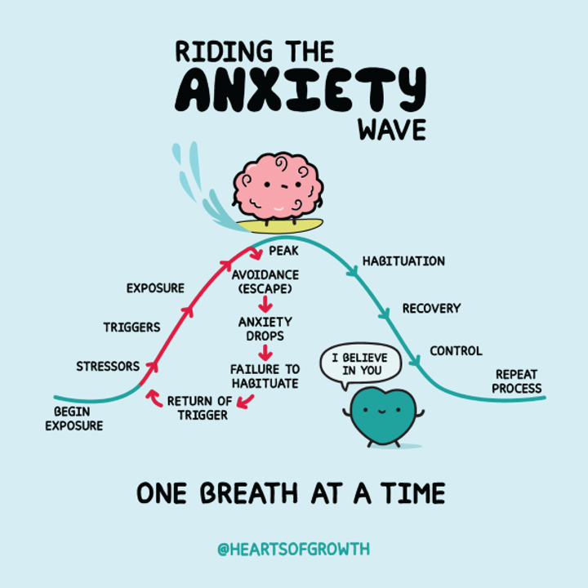
Graded Exposure
Everyone has things they would like to try, but don’t because they feel worried about doing them.
In the short term, it is easier to avoid your anxiety and not take steps to reduce it... but, avoiding it means you will never find it easier to do. This can get in the way of things you would like to do in the future.
It is never too late to challenge irrational anxiety, but it is always difficult and takes time, care and patience

Slide 35
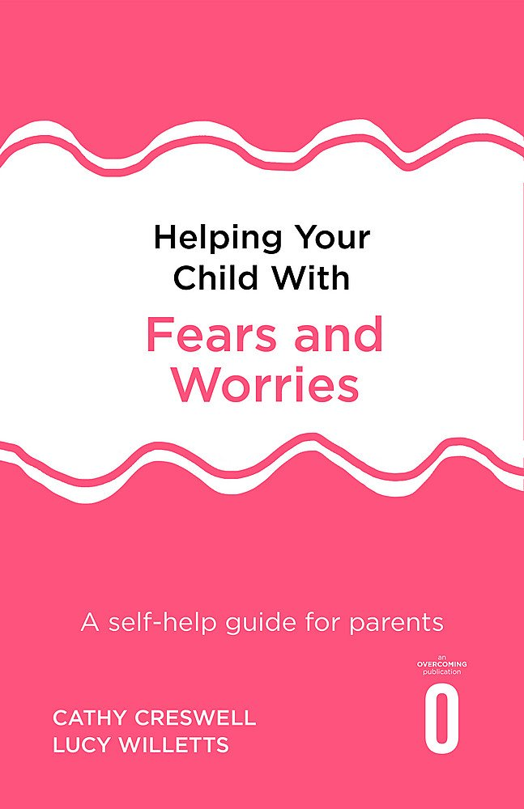
Step-by-Step plan example
Tom’s anxious thoughts:
The peeler is dangerous, I can’t cope
Ultimate Goal: To use a peel independently
Tom needs to learn:
He can cope, the peeler is not a danger. If it did cut his finger, someone will help.
Oliver holds the carrot on a spiked board and peels
Tom and Mum hold a carrot whilst Mum peels
Most Feared
Mum peels a carrot in front of Oliver
Least feared
Tom holds a peeler of his choice
Each step also has a reward to match. For Tom this included craft time, freddo chocolate, extra game/YouTube time.
Watch a video of someone peeling
Look at pictures of potato peelers
Don’t forget the rewards! These do not need to be monetary, start with quality time. Involve your child – what rewards would they like?
Notes:
Replace with oliver’s potato peeler

Slide 36
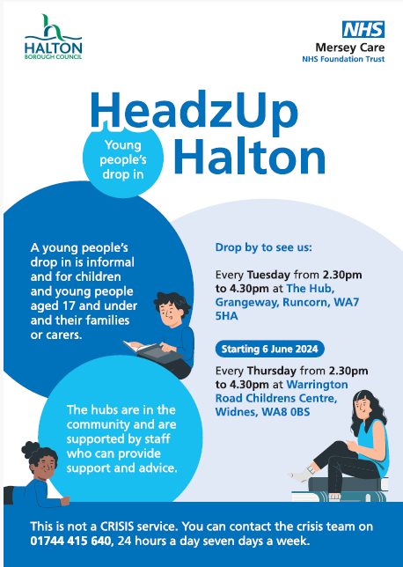
Signposting

Slide 37
MHST & Neurodiversity
As a service, we adapt interventions to meet an individual’s needs dependant on their presentation
Adaptations made include visual aids, social stories, adapting the standard questionnaires to meet the CYP need such as using pictures/symbols, additional sessions, shorter session times etc.
When referring, it is best practice to look for a change to the young person’s baseline presentation e.g., Has anxiety coming into school intensified? Is the CYP presenting as more unsettled or more tearful? Is there an upcoming transition/change that is making the CYP worry more?
We accept and assess those with neurodiversity, however to complete intervention we look for a clear mental health need e.g. an irrational anxiety

Slide 38
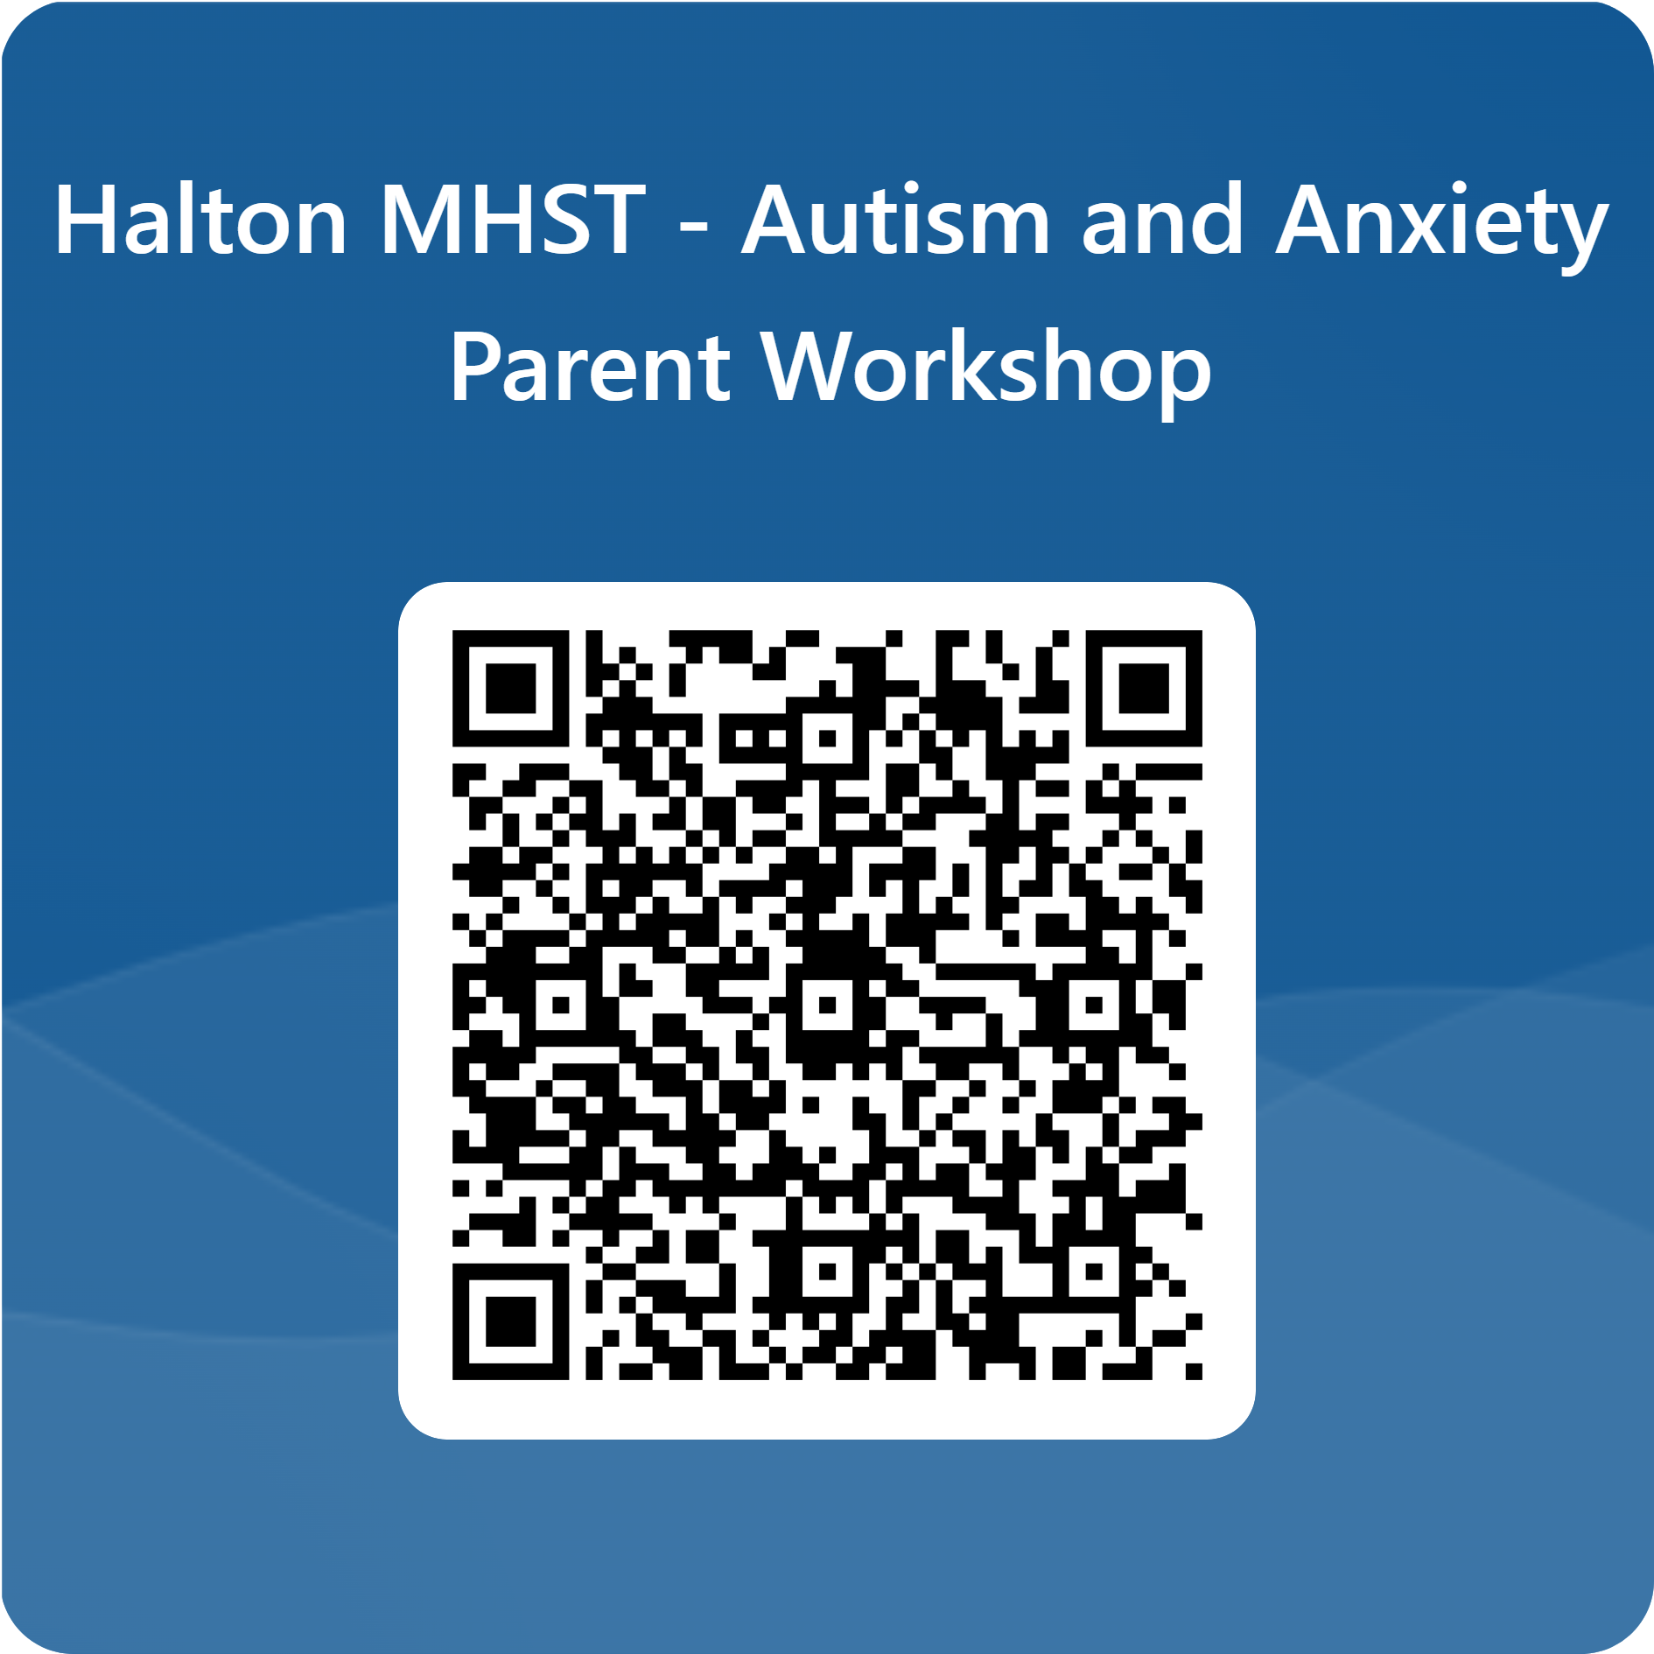
Thank you.
Any questions?

