Slide 2
Aim
I can discuss how friendship makes us feel and talk about how this helps us.
Success Criteria
I can explain how my friends make me feel.
I can talk about how friends can help us to achieve.
I can think about how I can help others.

Slide 3
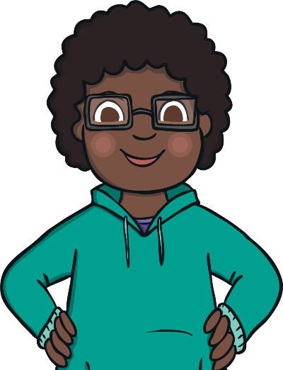
How Do Friends Make Us Feel?
Working in small groups, we are going to look at some pictures. Talk to the people in your group and think carefully about what the picture is showing.
How do you think they are feeling?
What are the children in your picture doing?
What makes them feel this way?
Having friends is very important. Friends can make us happy and show us that we have people around us that we can trust.

Slide 4
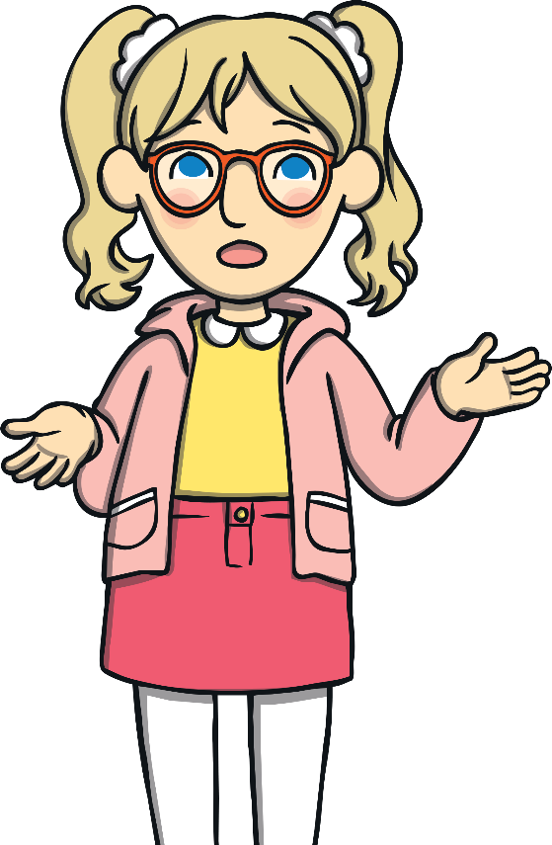
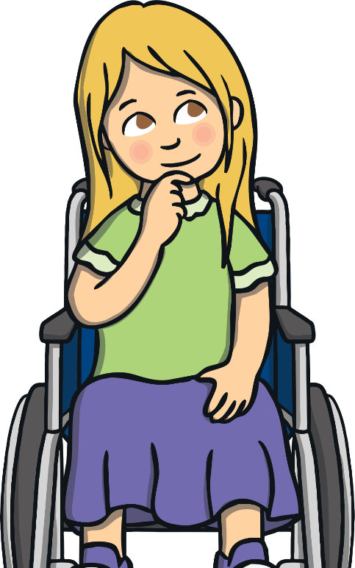
How Do Our Friends Help Us?
BBC Children in Need has a vision. That vision is for every child to have a childhood that:
is safe;
is happy and secure;
allows potential.
How does having friends make you feel?
Having friends makes me feel… because…
Can you think of a friend who has helped you to achieve something?
Achieving our potential means that we are achieving all that we possibly can.

Slide 5
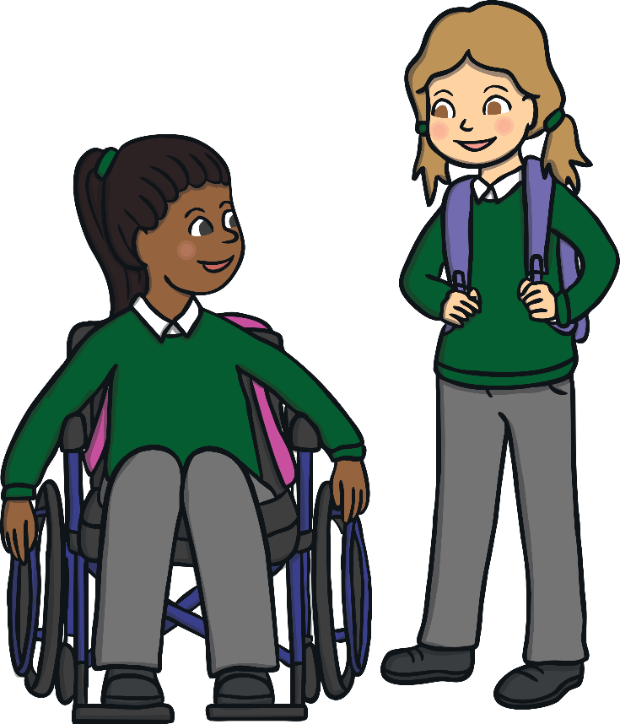
Overcoming Obstacles
I can help, we can learn them together then test each other!
I’d really like to improve the number of words I get right in my weekly spellings.

Slide 6
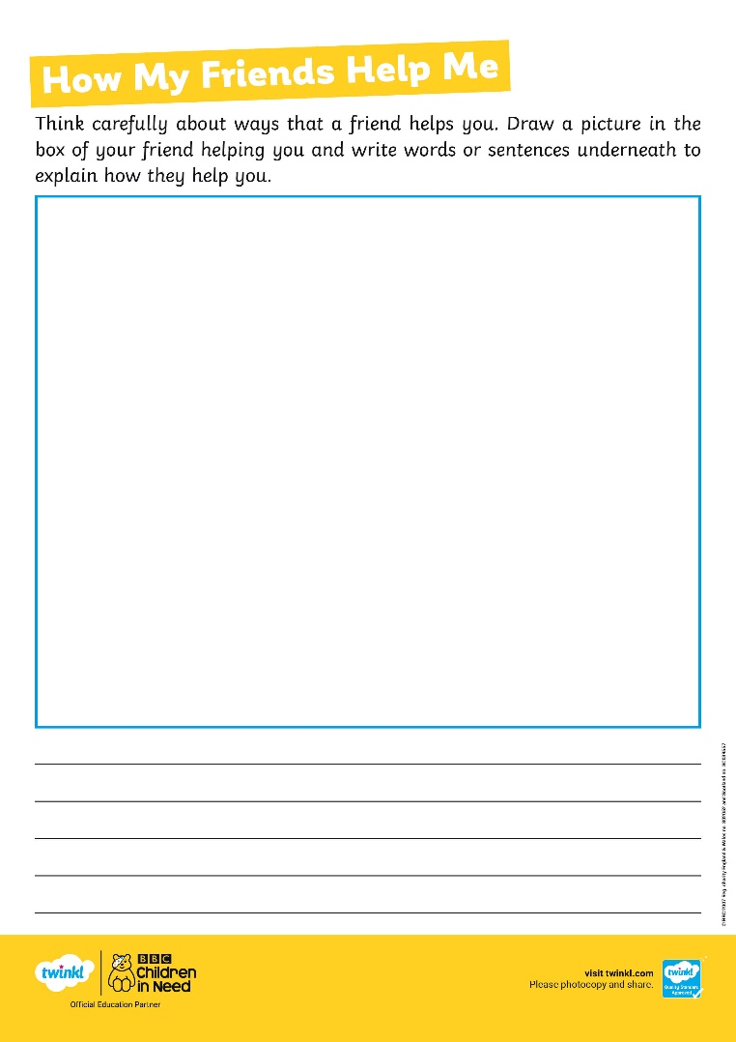
Overcoming Obstacles
Now try to think about a time when a friend has helped you. What was it you needed help with? What did your friend do?
We can now record our ideas on How My Friend Helps Me Activity Sheet.

Slide 7
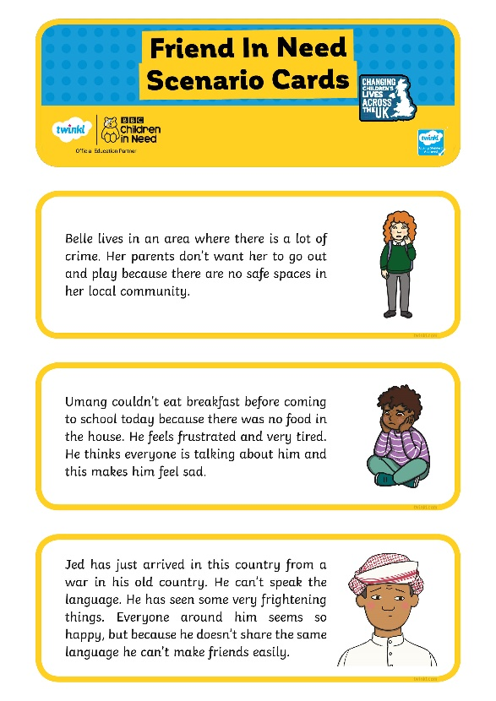
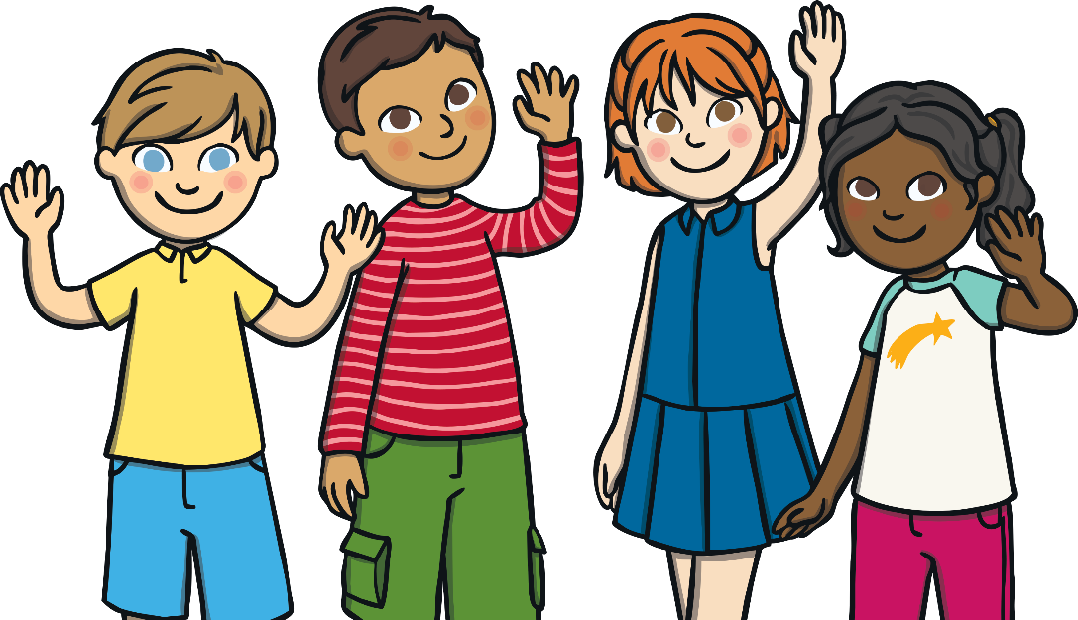
Friends Make a Difference!
You will now work in small groups and read a scenario, from this you can discuss in your groups how friendship can help overcome problems. Read your Friend in Need Scenario Card carefully and try to answer these questions:
What is the problem or obstacle for this child?
How do you think they feel about the problem?
What could a friend do or say to help?
How would that make the child feel?

Slide 8
Friends Make a Difference!
We will now share our ideas with the class. When you see the picture of the child from your Friend in Need Scenario Card, discuss your answers to the questions:
What is the problem or obstacle for this child?
How do you think they feel about the problem?
What could a friend do or say to help?
How would that make the child feel?

Slide 9
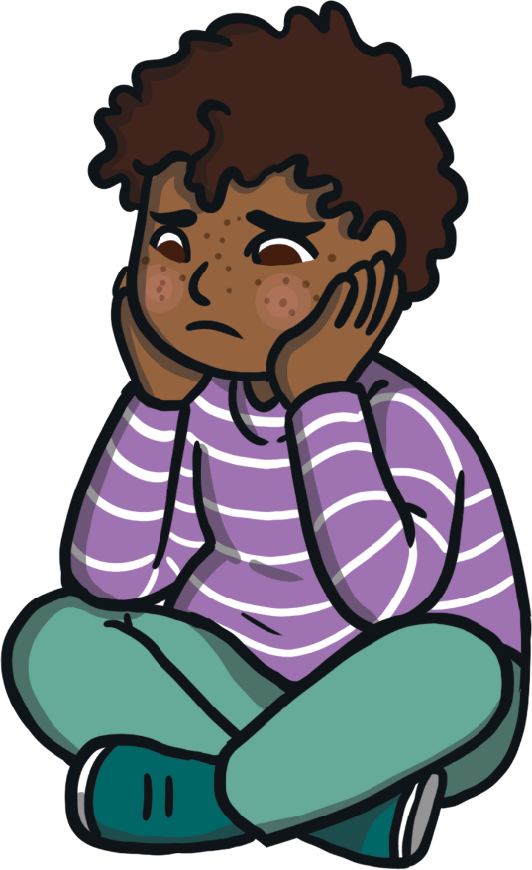
Friends Make a Difference!
What is the problem or obstacle for this child?
How do you think they feel about the problem?
What could a friend do or say to help?
How would that make the child feel?

Slide 10
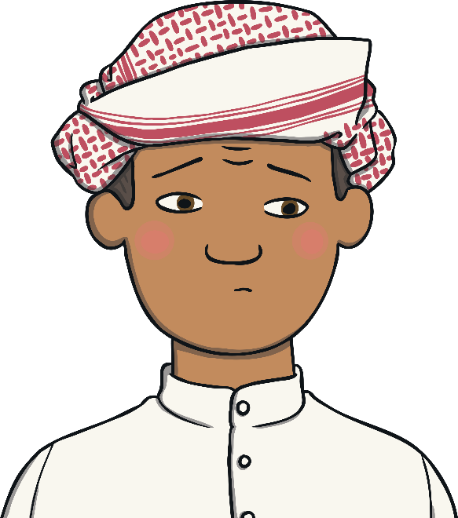
Friends Make a Difference!
What is the problem or obstacle for this child?
How do you think they feel about the problem?
What could a friend do or say to help?
How would that make the child feel?

Slide 11
Friends Make a Difference!
What is the problem or obstacle for this child?
How do you think they feel about the problem?
What could a friend do or say to help?
How would that make the child feel?

Slide 12
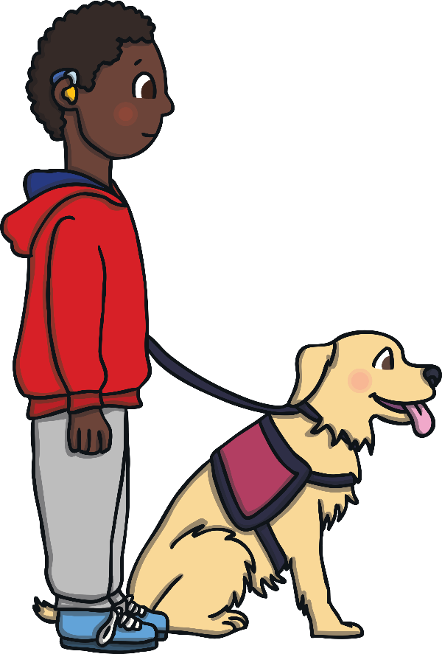
Friends Make a Difference!
What is the problem or obstacle for this child?
How do you think they feel about the problem?
What could a friend do or say to help?
How would that make the child feel?

Slide 13
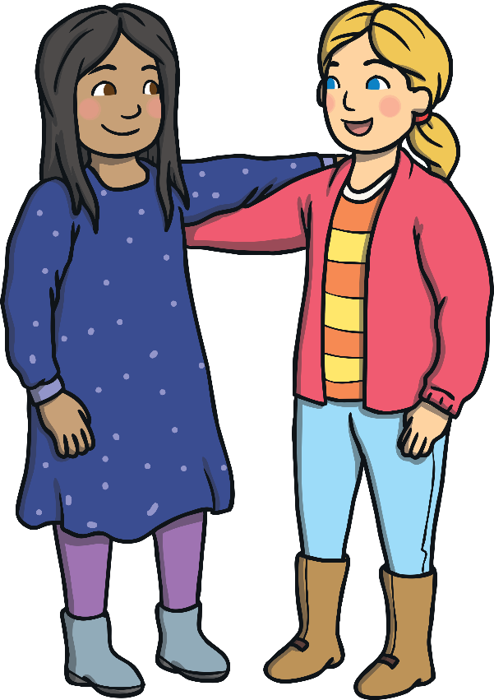
Friends Make a Difference!
BBC Children in Need have a vision. That vision is for every child to have a childhood that:
is safe;
is happy and secure;
allows potential.
For anyone to achieve their potential, they need to feel safe, secure and happy. BBC Children in Need makes this possible for certain children by supporting local groups and organisations where children can go to meet other children who may be in a similar situation to them. At these groups, many friendships are formed. We have discussed today, how much friendship can make a difference and help us achieve things we thought may not be possible. Groups that form friendships are so important!

Slide 14
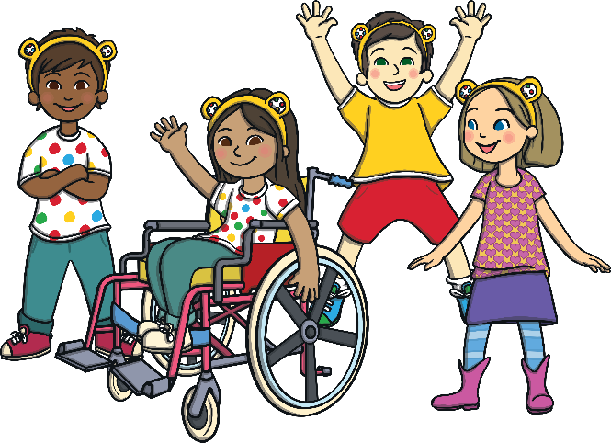
Friends Make a Difference!
BBC Children in Need raises money for projects in local communities and to support children who need help. Now, let’s think about how we can help!
Working in your group, think of a fundraising idea that our class can use to raise money for BBC Children in Need. You can use the Fundraising Ideas Pack to start you off if you’d like. Record your ideas on your sugar paper to present to the class shortly.
Try to include:
what people will do to raise money;
how they will encourage people to make a donation;
who will be involved.
What can we do to help? Every donation makes a difference!

Slide 15
Aim
I can discuss how friendship makes us feel and talk about how this helps us.
Success Criteria
I can explain how my friends make me feel.
I can talk about how friends can help us to achieve.
I can think about how I can help others.

