Slide 1
Feelings and Emotions

Slide 2
We don’t always recognise our feelings and emotions and the feelings of those we live with…

Slide 3
It is especially hard at the moment. The way we usually do things is different because of the coronavirus. For now we are not able to see our friends and teachers at school. This can make us feel unhappy.

Slide 4
Our feelings can change throughout the day, and we can feel mixed emotions at the same time.

Slide 5
It’s okay to feel like this, but it can be very confusing and difficult to understand.

Slide 6
Looking after our minds, as well as our bodies, is very important. We need to take time to do things we enjoy in order to relax and feel happy.

Slide 7
We don’t always recognise when we are feeling anxious or worried.
There are signs to look out for if you think you might be feeling anxious or worried…

Slide 8
You may feel angry and you want to shout...

Slide 9
You might feel lonely and upset…

Slide 10
Perhaps you find it difficult to concentrate and don’t feel like doing much at all?

Slide 11
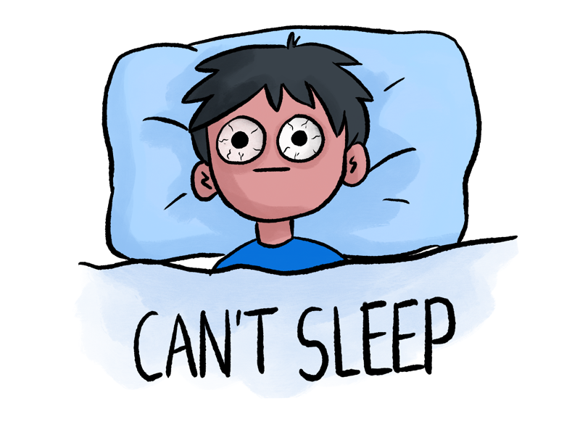
You might have trouble sleeping at night, can’t switch off, or have difficulty getting out of bed. Maybe you don’t feel like getting ready in the morning

Slide 12
If you think this is happening to you then there are things you can do to make yourself feel better!

Slide 13
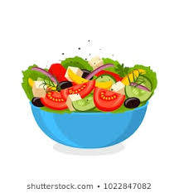
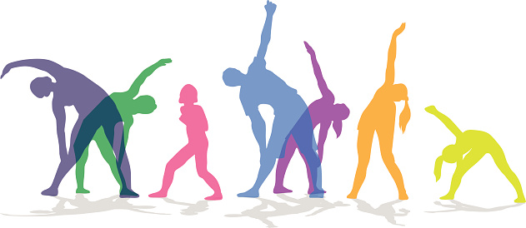
Try to eat healthily, drink water and find time to do some exercise every day.

Slide 14
If you take regular medication, make sure you are taking it on time. It is very important you don’t run out.

Slide 15
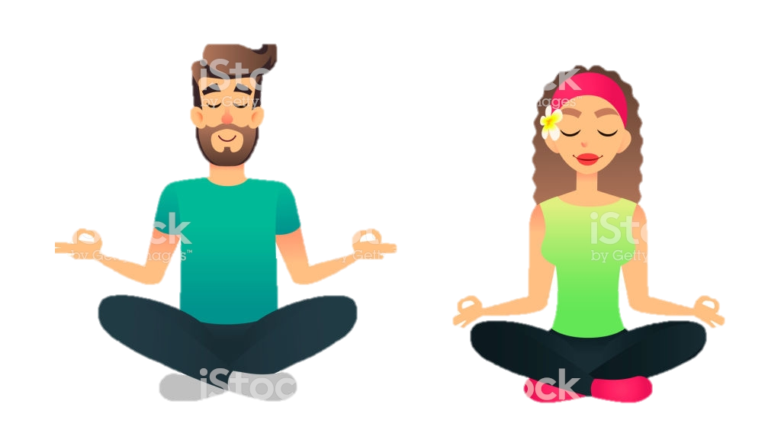
Be kind to yourself, take time out, find a safe space. Try listening to music. Sing, dance or practise relaxation to slow down your breathing.

Slide 16
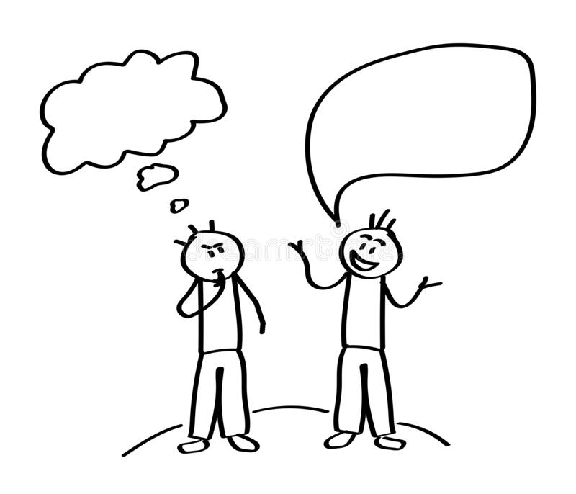
If you can, talk to someone you trust who can help support you and try to explain how you are feeling, maybe draw a picture or write it down.

Slide 17
Remember what makes you happy, such as: - Your pet - A holiday - Your favourite hobby - Your friends - Your family

Slide 18
Remind yourself of the things you are grateful for!

Slide 19
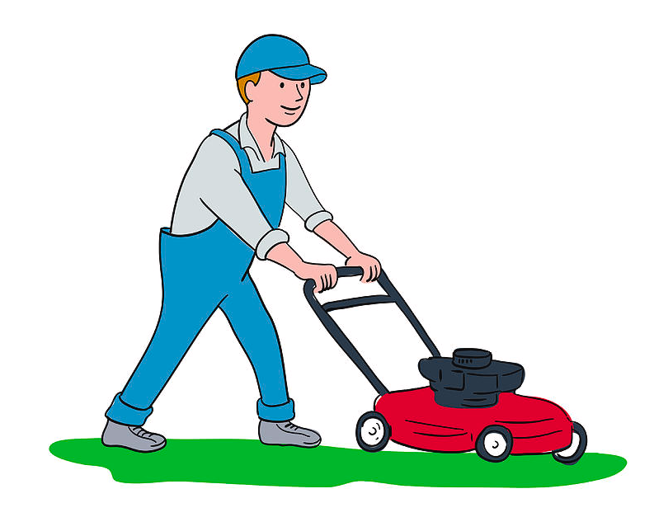
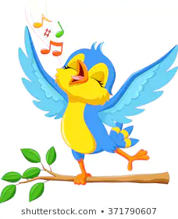
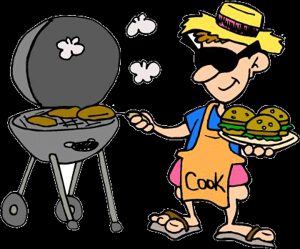
Listen to the world around you… try counting the different sounds you might hear

Slide 20
Look to the future. Plan ahead.

Slide 21
Make a wish list of all the things you are going to do when the virus has gone.

Slide 22
Remember… GOOD TIMES ARE COMING!

Slide 23
And everybody please…

