Slide 2
Notes:
Here are Mo and Jaz. They love playing games online.

Slide 3
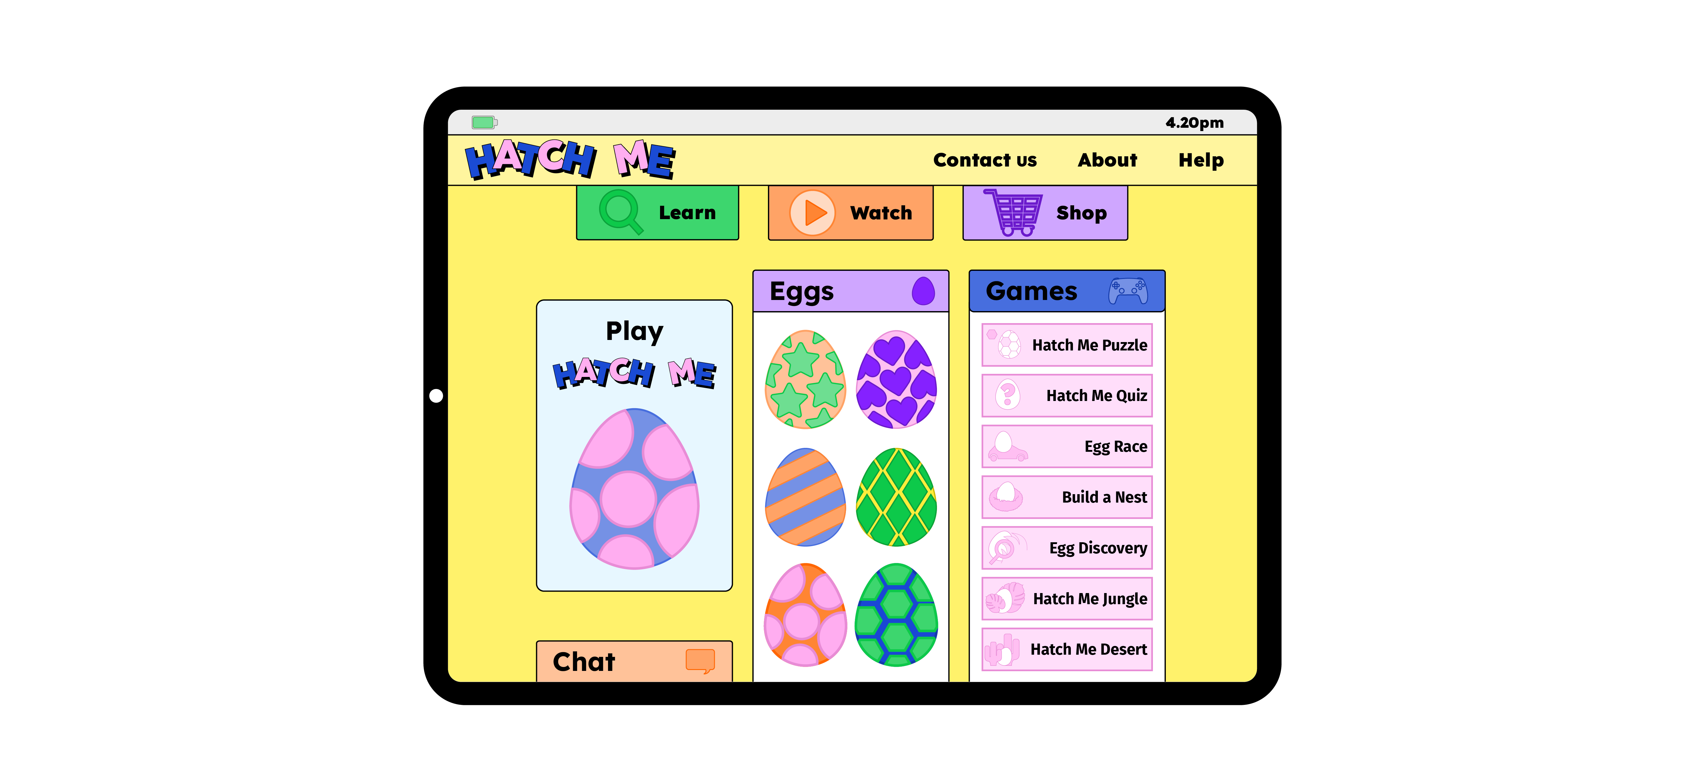
Notes:
One day, Mo and Jaz start to play a new game called ‘Hatch Me’.

Slide 4
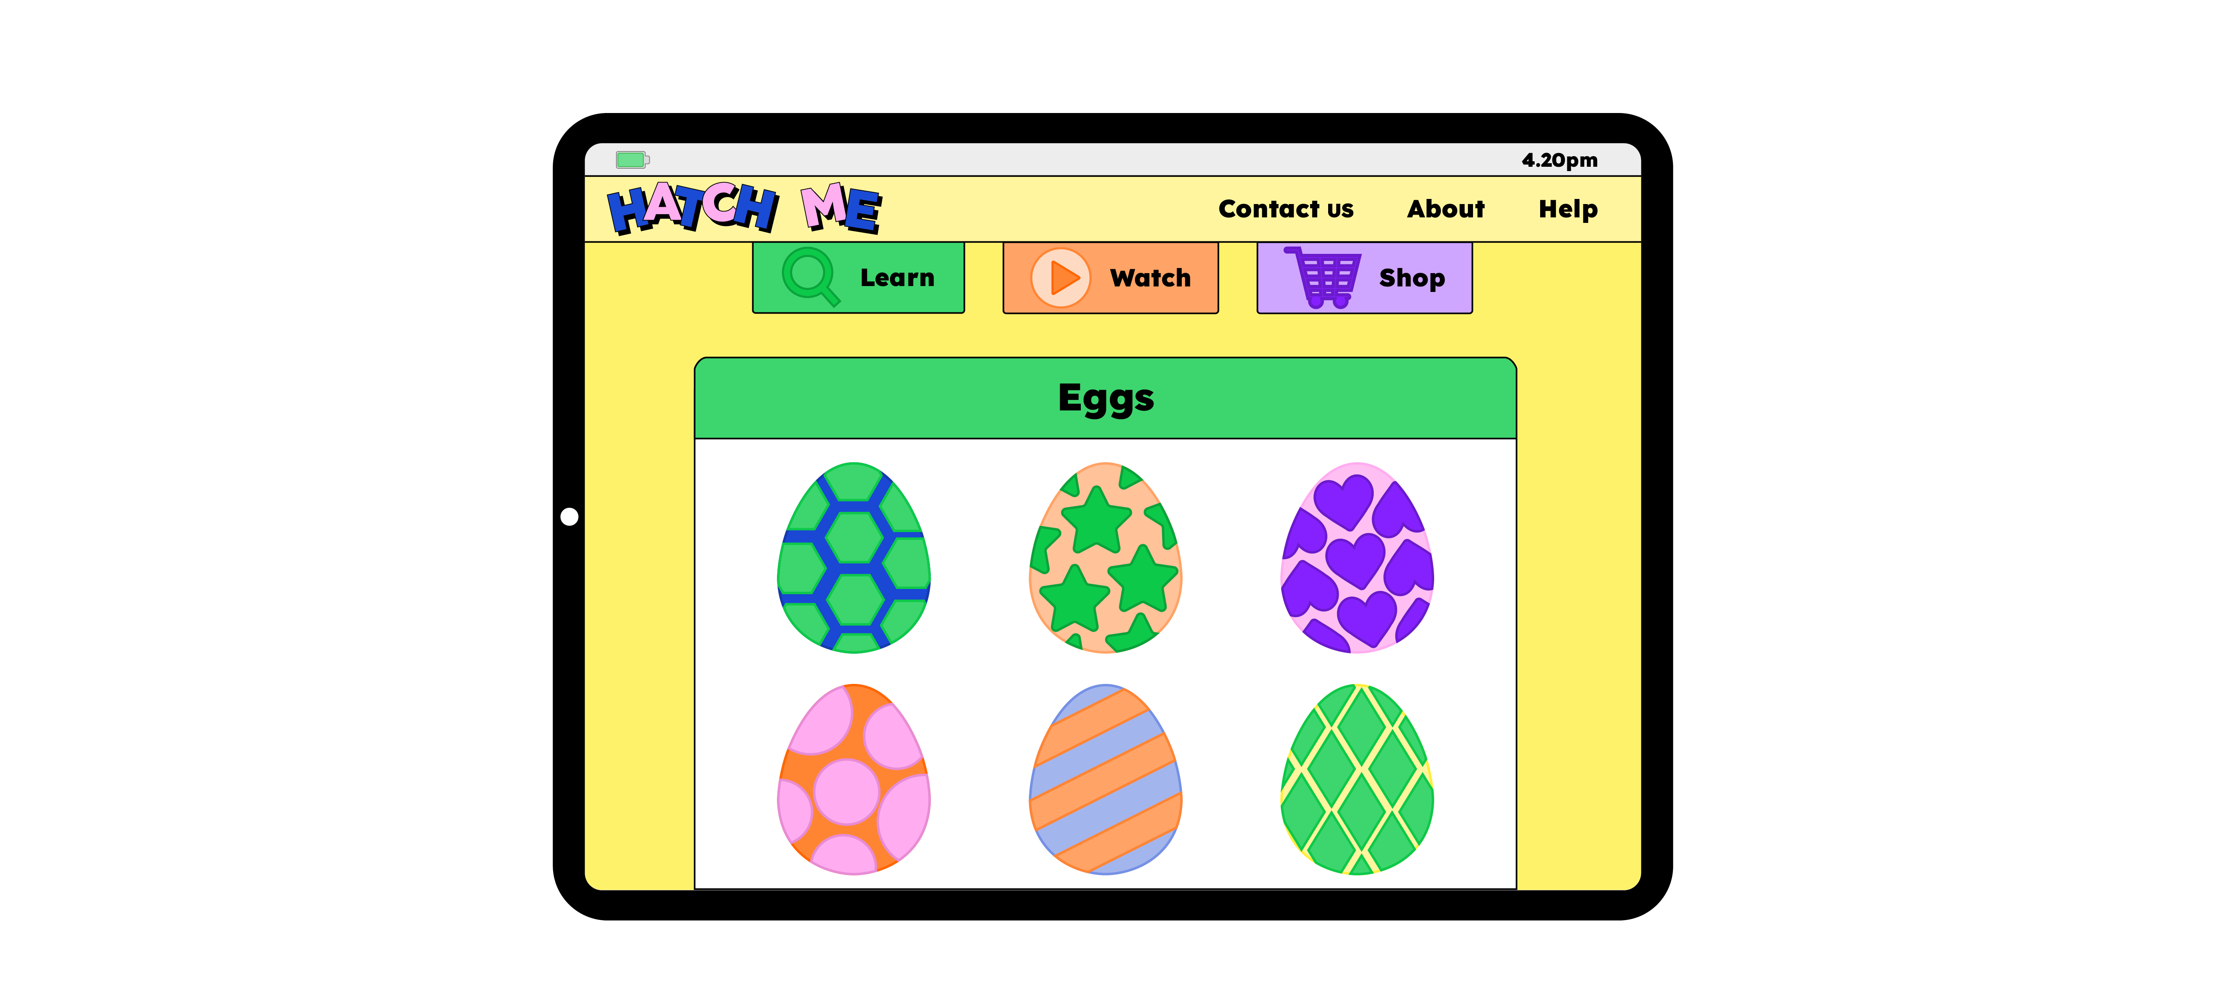
Notes:
In the game, you collect eggs which hatch into different animals.

Slide 5
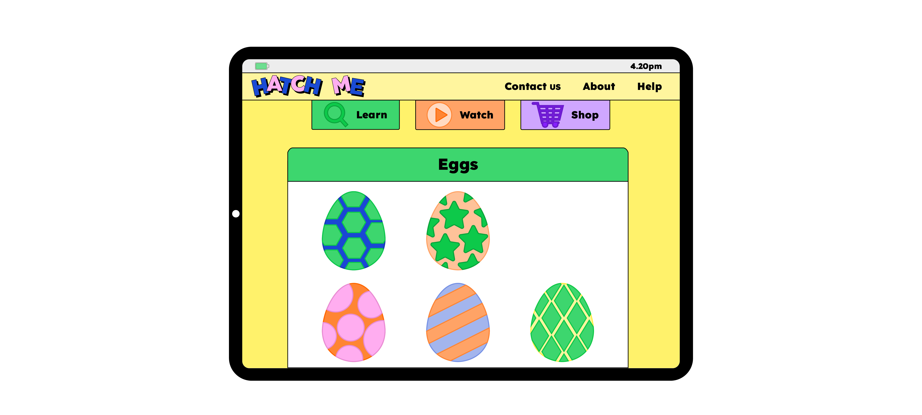
Notes:
In the game, you collect eggs which hatch into different animals.

Slide 6
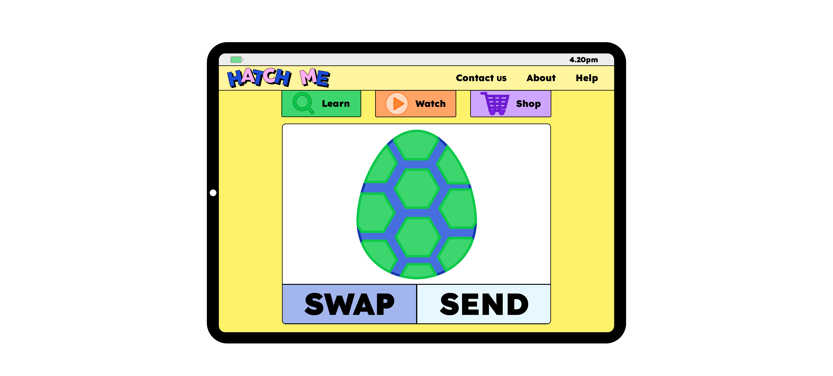
Notes:
You can swap eggs with other players too, using a swap button.

Slide 7
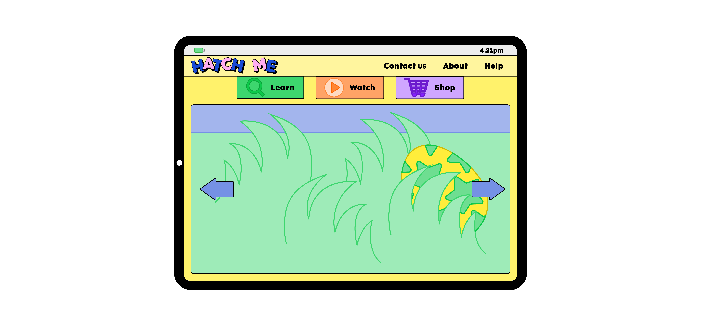
Notes:
“Look!” says Jaz. “There’s an egg!” They walk over to it, and with a quick CLICK, they pick it up. “I wonder what it’ll be!” says Mo with excitement.

Slide 8
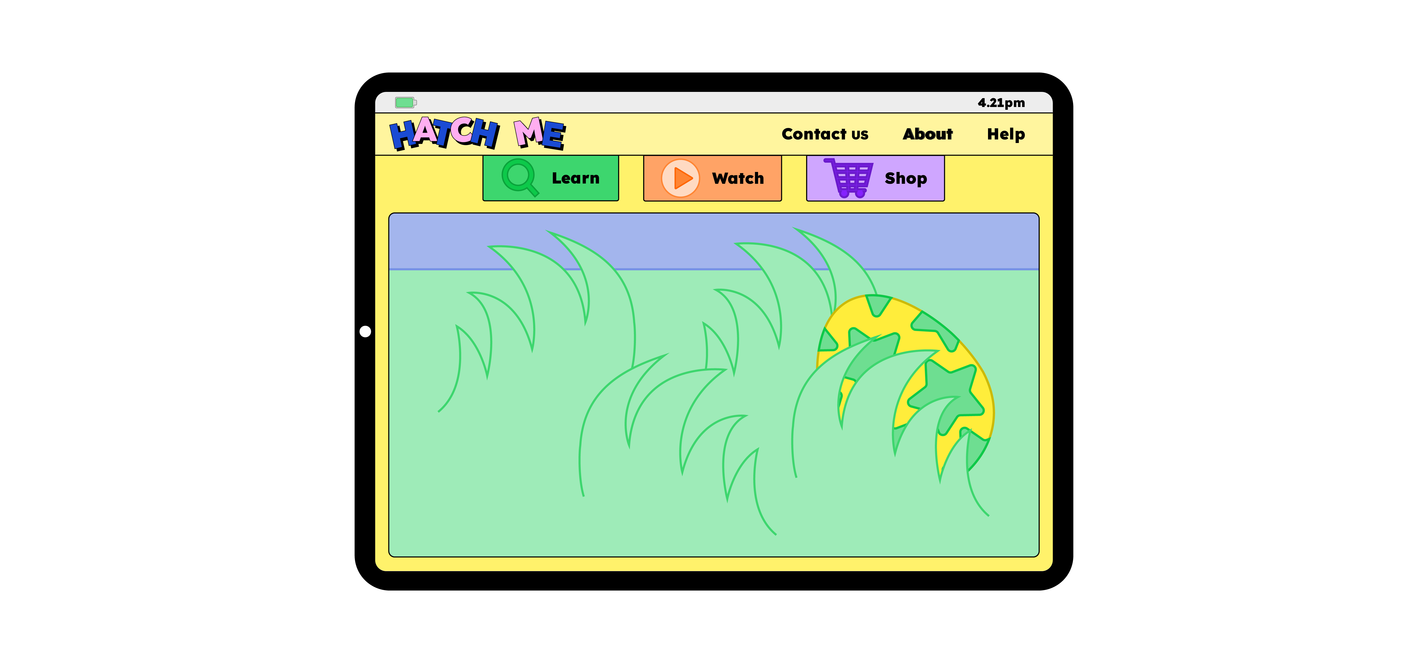
Notes:
“Look!” says Jaz. “There’s an egg!” They walk over to it, and with a quick CLICK, they pick it up. “I wonder what it’ll be!” says Mo with excitement.

Slide 9
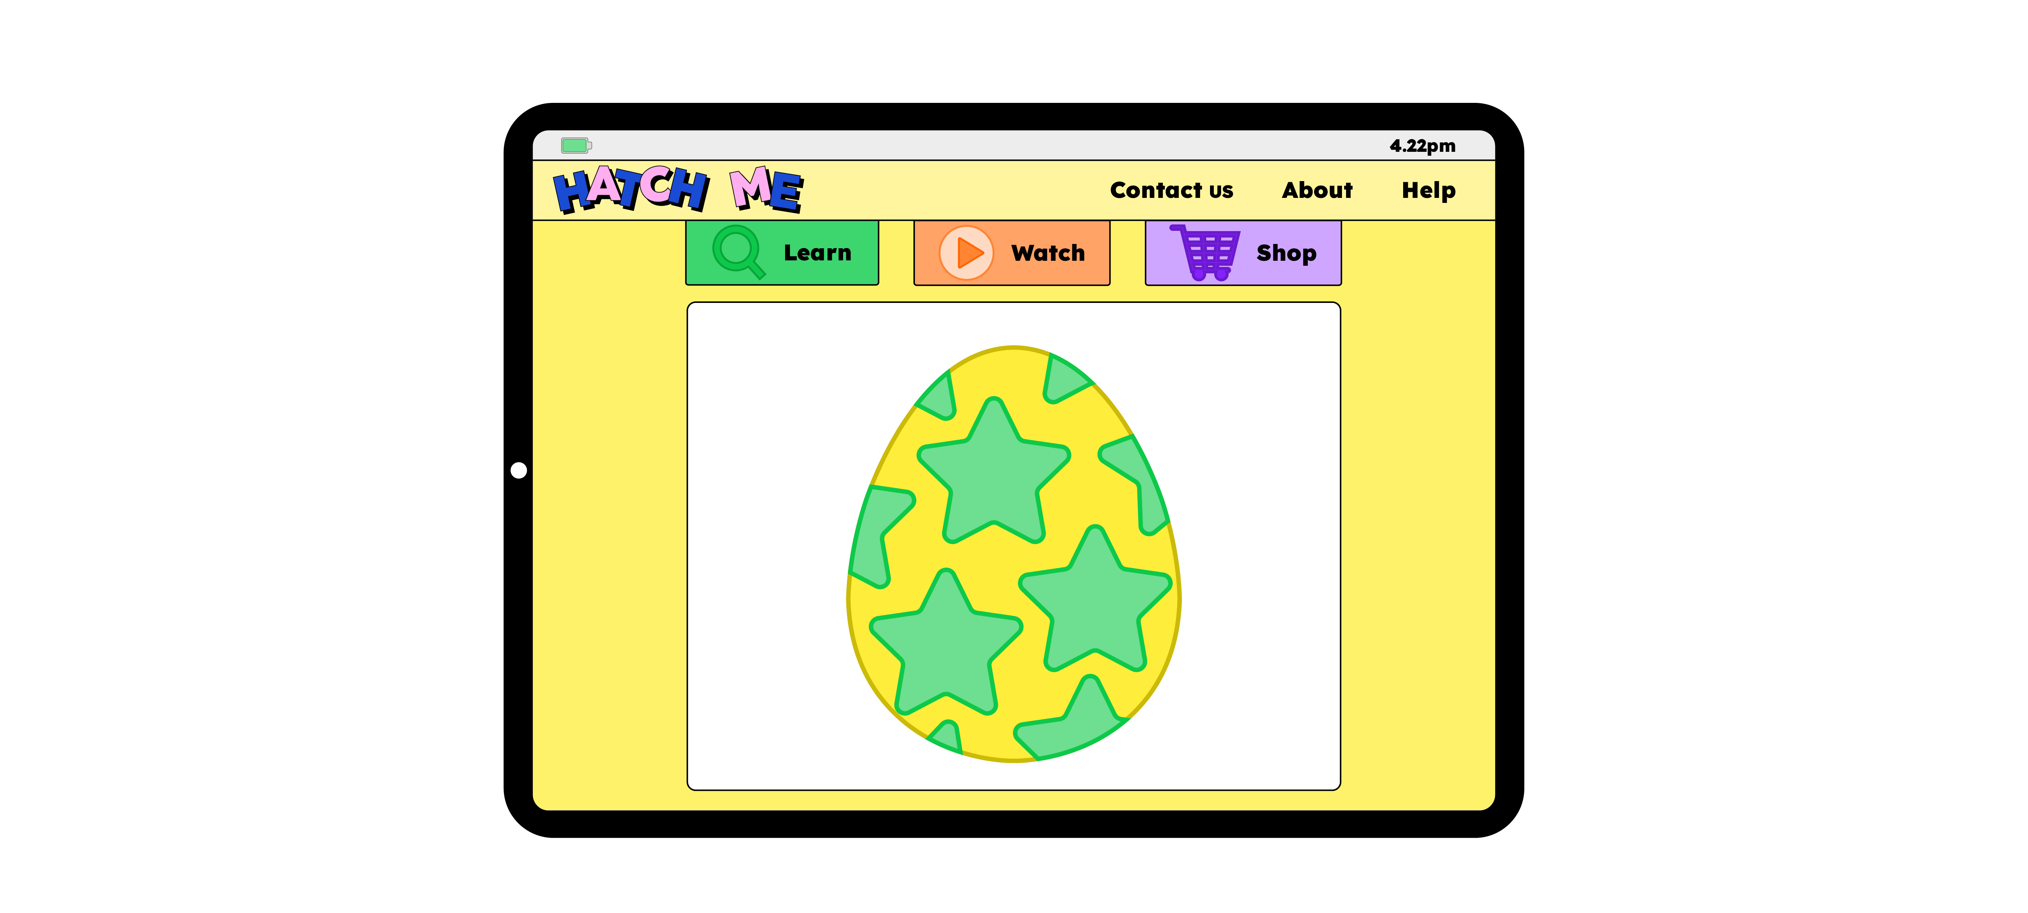
Notes:
They hear a PING and see their egg has a message for them. It says,

Slide 10
Notes:
“Tap me to hatch me.”

Slide 11
Notes:
Can you help Mo and Jaz hatch their egg?
Can you go tap, tap, tap?

Slide 12
Notes:
Can you help Mo and Jaz hatch their egg?
Can you go tap, tap, tap?

Slide 13
Notes:
Mo taps the egg, and a baby crocodile appears.
“This is the best game ever,” cries Jaz happily.

Slide 14
Notes:
Suddenly, they hear a POP! A new message appears on the screen from another player.

Slide 15
Notes:
It says, ‘If you give me your crocodile, I will give you 5 animals. Send it straight to me, we don’t need the swap button.’

Slide 16
Notes:
“I don’t know,” says Mo. “This makes me feel nervous. ” “It’ll be fine,” says Jaz. “They’re going to give us five animals.” “Okay,” replies Mo, still feeling a little worried.

Slide 17
Notes:
With a whoosh, Mo and Jaz send their crocodile to the other player. But, in a flash, the other player is gone.

Slide 18
Notes:
With a whoosh, Mo and Jaz send their crocodile to the other player. But, in a flash, the other player is gone.

Slide 19
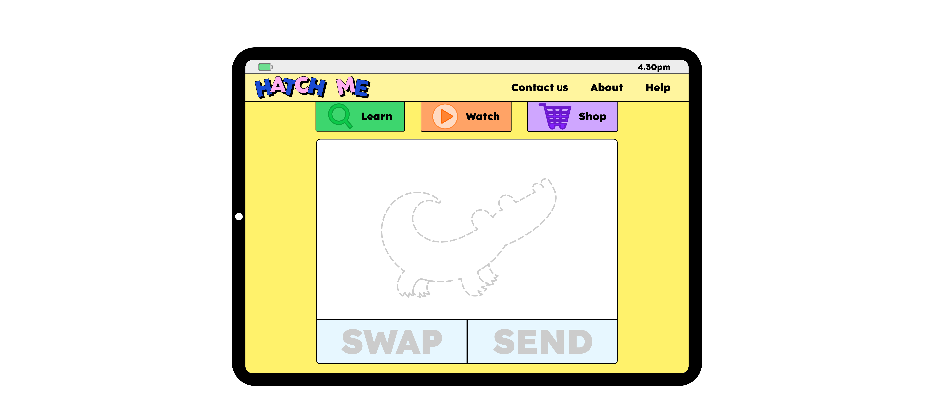
Notes:
Mo and Jaz are both shocked. “We’ve lost our crocodile,” says Mo. “We’ve been tricked,” says Jaz sadly. Suddenly, going online doesn’t feel fun anymore.

Slide 20
Notes:
Questions
How are Mo and Jaz feeling?
What do you think they should do next?

Slide 21
Notes:
Mo and Jaz go to find Dad. “Are you okay?” asks Dad. “You don’t look very happy.”

Slide 22
Notes:
They show Dad the game and tell him what happened with the other player.

Slide 23
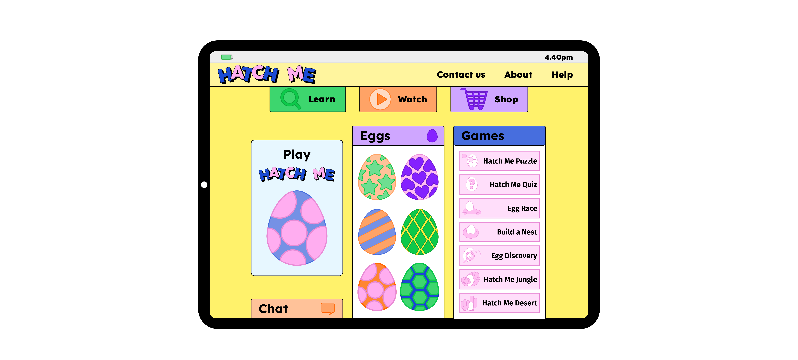
Notes:
“I’m so sorry that happened,” says Dad. “It’s not your fault. Sadly, not everyone is kind online. I’m glad you came to tell me. If you get a message from someone in the game, or you want to swap something, I’m here to help.”

Slide 24
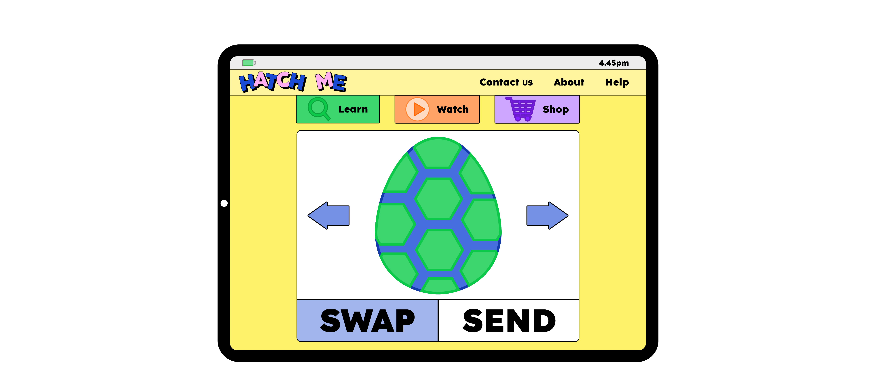
Notes:
Mo and Jaz feel much better. Dad tells them it’s important to think carefully before swapping anything, because once a swap is made, you can’t change your mind. He shows them how the swap button works so they can do it properly.

Slide 25
Notes:
Dad also shows them how to report and block anyone who is not doing the right thing. They all agree that Mo and Jaz will tell a grown up straight away if anything happens online that makes them feel worried, upset, or unsure.

Slide 26
Notes:
Dad also shows them how to report and block anyone who is not doing the right thing. They all agree that Mo and Jaz will tell a grown up straight away if anything changes online that makes them feel worried, upset, or unsure.

Slide 27
Notes:
Questions
What’s your favourite thing to do online?
Have you ever seen anything that surprised you on your device?
How did Mo and Jaz feel when they were playing the game?
What have you learnt from this story?

Slide 28
Notes:
Mo and Jaz’s message to you
We are very lucky to live with Dad, he helps us with whatever we need.
Who are the grown-ups in your life that you can go to for help?

