Slide 1

Understanding Anxiety:
An introduction for parents
| Education Mental Health Practitioner

Slide 2


Who are we?
[] Mental Health Support Team (MHST) is an NHS service providing mental health support to primary schools and secondary schools in [].
We aim to help young people to learn strategies and new ways of taking care for their mental wellbeing.
We provide interventions to pupils struggling with anxiety, low mood or behavioural difficulties.
..and deliver talks like these!
Notes:
At the end of the presentation there will be the QR codes to take them to their local MHST webpage – from there you can see if your child attends one of the schools we work in. If they do, speak to their school who can look at referring into our service.

Slide 3


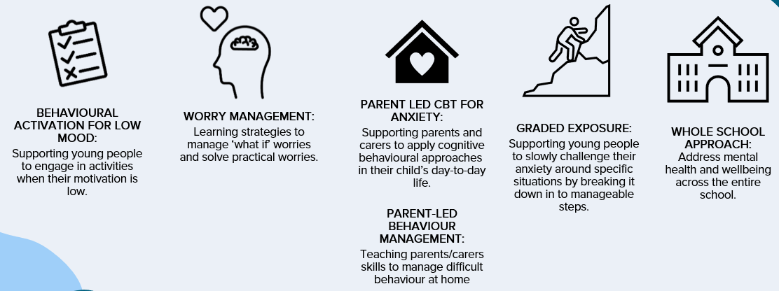



Who are we?
Mental Health Support Teams (MHST) are an NHS service providing mental health support to primary schools and secondary schools in St. Helens, Warrington, Knowsley and Halton.
We aim to help young people learn strategies and new ways of caring for their mental wellbeing.
We provide interventions to pupils struggling with anxiety, low mood or behavioural difficulties.
..and deliver talks like these!
Notes:
At the end of the presentation there will be the QR codes to take them to their local MHST webpage – from there you can see if your child attends one of the schools we work in. If they do, speak to their school who can look at referring into our service.

Slide 4
Agenda
- What is anxiety and the flight, fight, freeze response.
- Understanding how we can get stuck in the anxiety cycle.
- Talking to your anxious child.
- Strategies to support their anxiety.

Slide 5




What is Anxiety?

Slide 6
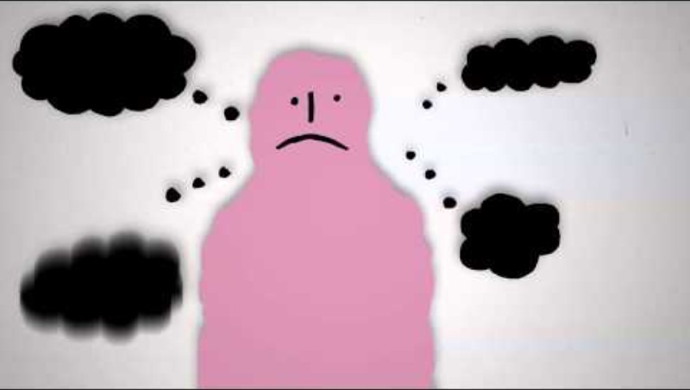
Notes:
Play video

Slide 7
Age | Developmental stage | Fears and worries
0-6 months | Sensory | Strong sensory stimuli (e.g. loud noises); loss of support
6-12 months | Sensori-motor: cause and effect; object-constancy | Strangers; separation from care givers
2-4 years | Pre-operational thinking: imagination, but limited distinction between fantasy and reality | Imaginary creatures; potential burglars; the dark
5-7 years | Concrete operational thinking: Concrete, logical thinking | Natural disasters; injury/illness/death; animals; media-based fears
8-11 years | Self esteem based on academic and athletic abilities | Poor academic and athletic performance
12-18 years | Formal operational thinking: meta-thinking and anticipation of future dangers. Self esteem based on peer relationships | Peer rejection; world issues
Notes:
There are worries which are common for certain ages, however all anxiety has three things in common…

Slide 8
Anxiety
Anxiety is a normal emotion, and in the right amounts it can be useful. It has three characteristics…
  Physical sensations in the body
    Associated with adrenalin - preparing the body for action
    E.g. sweating, heart beating faster, trembling
    Activating their fight, flight, freeze response
  Anxious thoughts
    Over-estimate “danger”; underestimate ability to cope
  Anxious behaviour
    Behaviour aimed at helping the child anticipate and/or avoid future danger, e.g. looking out for danger (hypervigilance), avoiding worrying situations
N.B. Anxiety occurs in all of us, parents included!!!

Slide 9
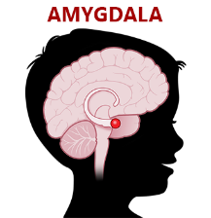


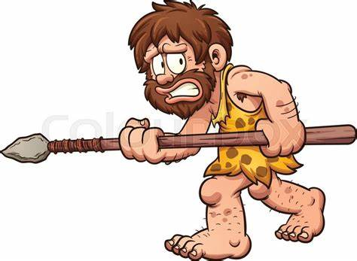
Fight, Flight, Freeze Response
When in fight mode, children may react in a way that we see as aggressive:
Hitting out
Throwing things
Shouting
Swearing
Hurting self
Fighting with peers
When in flight mode, children may react in a way that we see as avoidant:
Pleading to leave a situation or walking/running away
Feigning illness to avoid leaving home
Escaping to a perceived safe place e.g. the bathroom, bedroom, to a caregiver
When in freeze mode, children may react in a way that we see as ignorant or rude:
Refusing to answer questions/participate in family activities
Hiding under/behind furniture
Refusing to get out of the car
Refusing to leave caregivers

Slide 10
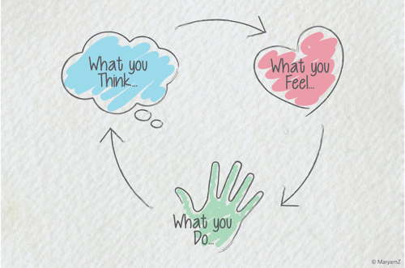
Understanding the anxiety cycle

Slide 11
Anxiety Cycle
There are several common maintenance cycles in anxiety:
  Things that children do to look after/protect themselves
  Things other people do to try and help/protect them
What children do…
What others do that might contribute…
Anxious thinking:
notice / remember things that fit in with their worries; overestimate danger; underestimate coping
Misinterpret physical symptoms of anxiety:
“something bad is happening”; “something is wrong with me”; “I can’t bear the feeling”.
Anxious behaviour:
avoidance; “safety behaviours”; seek reassurance from others
Demonstrate anxious behaviour
React to the child in an anxious way
Become very involved and protective – maybe too much?
Reassure them – maybe too much?
Don’t encourage them to try/do things
Notes:
Anxiety cycles are tricky, we often find ourselves stuck in these cycle and it can be hard to get out.

Slide 12
Isla (7 yrs. Old) and Amy (Mum). Isla is experiencing some difficulties with separating from mum, particularly at the school gates and going upstairs alone.
Situation – in the mornings, when Mum asks Isla to get her bag from upstairs, Isla will refuse
What are Isla’s anxious thoughts? What is she worried about?
When Isla acts like this, what are you thinking?
The monster will get me. I can’t cope alone; I need someone with me.
What is this telling Isla’s anxious mind?
We are going to be late. She needs to stop being so silly – I can’t keep doing this.
When she thinks this, how does it make her feel?
When she thinks these thoughts, and feels like this, what does she do?
And in this situation, what do you typically do?
How do you feel in this moment?
Upset
Worry
Refuse to go up
Crying and Winging
Shout
Frustrated
Grumpy
Anxious – is it always going to be like this?
Guilty for shouting
Raise my voice
I go upstairs with her to get the bag
Notes:
It’s important to be aware of your child’s anxiety cycle and what people around your child including yourselves, siblings, other family members, teachers etc do in response to this.
We’ve recorded a demonstration between a practitioner and a parent to show how you can consider this for yourselves, a worksheet will be sent with this video for you to complete.

Slide 13
Isla (7 yrs. Old) and Amy (Mum). Isla is experiencing some difficulties with separating from mum, particularly at the school gates and going upstairs alone.
Situation – in the mornings, when Mum asks Isla to get her bag from upstairs, Isla will refuse
I am only safe because my mum was with me. The monster would have got me if she wasn’t there.
What is this telling Isla’s anxious mind?
What if I never see her again?
What if the monster gets mum? I need to stay with her to keep her safe
What if she gets taken when I’m in school?
…
Notes:
It’s important to be aware of your child’s anxiety cycle and what people around your child including yourselves, siblings, other family members, teachers etc do in response to this.
We’ve recorded a demonstration between a practitioner and a parent to show how you can consider this for yourselves, a worksheet will be sent with this video for you to complete.

Slide 14
*remember* - What do we already know about anxiety?
  Anxious people overestimate the danger (there is a monster upstairs)
  Anxious people underestimate their ability to cope (I need someone with me, I can’t do this alone, the monster is too scary)
  Anxious people look out for evidence to confirm their thoughts are correct (Mum had to come with me, I knew I couldn’t do it alone, I knew the monster would have got me.)
  Anxious people make conclusions from this evidence, keeping them in the anxiety cycle (I am only safe if someone is with me)
I am only safe if someone is with me.
Anxious
Upset
Continue to avoid going upstairs alone. Continue to struggle leaving mum
What is it that Isla needs to learn?
After this webinar, consider drawing out your child’s anxiety cycle – what is it that they need to learn?
Notes:
It’s important to be aware of your child’s anxiety cycle and what people around your child including yourselves, siblings, other family members, teachers etc do in response to this.
We’ve recorded a demonstration between a practitioner and a parent to show how you can consider this for yourselves, a worksheet will be sent with this video for you to complete.

Slide 15

Reassurance
Reassurance is a natural response, and in some situations, it may reduce distress in the short-term.
Anxious children often seek out reassurance however, it often does not help them to feel less anxious in the long run.
Reassurance can be addictive: the more a child gets reassurance, the more they will want it/think they need it.
Cutting out reassurance (by responding differently) can be attempted gradually and in a way that feels comfortable.
We will be discussing different ways of responding to children when they are seeking reassurance later on today.
Notes:
Linking back to the cycle, the first thing is to be aware of our reassurance

Slide 16
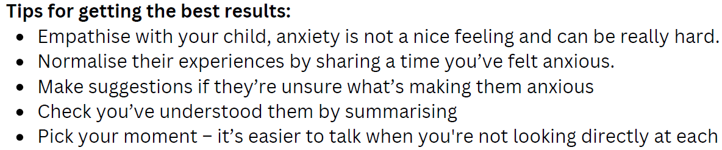
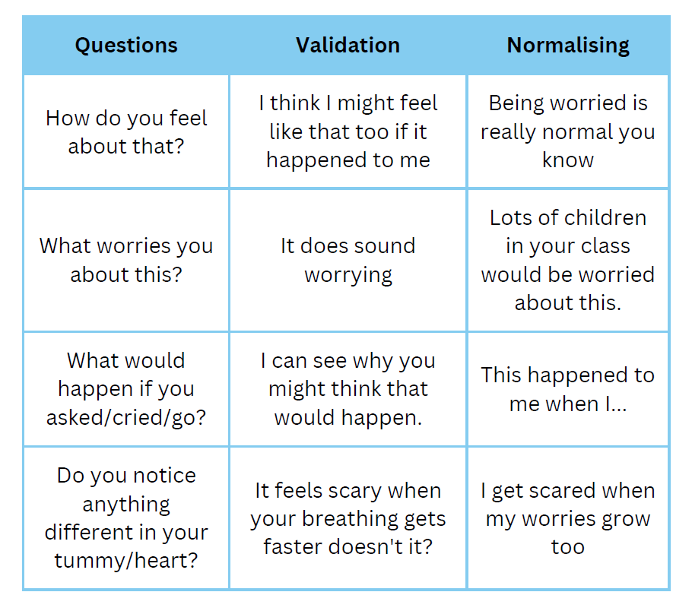
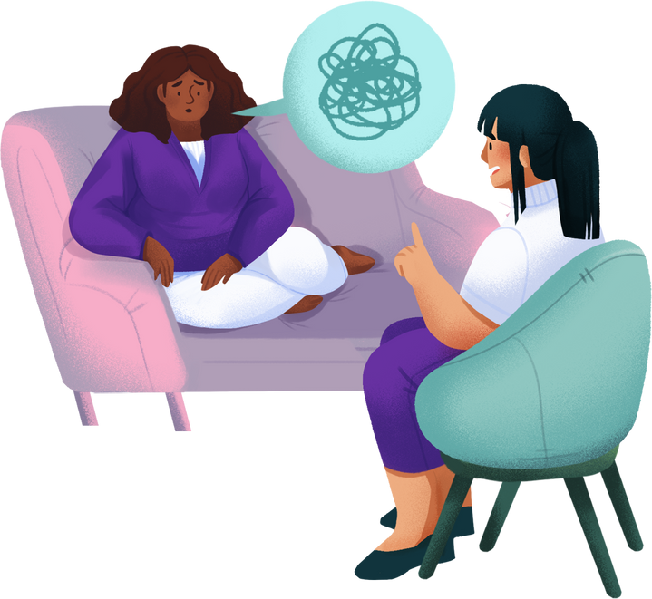
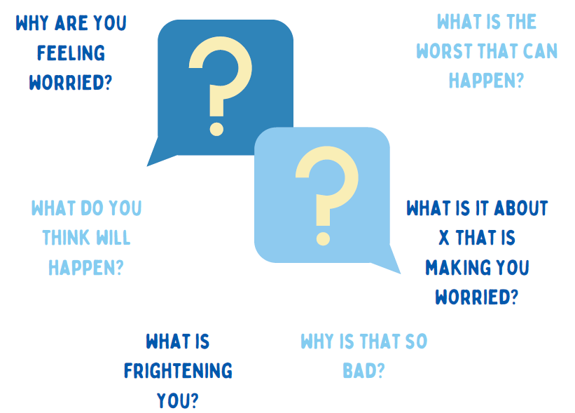
Talking to your anxious child
Video example – Saved on G drive in Master Copies folder
Notes:
Talking to a child about how they’re feeling can be hard.
Try doing an activity together to create a relaxed space.
Use creative ways of discussing feelings if they would not like to use language.
If they don’t want to talk right now, that’s okay!

Slide 17
Strategies to support

Slide 18
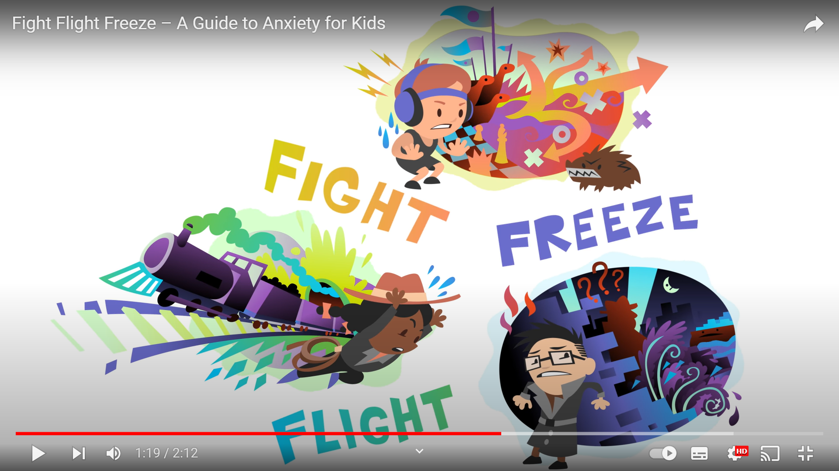
Managing Anxiety: Teach them about Anxiety
What is Anxiety and the associated bodily symptoms.
YouTube: Fight Flight Freeze – A Guide to Anxiety for Kids (https://www.youtube.com/watch?v=FfSbWc3O_5M)
Acknowledge that these symptoms aren’t very pleasant but teach them that these are normal responses to anxiety

Slide 19
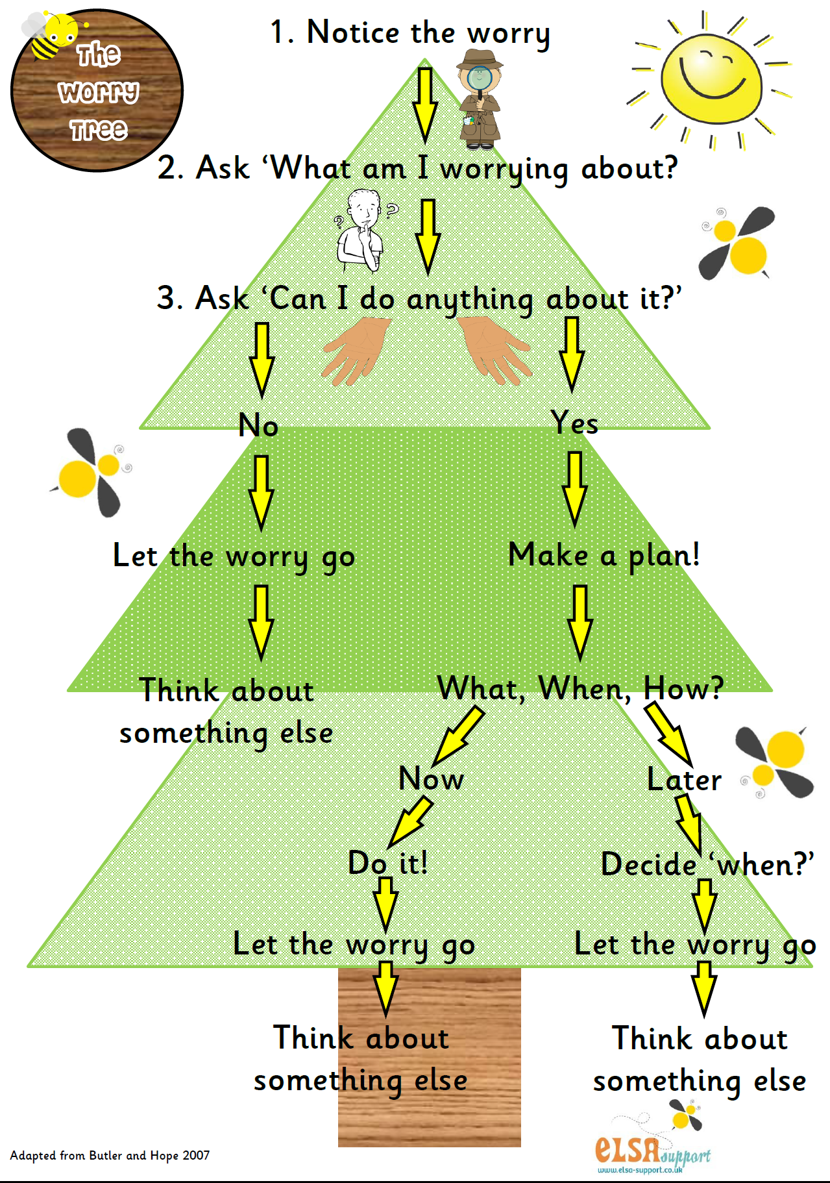
Managing Anxiety: Worry Tree
Introduce children to the Worry Tree
Encourage them to use this to work out what to do with their worries

Slide 20
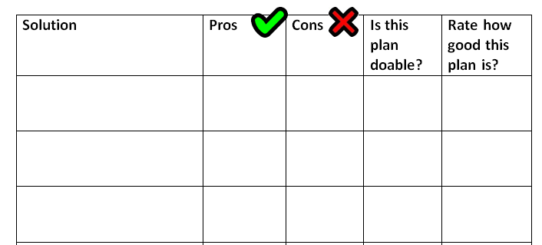
Managing Anxiety: Problem-Solving “here & now” worries
All children have to face difficult situations at one time or another
Sometimes your child’s worry is realistic
We may want to solve the problems ourselves, which can be helpful sometimes.
However, as they get older, it’s important that we also teach them how to solve problems themselves

Slide 21
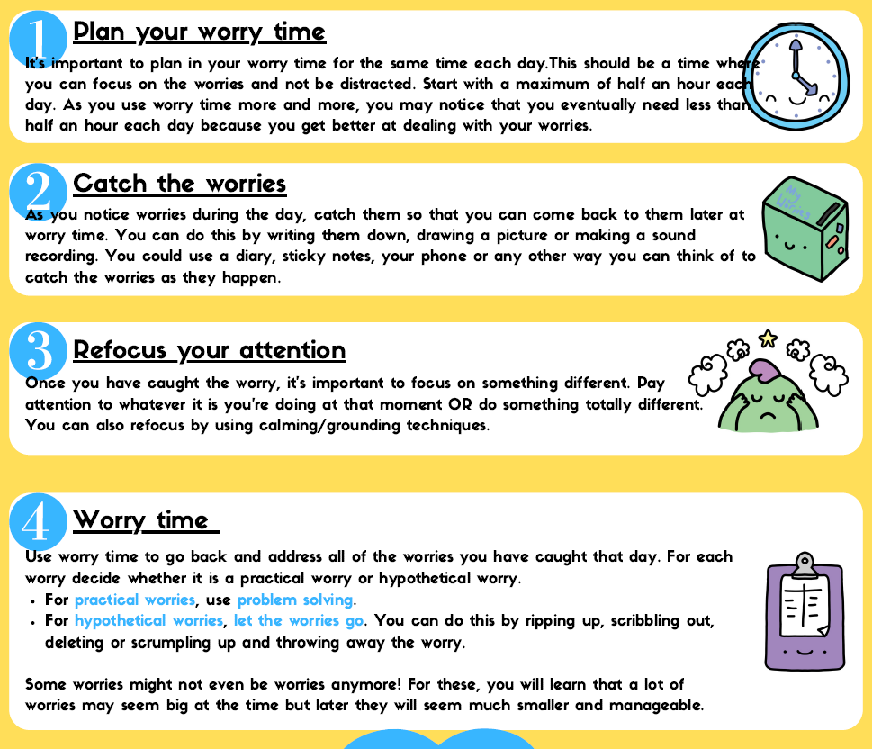
Managing Anxiety: Worry Time
Video example – Saved on G drive in Master Copies folder

Slide 22
Managing Anxiety: Promote Independence.
Be confident in your child – and let them know.
Show your child how to be independent and do things for themselves
Encourage them to have an internal voice that says “have a go – I can do this”
Slowly build up what your child can do
Give your child choices, rather than choosing for them
Usual age | Skill
6+ | Choosing own clothes, dressing self Tying shoes
7+ | Taking a bath independently Brushing teeth or combing hair without help
8+ | Putting dirty clothes in the washing basket
9+ | Making breakfast or a packed lunch Packing bag for school
10+ | Choosing own haircut/style
11+ | Getting up in the morning without a reminder (using an alarm) Being responsible for own bedroom (e.g. tidiness, decorations)
12+ | Arrange own transport e.g. bike, bus

Slide 23
Individual Strategies: Encouraging brave behaviours (graded exposure)
Children who are anxious about a particular thing will often use avoidance as a strategy to manage this anxiety.
Some fears can be too overwhelming to have a go at straight away, so they need to face these gradually to build up their confidence get them used to testing out what they are afraid of.
By breaking down the goal behaviour into smaller, achievable steps we are more likely to be able to get the child to do this.
How to create a step-by-step plan
Decide on which fear to face first (come back to what we discussed earlier – what is it that they need to learn?)
Think about an ultimate goal
Break this goal down into 6—10 steps
Put the steps in order from least difficult to most difficult
Think about implementing rewards for each step that will make taking these steps a little easier!

Slide 24
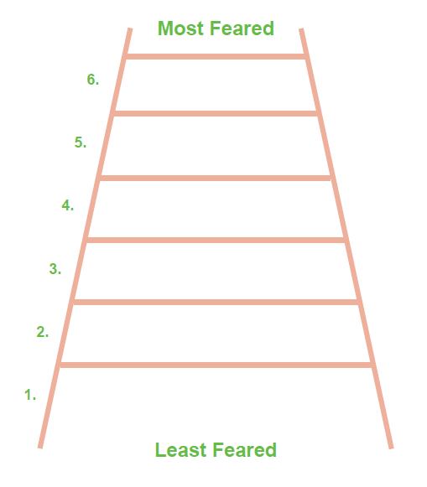

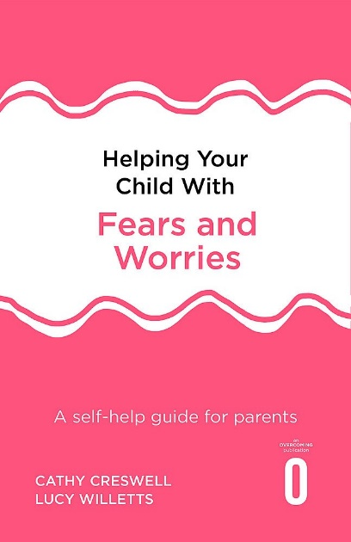

Step-by-step plan example
Isla’s anxious thoughts:
I am only safe if someone is with me.
Ultimate Goal: To go upstairs on her own
As you go up the ladder plan, the space and time that Isla and Mum are apart gradually increases.
Isla needs to learn:
She can cope on her own, she will be safe and there is no monster.
Go upstairs to my room, stay there for 20 minutes. Mum stays downstairs
Go upstairs to my room, stay there for 10 minutes on my own. Mum stays downstairs.
Go upstairs to get my school bag, Mum to wait in the living room
Most Feared
Go upstairs to get my school bag, Mum to wait at the bottom of the stairs
Least feared
Go upstairs with Mum to get my school bag, Mum to wait mid-way on the stairs
Don’t forget the rewards! These do not need to be monetary, start with quality time. Involve your child – what rewards would they like?
Go upstairs with Mum to get my school bag, mum to wait on landing

Slide 25
This concept can be applied to any anxiety, not just separation anxiety.
For example, if your child is generally anxious/dislikes uncertainty, their ladder might look like this…
Ultimate Goal: To tolerate uncertainty
Go to a new place that I haven’t been before, without asking where we are going
Talk to someone in school that I haven’t spoken to before
Put my hand up in maths class to answer a question
Some steps might need to be repeated a few times before moving up.
If your child gives the next step a go and it’s too much for them, it’s ok to add in extra step!
Not sure where to start? Get some post-it notes.
Only pack the schoolbooks that I need that day
Leave the house without checking the weather
Order something different at McDonalds

Slide 26
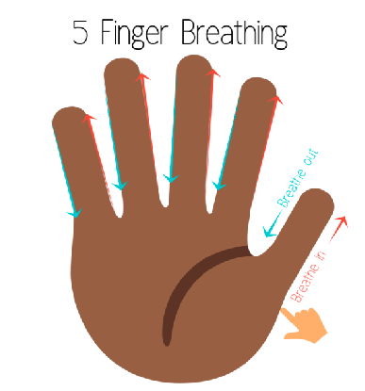

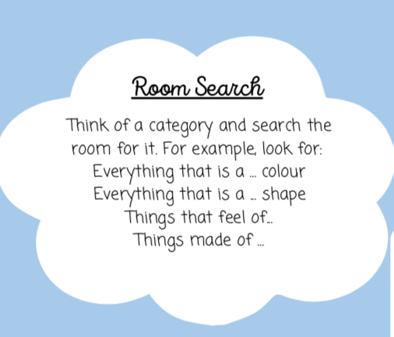
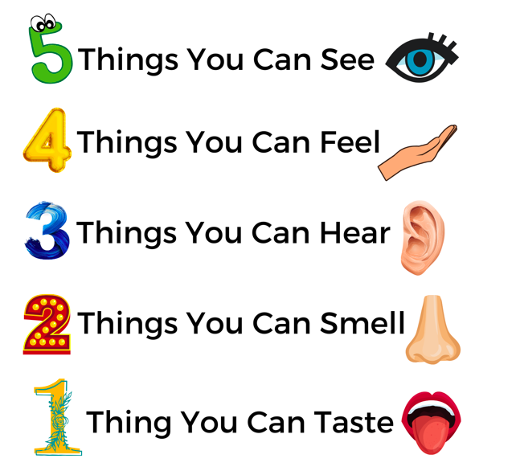
Managing Anxiety: Helping your child relax
Mindfulness Colouring
Breathing techniques
Grounding techniques
Meditation
Movement

Slide 27
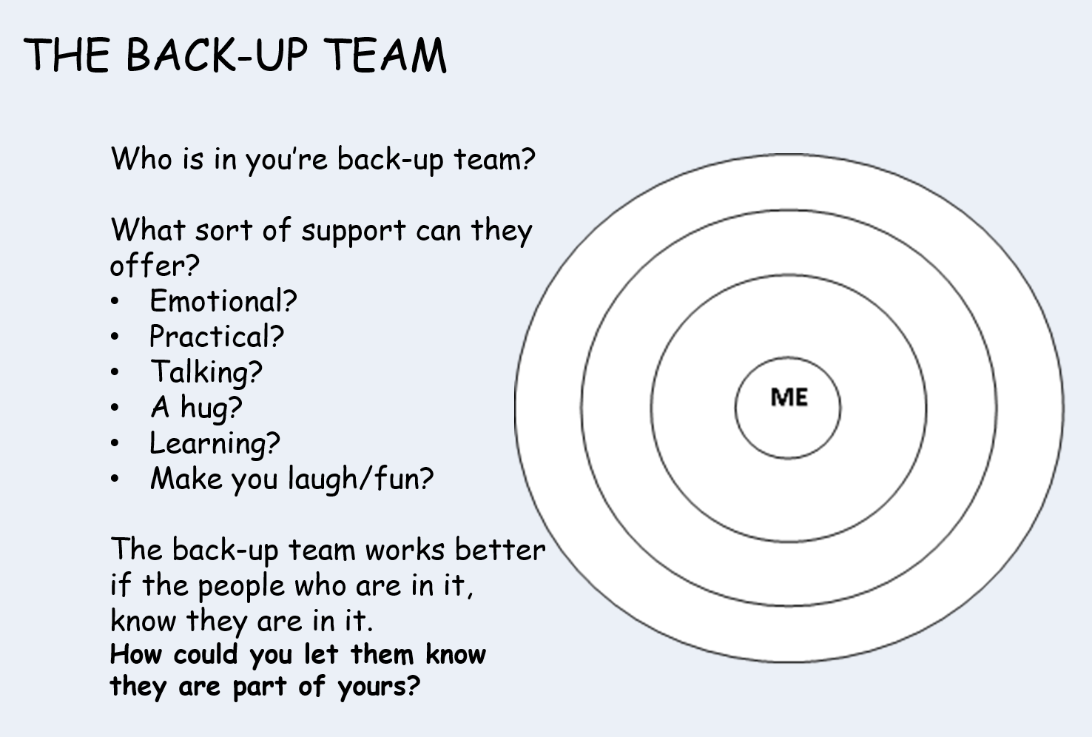

Think of yourself too!
Supporting a young person with their anxiety can be a massive drain on your own resources. It’s important to think of yourself too!

Slide 28
Summary
Statistically, anxiety is prevalent in a large number of young people.
By reducing reassurance and increasing independence young people can start to challenge their anxiety / face their fears.
Parents can help at home by considering the steps and strategies we have discussed today.

Slide 29
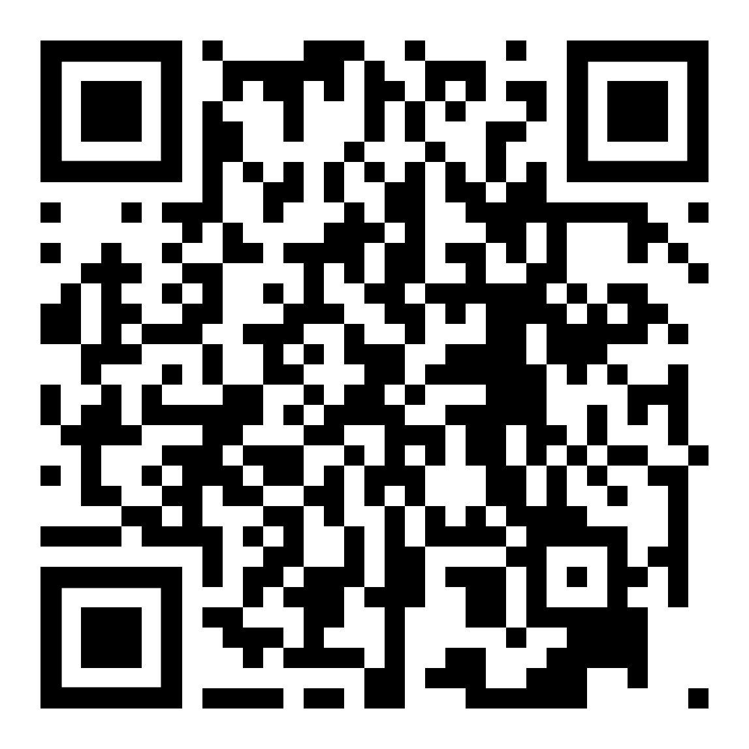
Support for parents
Mental Health Foundation - mentalhealth.org.uk
Mind - mind.org.uk
NHS - nhs.uk/nhs-services/mental-health-services
Young minds parent helpline: 0808 802 5544
Adult IAPT (talking therapies) services:
  Halton: 0151 292 6954
  Warrington: 01925 401 720
  St. Helens: 01744 415 650
  Knowsley: 0151 351 8890
ADDvanced solutions: 0151 486 1788
Parent / Carer forums
MHST website
Follow this QR code to access more information about our service, including patient stories and a list of the schools that we work in. If your child attends one of these schools and you feel that they would benefit from support from our teams, please speak with their school who can submit a referral.
Notes:
Add in IAPT numbers

Slide 30

Support for Young People
MHST – 01925 664 120
Warrington CAMHS - 01925 575 904
Halton CAMHS – 01928 568 162
St. Helens CAMHS – 01925 579 405
Knowsley CAMHS – 0151 351 8610
CAMHS 24/7 response team – 01744 415 640
Merseycare 24/7 crisis line (18+)- 0800 051 1508
MHST website

Slide 31
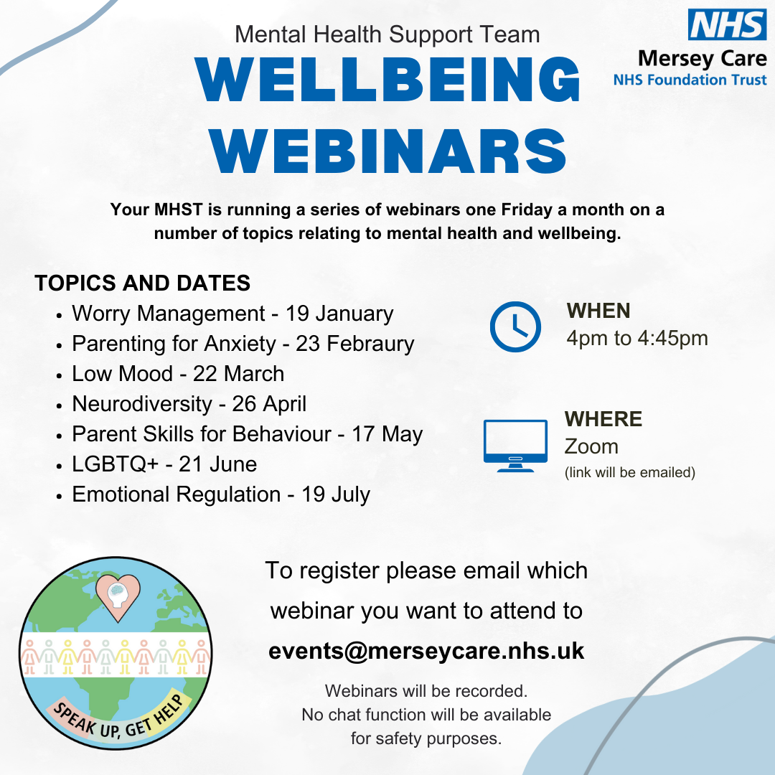

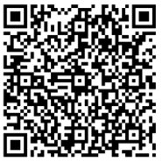
THANK YOU FOR LISTENING!
We would be grateful if you could complete the following feedback form about our presentation today.

