Slide 1
Anti Bullying Week 2021
Brookfields School

Slide 2
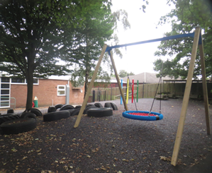
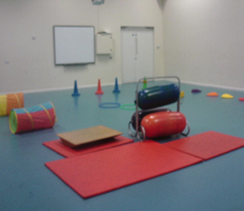
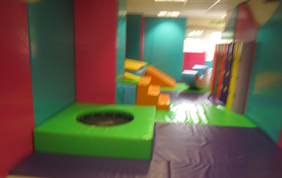
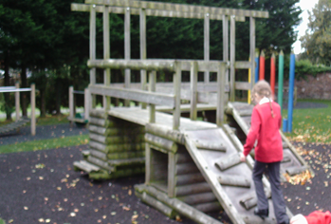
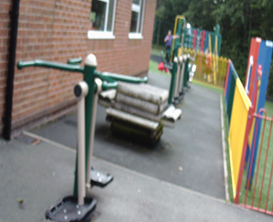
Indoor and outdoor areas help promote friendships, cooperation and tolerance.

Slide 3
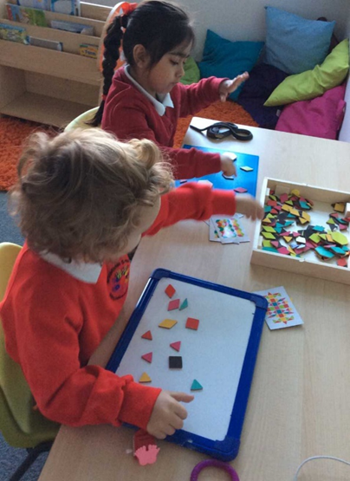
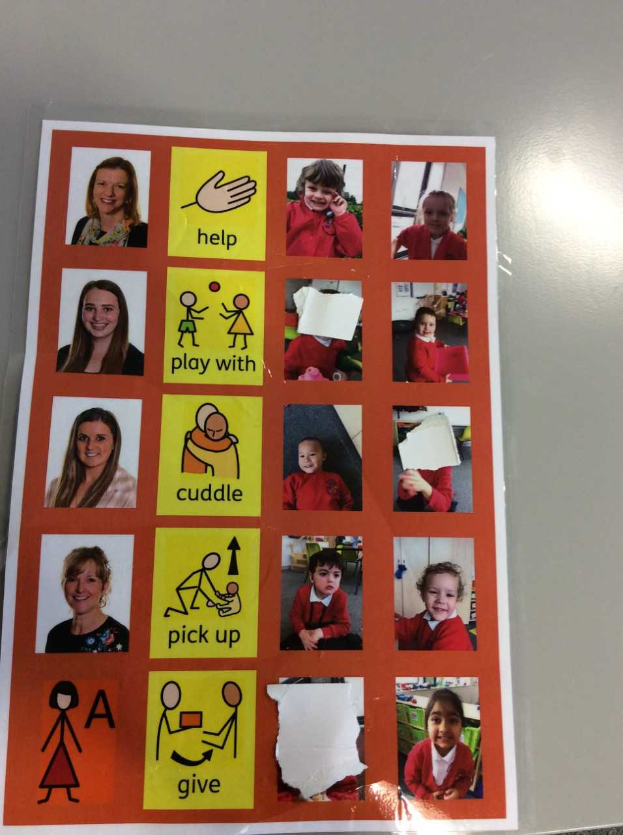
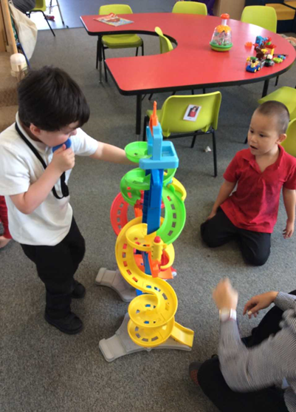
A sample communication board that helps our children request for help when they need it by pointing to the relevant images.
Cooperative play is encouraged and taught. The adult indicates whose turn it is by passing the car and verbalising ‘name’ turn.
We encourage our children to work and play alongside each other and together building friendships whilst learning new skills such as sharing.

Slide 4
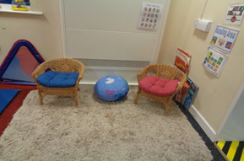
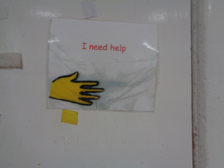
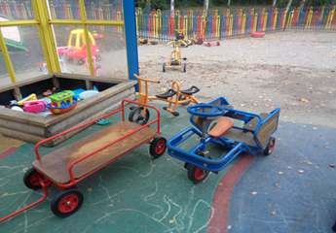
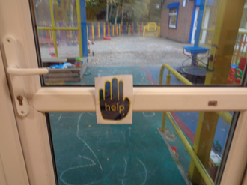
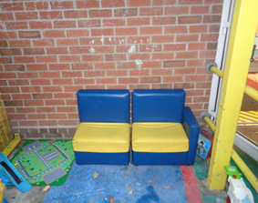
Here are some sample resources used to help support, teach and develop collaboration, emotional wellbeing and pupil voice. These are key areas we focus on from when the children join us to help prevent any conflict/bullying situations
Outside toys encourage parallel and co operative play and quiet areas are available to share quiet time with a friend.
Pupils have a way of communicating that they need help in the indoor and outdoor areas.

Slide 5
We listened to a friendship song called “make new friends” and passed the heart around the circle to our friend.
Anti- Bullying week in Bumblebees Class.
We made friendship cupcakes, we chose a picture of a friend in class and decorated a cake for them.
We share our fun activities.

Slide 6
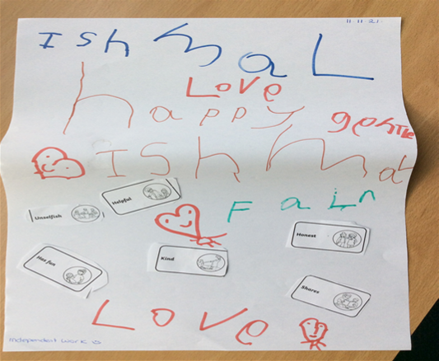
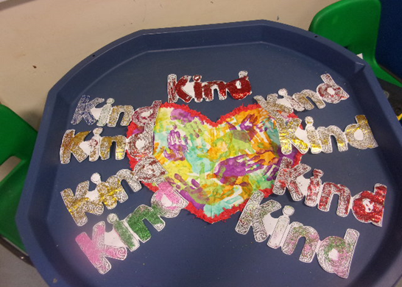
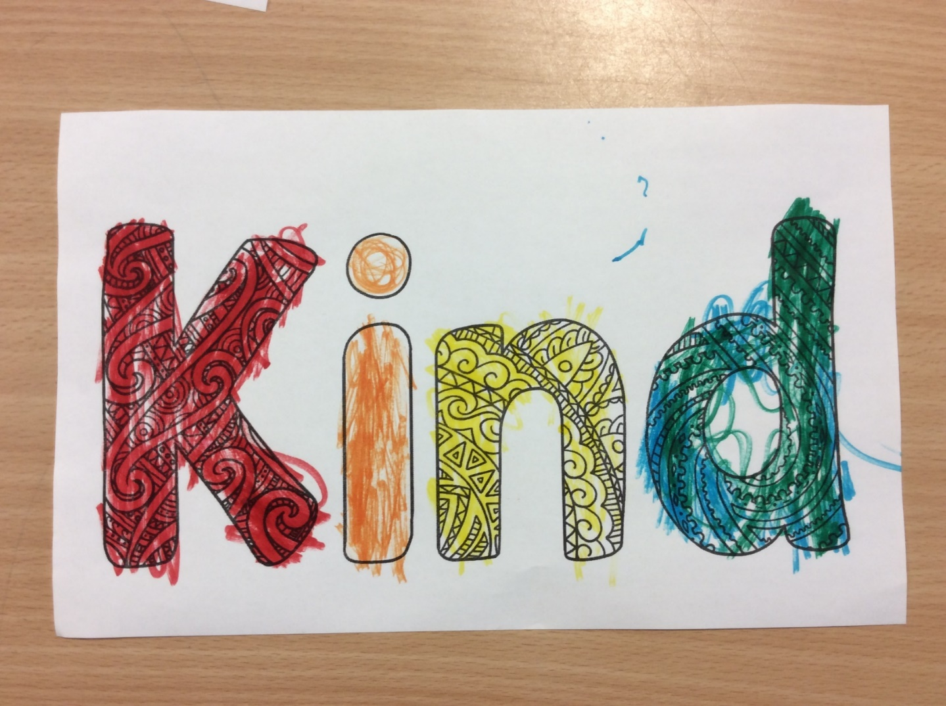
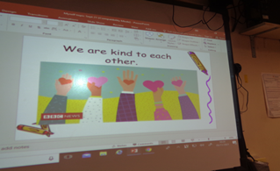
A handprint heart collage to show we are all unique!
The children made friendship posters in Anti-Bullying Week and learnt songs.

Slide 7
Activities we do in Woodpeckers class to promote helping hands & turn taking:
Turn taking during continuous play activities; adult modelling and adult led ‘my turn, your turn’; gradually introduce another pupil
Turn taking during whole class lesson times, with objects of reference, taking a turn on interactive programmes on the interactive board etc.
Present high interest activities such as balloons, bubbles – for children to request (using preferred communication method) & can use as turn taking activity too
Modelling helping & asking for help
Praise & rewards for helping, sharing & turn taking; informing parents, visiting Sara / Harry to get a sticker
Helpers at tidying up time, praise & rewards
Communication board to identify feelings; recognise and discuss how the pupils are feeling each morning
Opportunities to access sensory diet activities to help pupils to be calm / alert
Encouraging games of hide and seek and chase on the playground
Range of turn taking games in class i.e. Cars racing game, dominoes, lotto match
Encouraging ‘kind hands’ when playing and working alongside others
Praise and reward ‘kind hands’
Recognising times of potential conflict & distracting before hand
Calm and consistent approach
Encourage to explain if upset; ask ‘what’s wrong’; allow time to listen to explanations; for pupils who cannot communicate verbally they may indicate by guiding adult to another area / to the door, etc; closely observe to identify any nonverbal indications, offer communications board
Talk about being kind linked to range of literacy materials, in prayers
Model being kind in the things we do as an adult
Naming emotions and teaching what they are

Slide 8
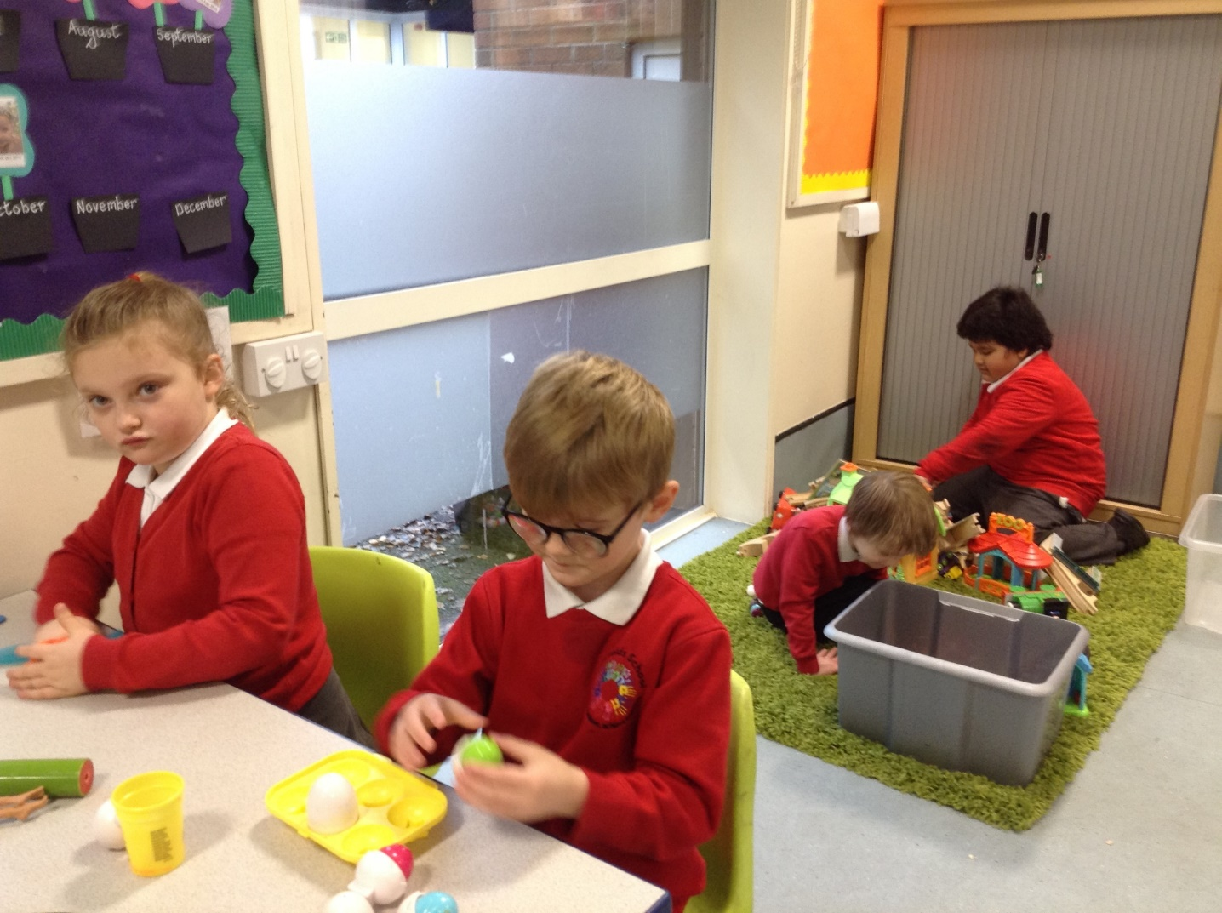
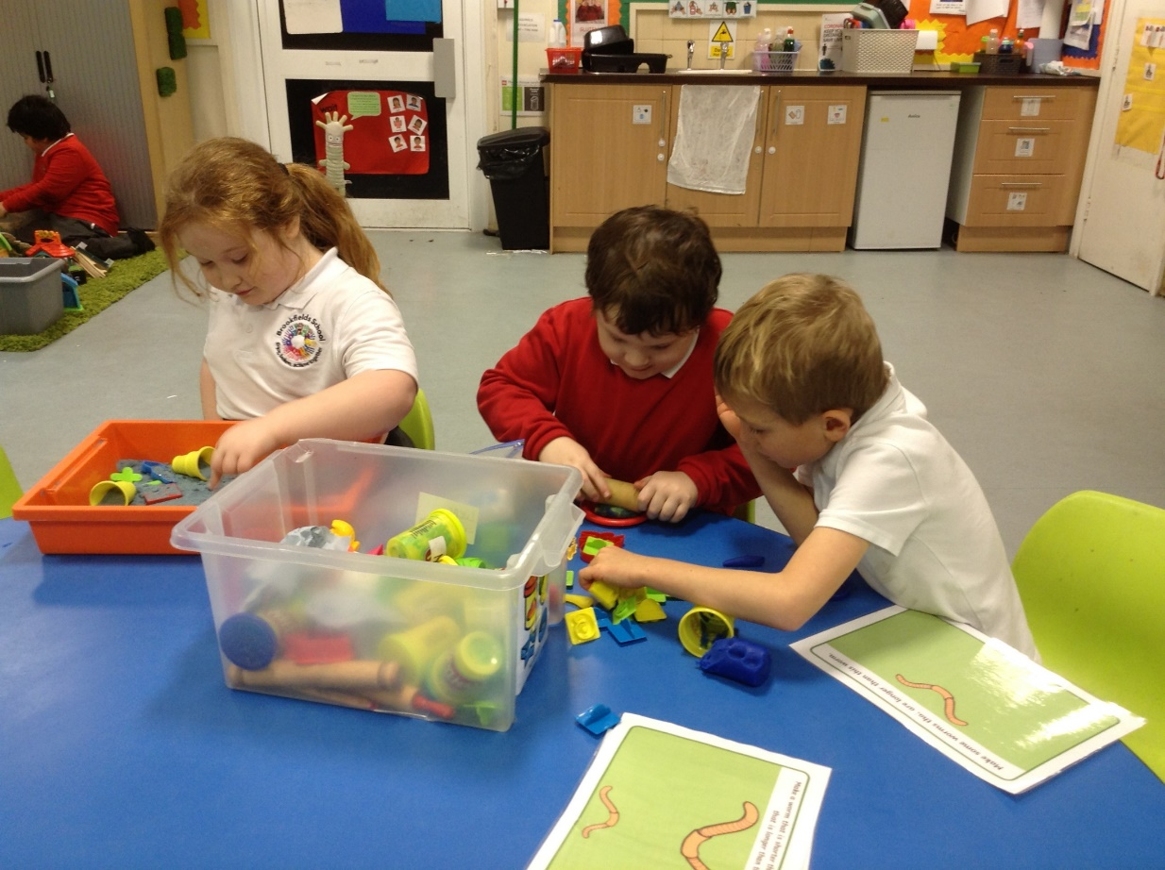
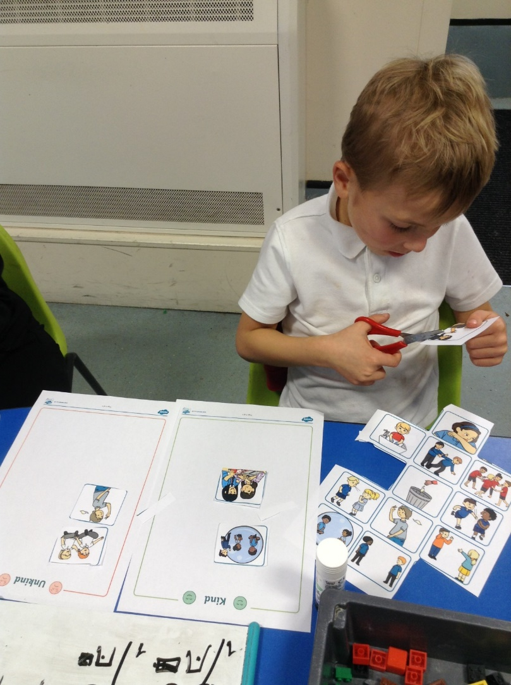
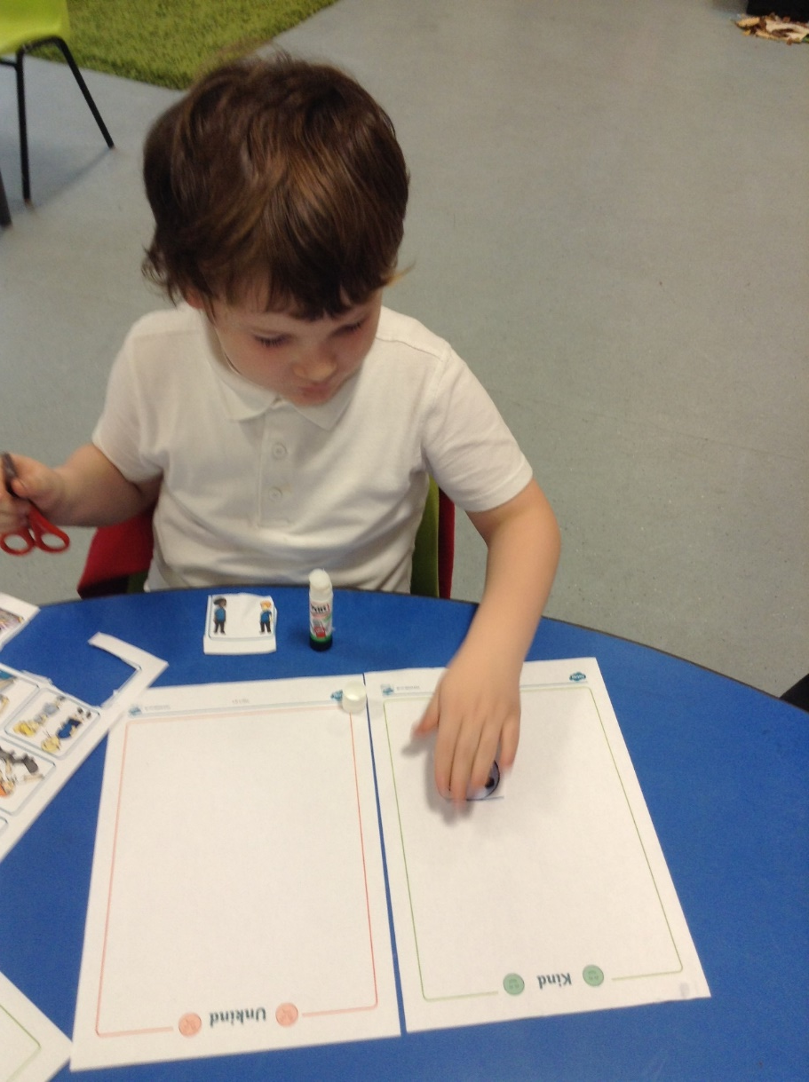
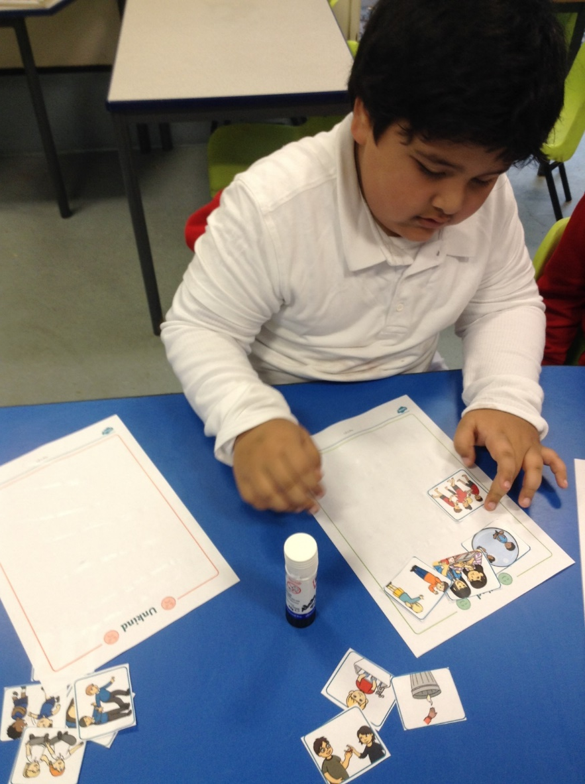
Learning how to work and play together in Squirrels.

Slide 9
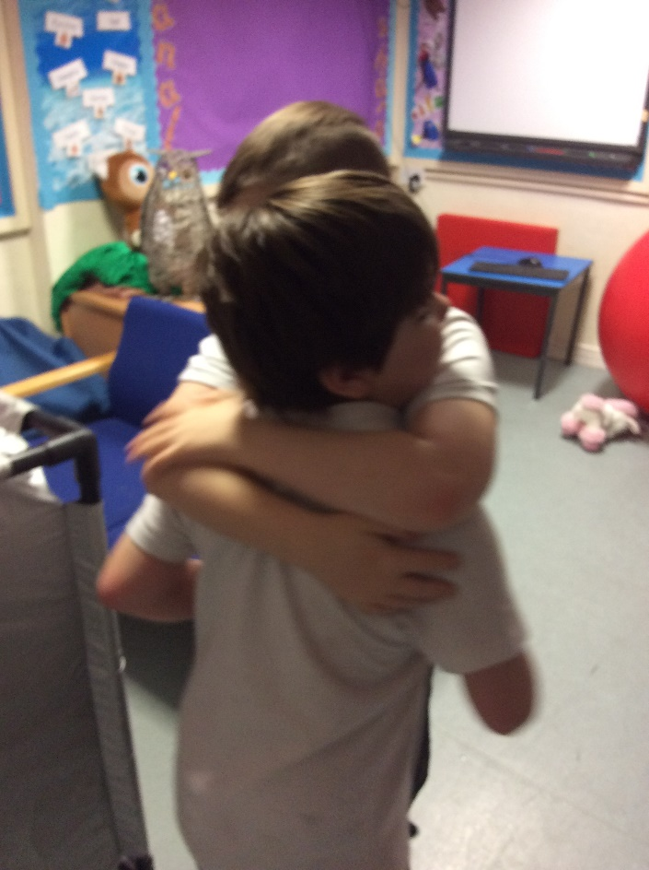
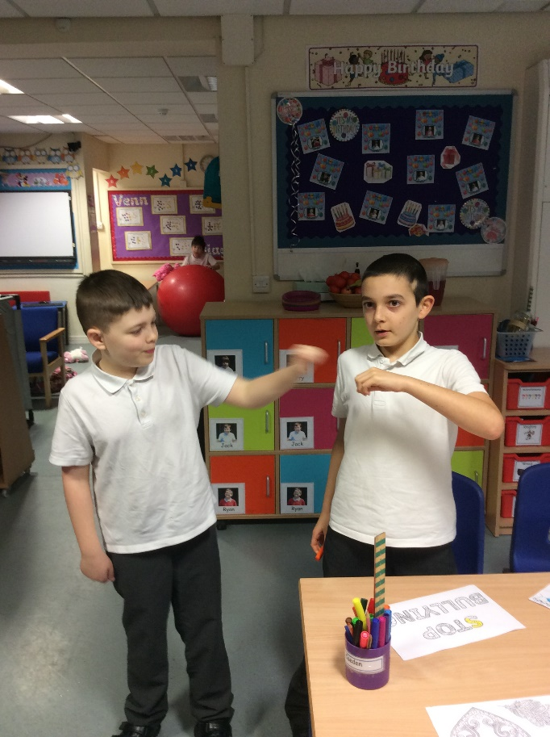
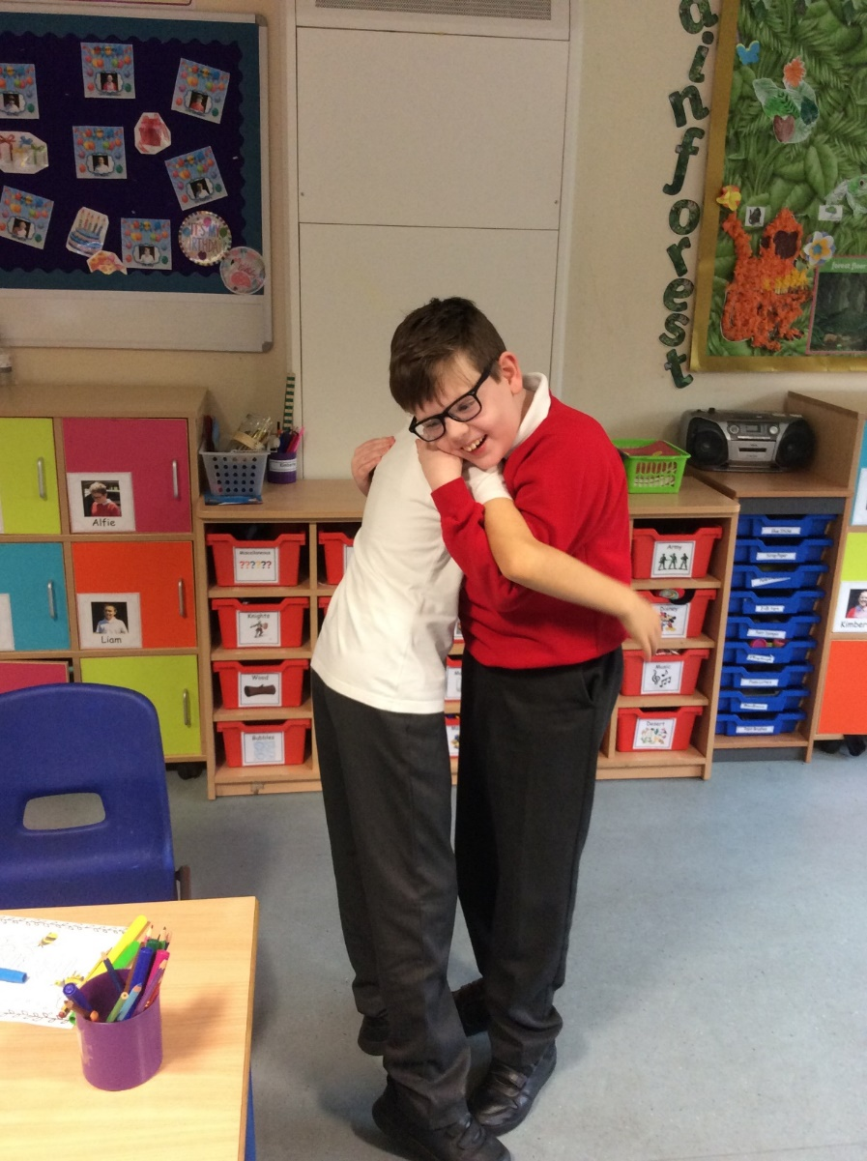
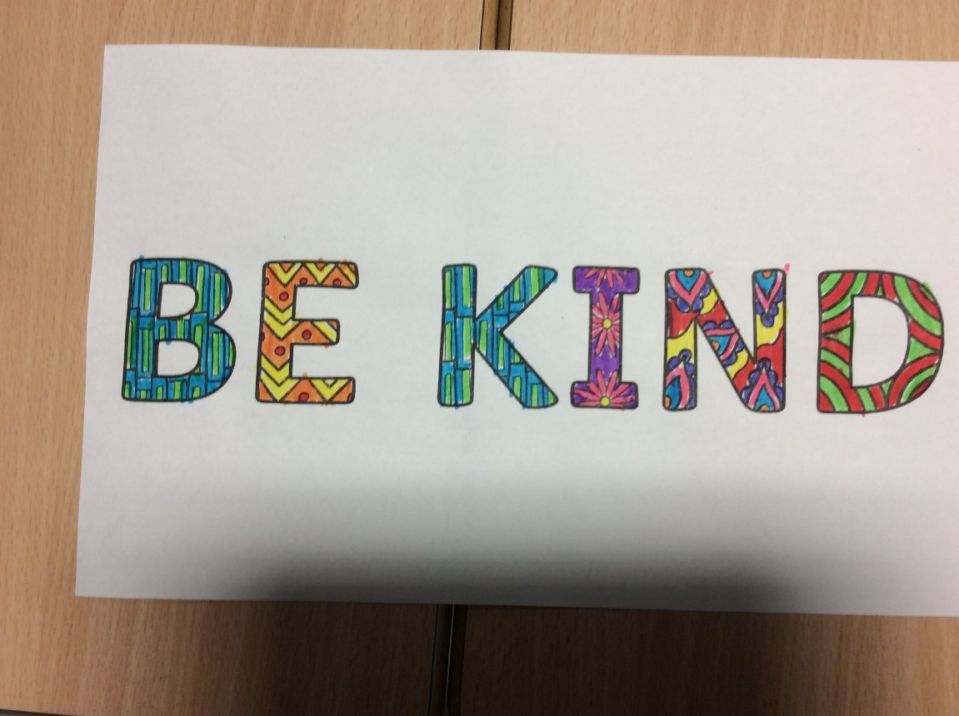
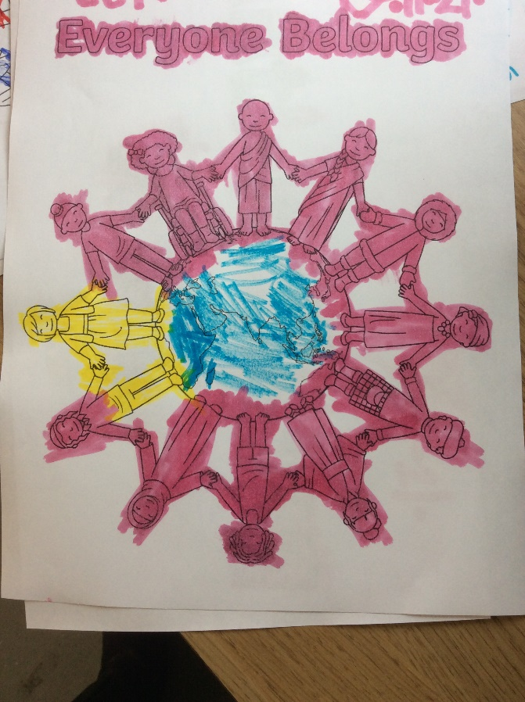
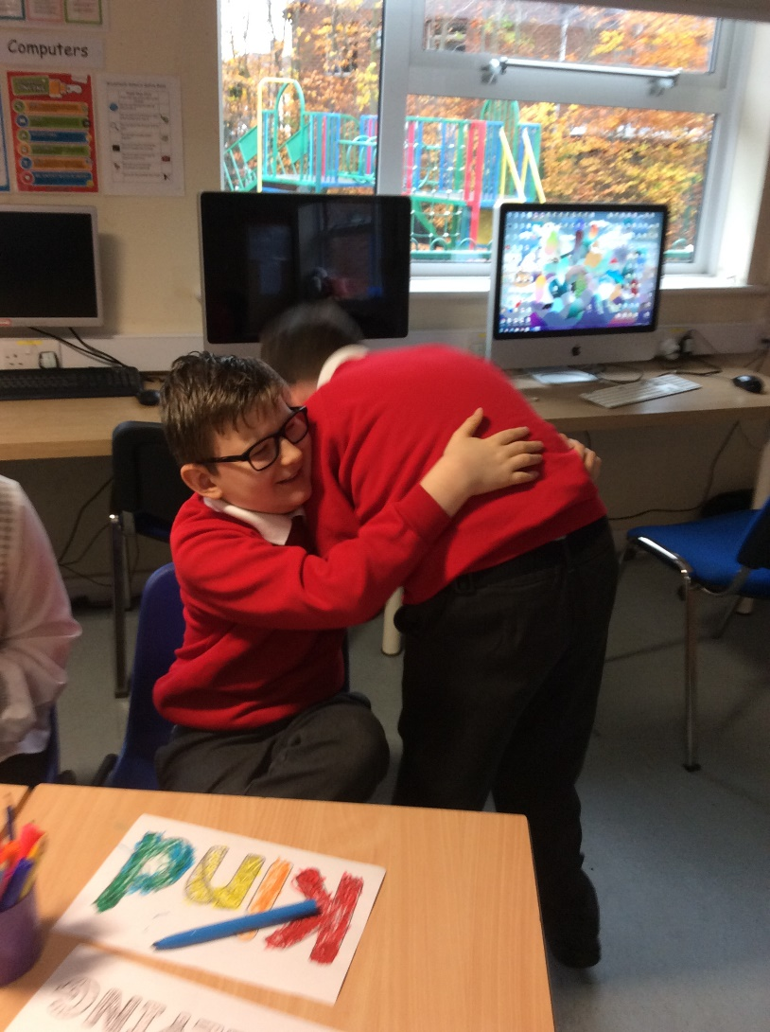
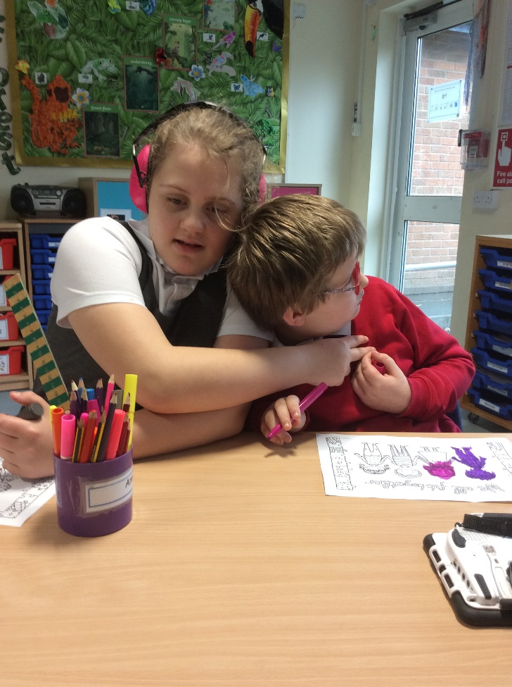
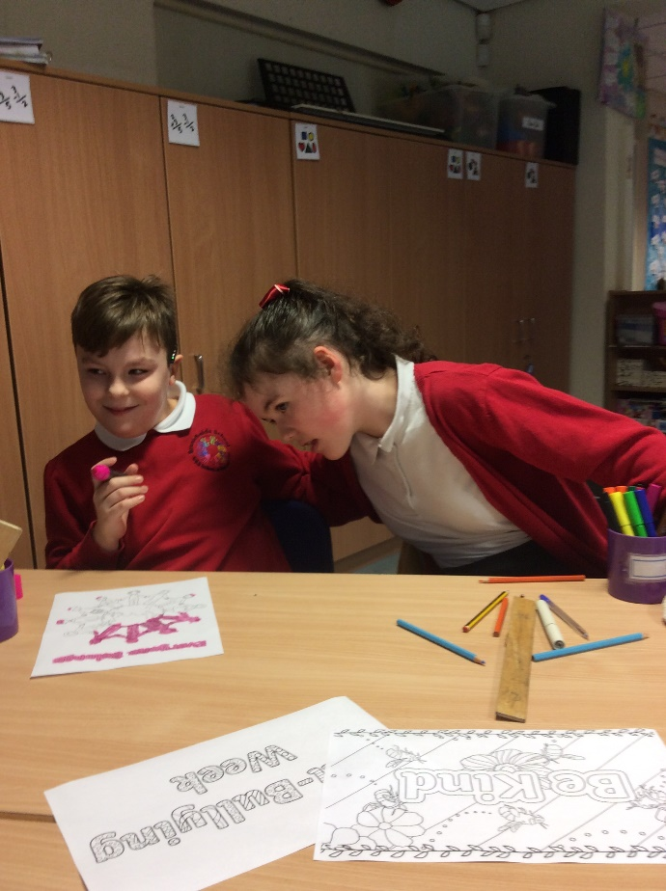
Showing kindness in Owls class

Slide 10
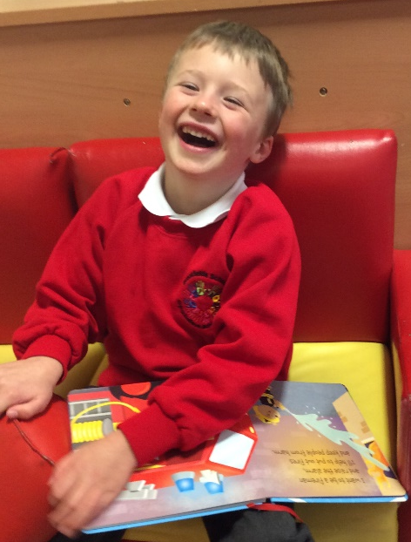
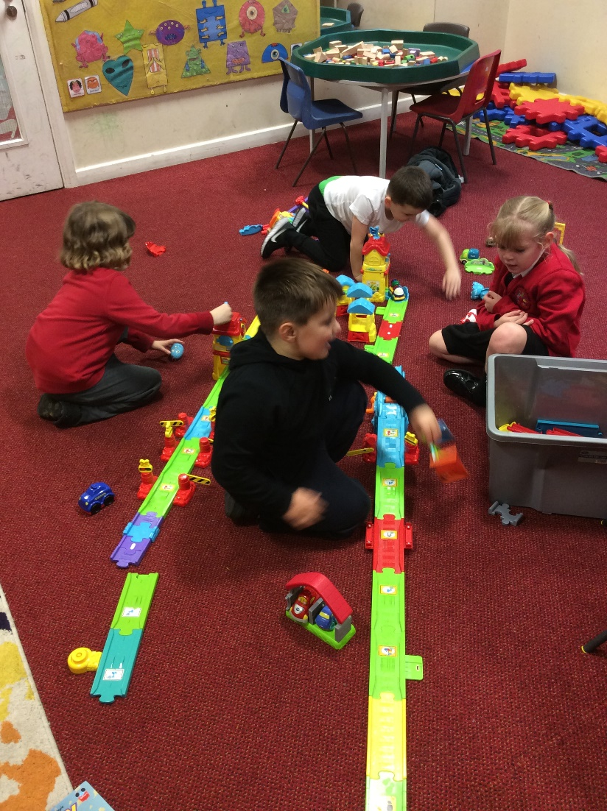
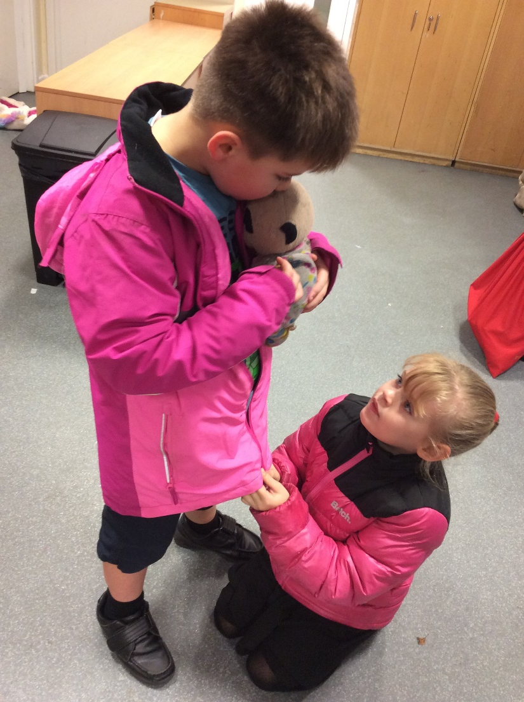
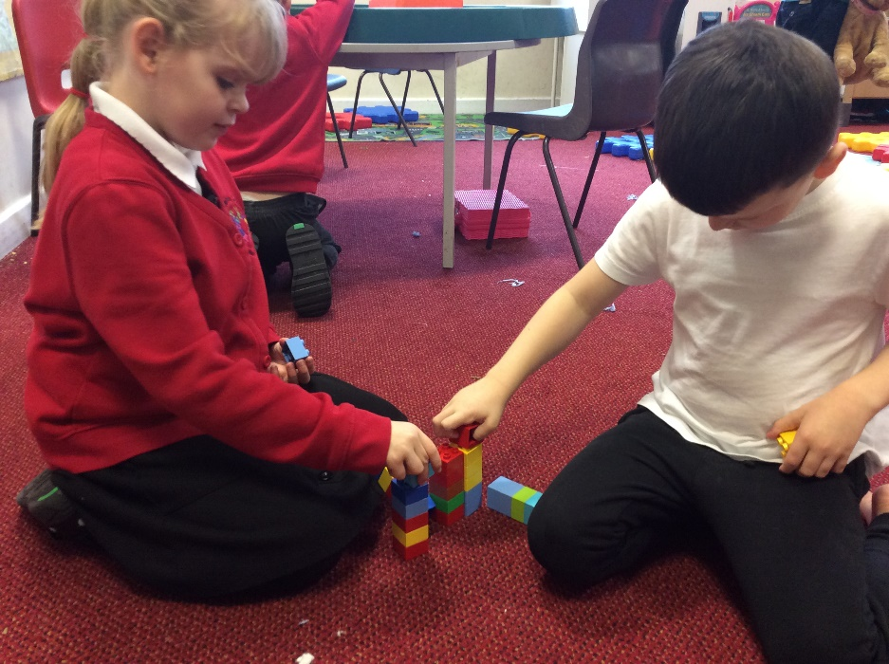
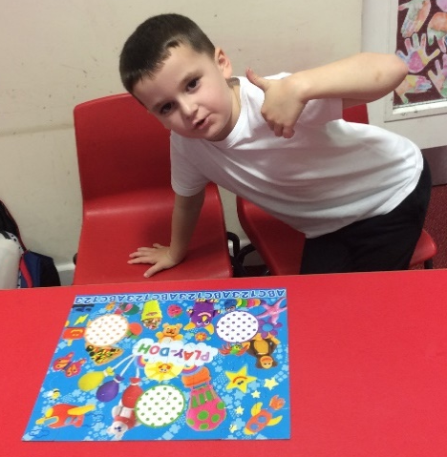
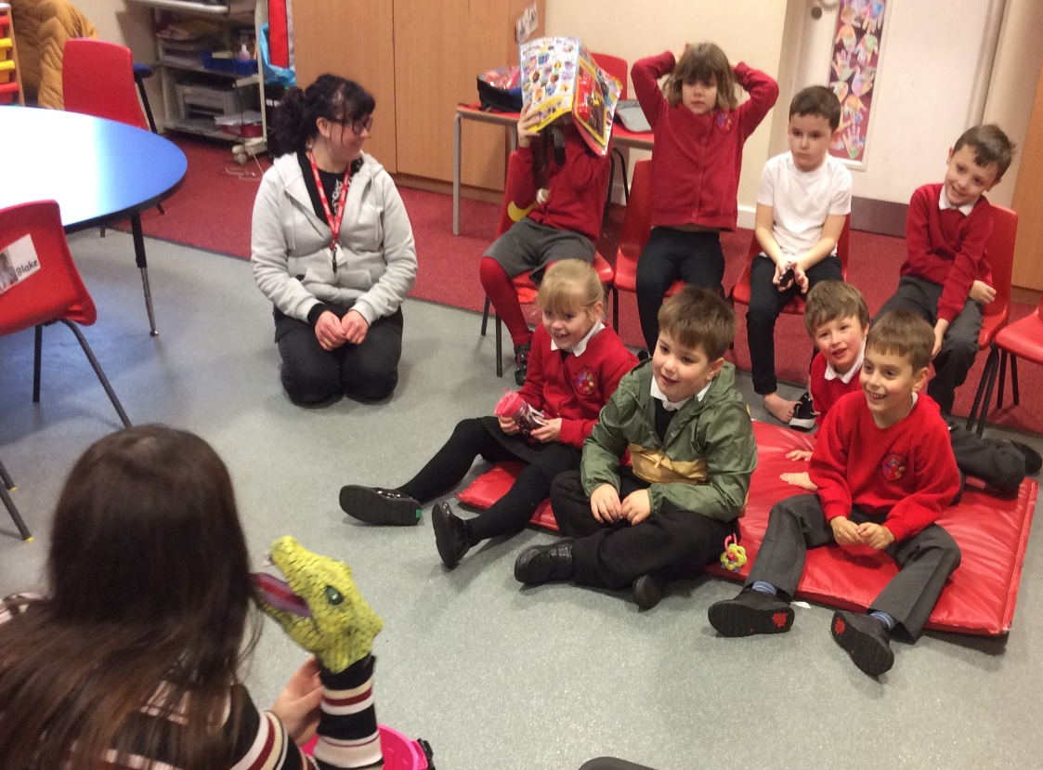
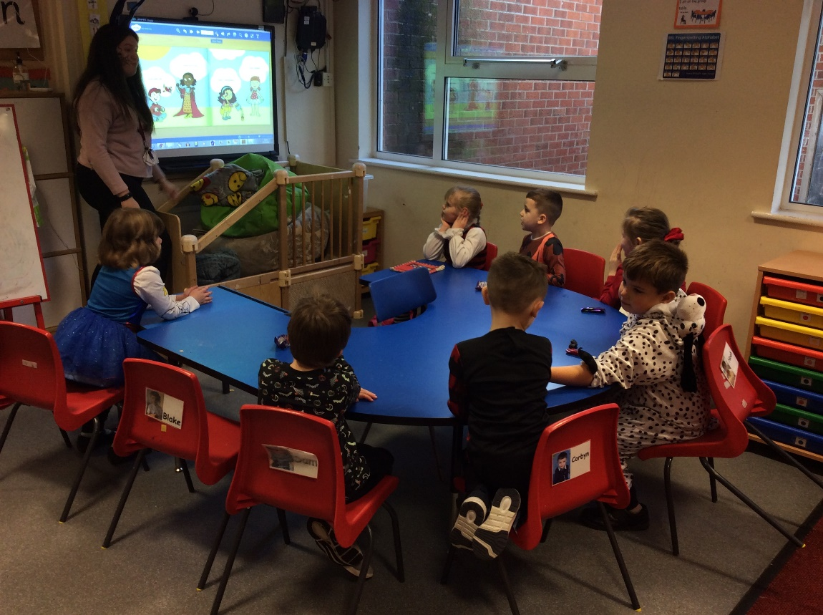
In Hedgehogs class Nov 21
We always have fun.
We share and take turns.
We support our friends when they need help with something like zipping up a coat.
We show when we are proud of our work.
We work together and use good team work.
We listened to Kenny the crocodile as he told it what it took to be a good friend.
We learnt about how we are all different and how that makes us special and unique.

Slide 11
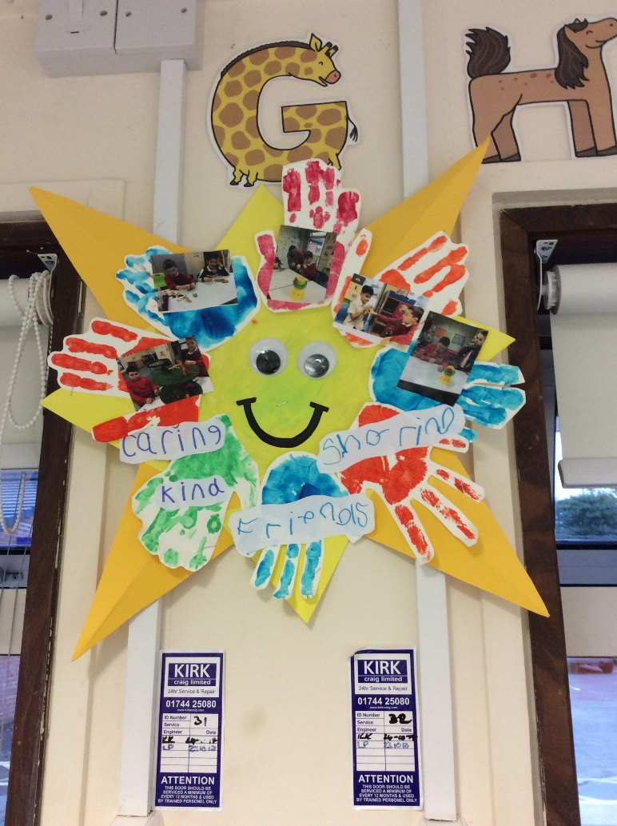
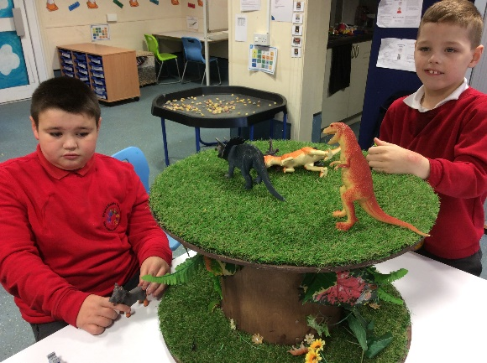
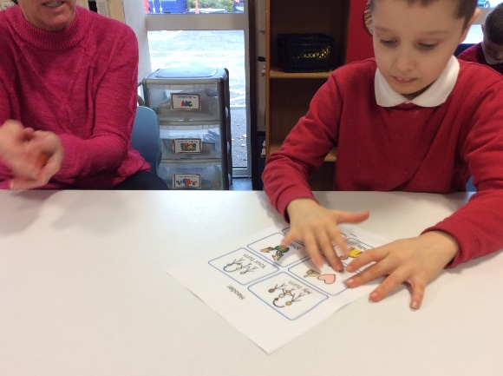
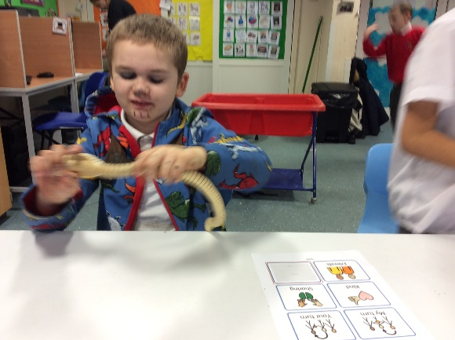
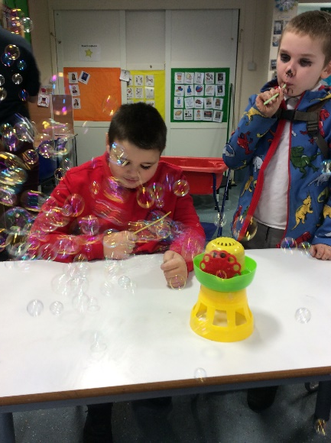
In Hawks class we have been sharing and turn taking with our peers and adults in the room.
We listened to the rainbow fish and developed an understanding of how important it is to be kind to one another.
We created a kindness sunflower for display in our classroom to remind us throughout the year to be kind to our friends. We used other core key vocab to support our acts of kindness.

Slide 12
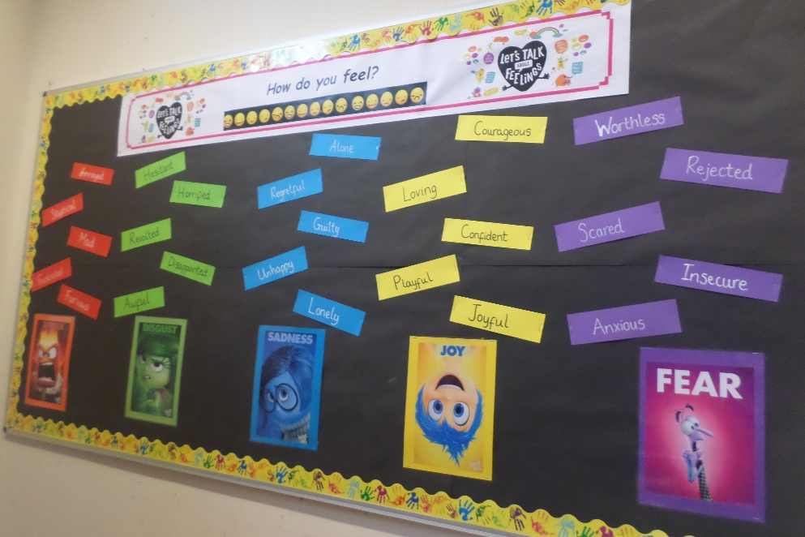
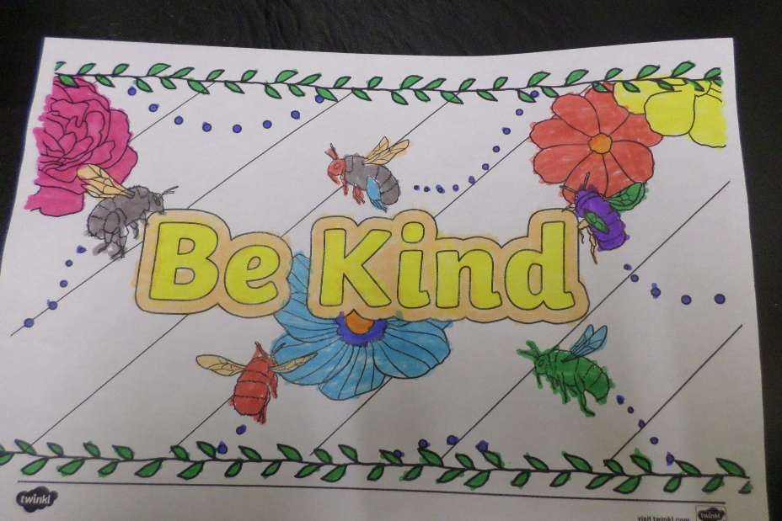
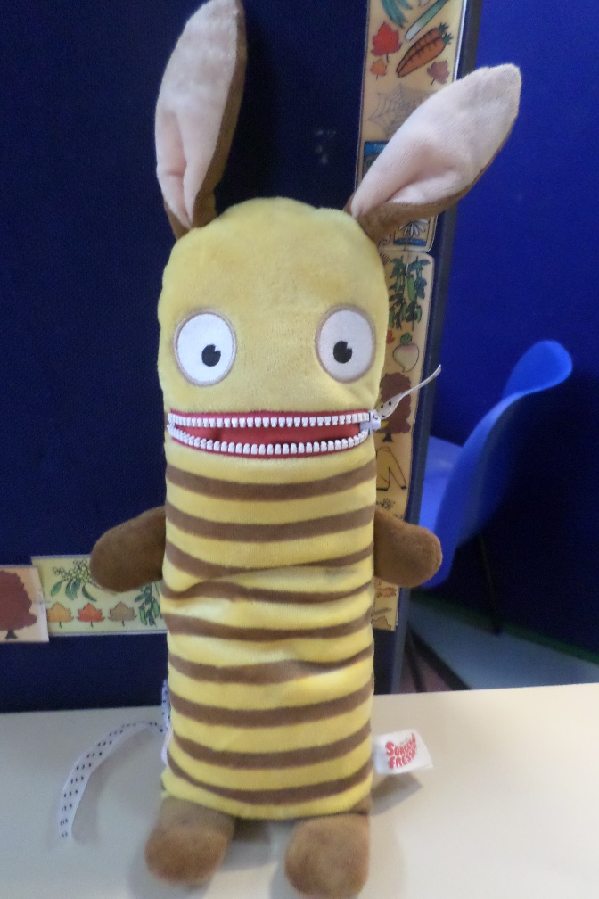
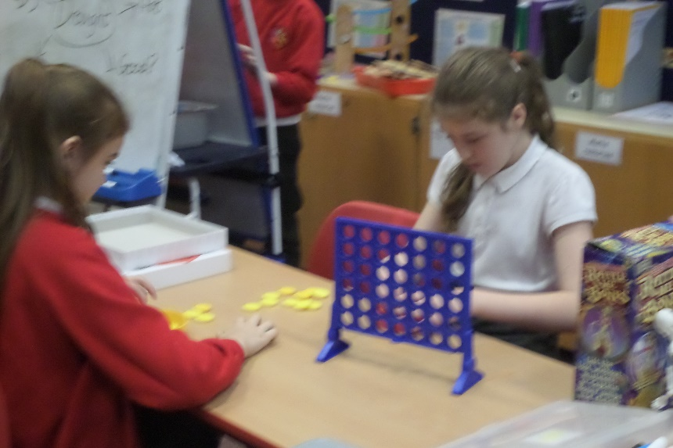
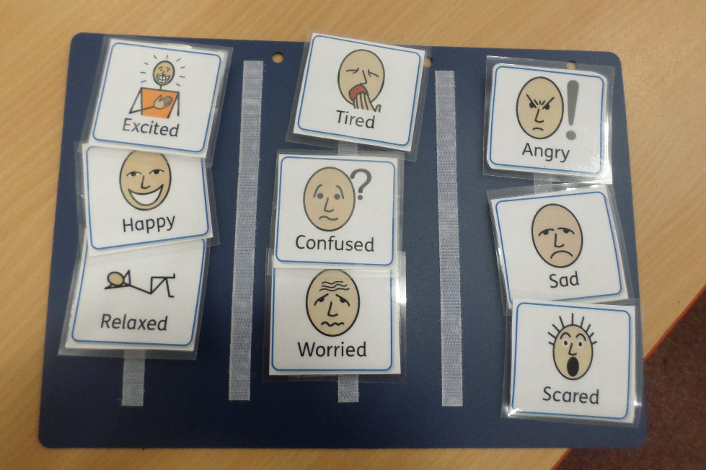
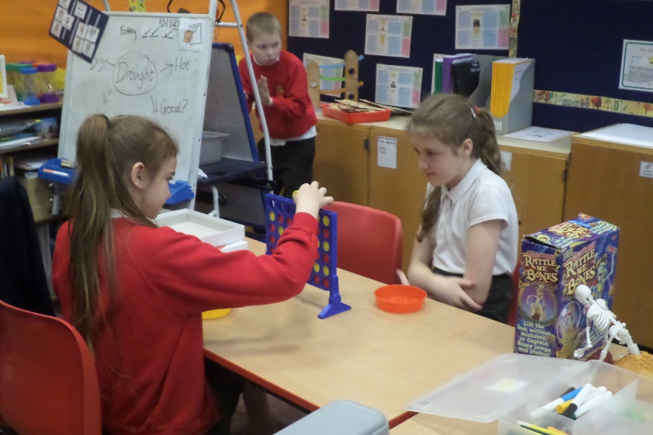
Otters class
Here are some examples of what we use in Otters class to support friendship and well being.
Our Inside out themed emotions board
PSHE lessons allowing time for reflection.
Dedicated time to share resources and games with peers promoting positive relationships and friendships.
Our worry monster to eat our worries
Good morning routine expressing feelings and emotions, promoting conversations between peers.
Good morning routine expressing feelings and emotions, promoting conversations between peers.
Dedicated time to share resources and games with peers promoting positive relationships and friendships.

Slide 13
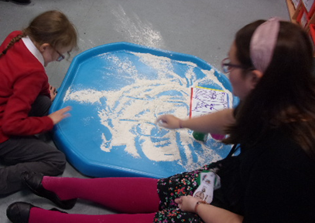
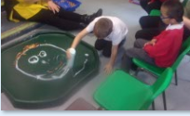
Exploring our feelings in our flour tuff tray and making faces during Attention Autism.
Learning with our class adults.
Using feeling mirrors for our reflection.

Slide 14
Learning to understand our emotions through photographs and visual communication aids.
Learning about the differences that make us special through music, song and dance!

Slide 15
We just love working and playing together. We have lots of fun!
At the same time we are practising our social skills and learning to be good friends.

Slide 16
We are all working on a turn-taking task requesting the water spray and towers to be built. Some pupils are working on our class anti-bullying poster. We were very proud of our finished poster!

Slide 17
Drawing pictures of how we feel.
Playing together at the tyre park.
Using high interest programmes to develop turn taking.
A helping hand in PE. And at the tyre park too.
Playing social interaction games with classmates.

Slide 18
Looking after the babies
Having a relaxing time on the basket swing alongside our classmates
Turn taking games

