Slide 2
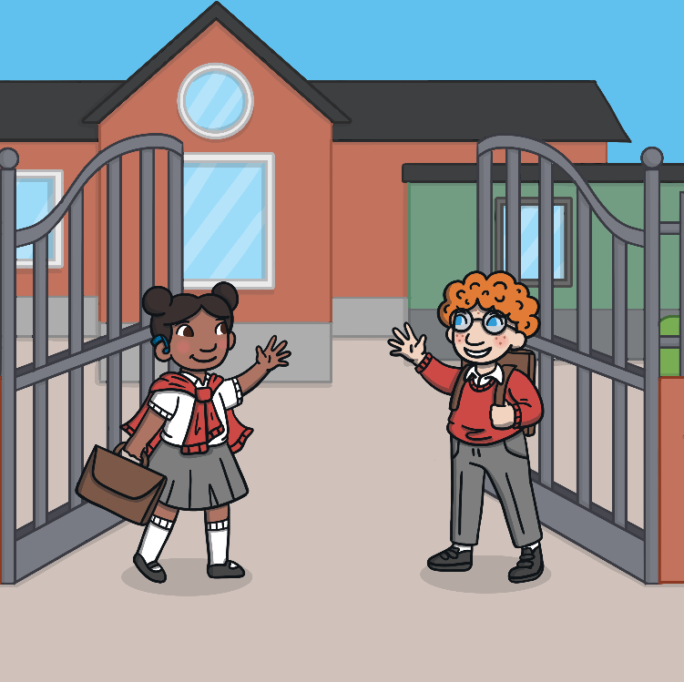
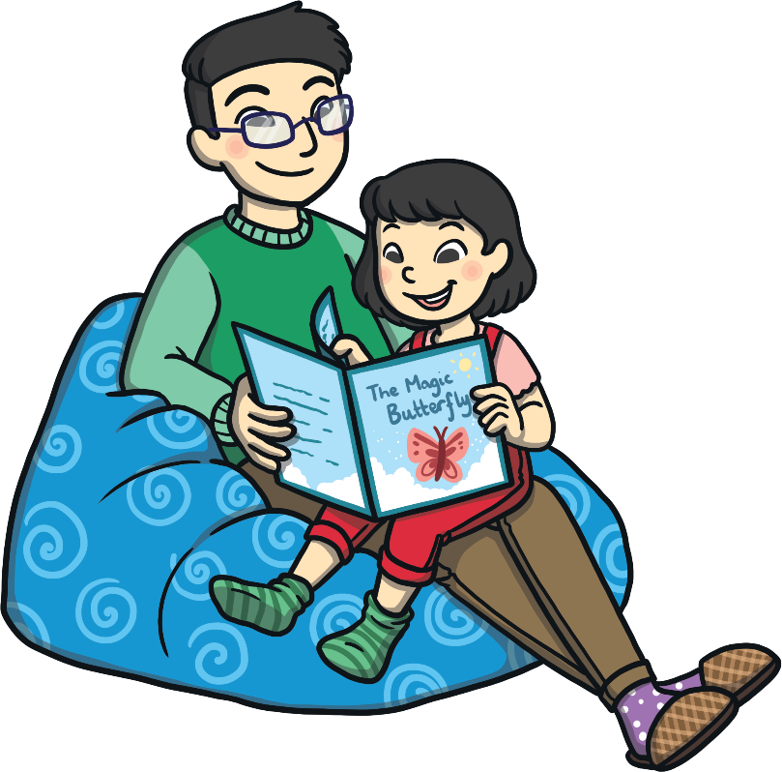
It’s Good to Be Back
Schools all over the world have been closed to help keep us safe from coronavirus.
For the last few months, children have been doing their schoolwork at home.
Now it is safe for children in some classes to return to school.
It is good to be back together again.

Slide 3
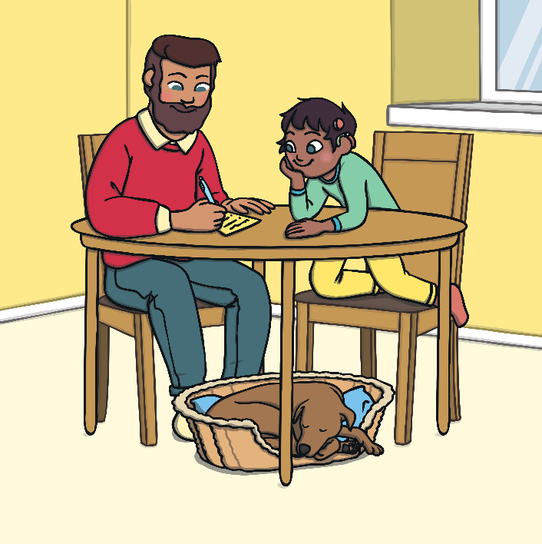
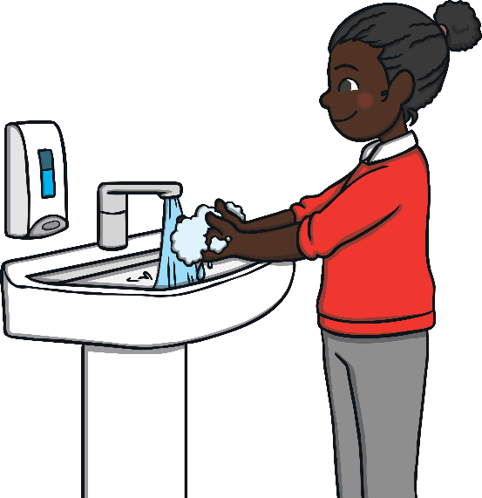
Staying Safe
So far, we have been keeping safe by:
staying at home
social distancing
washing our hands
It is still very important that we stay safe.

Slide 4
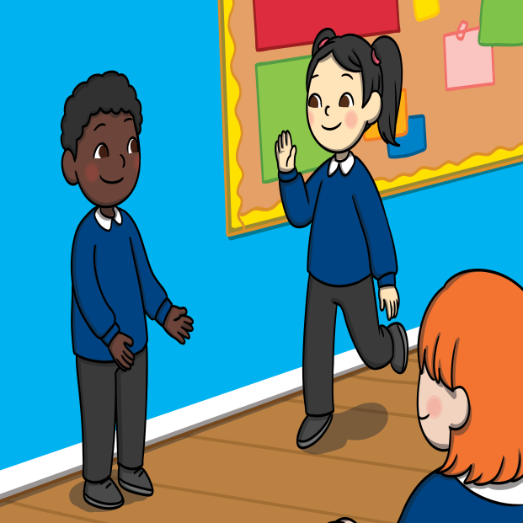
Social Distancing at School
In some ways, school looks different to how it did before it closed.
What do you notice that is different?
Why do you think this is?
Everyone needs to have more space around them to stop germs spreading. This is called social distancing.
Remember:
To stay safe we keep our distance.

Slide 5
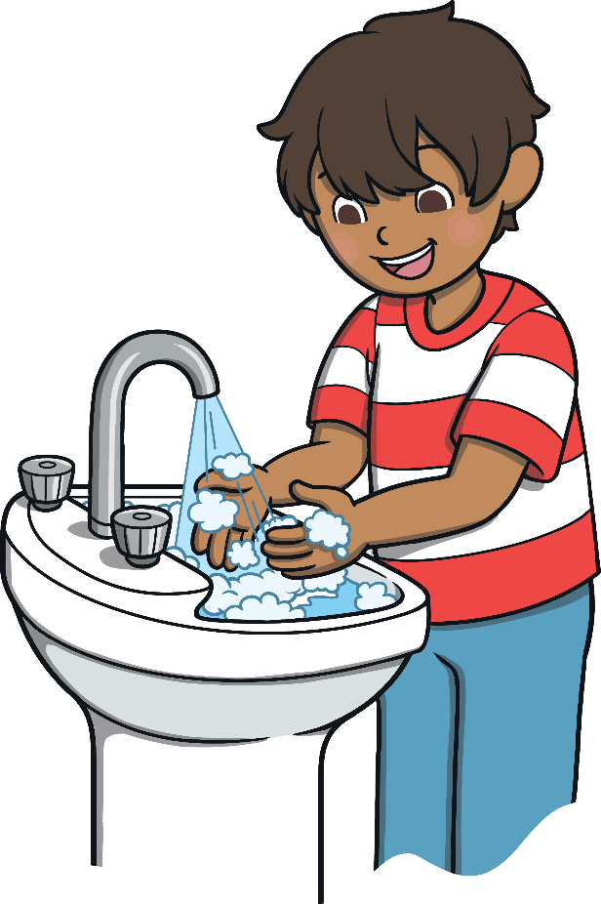
Washing Our Hands
Regularly washing our hands helps to keep us safe.
We must wash them with soap for 20 seconds.
This washes away germs and helps to stop us getting ill.
We should wash our hands throughout the day:
before eating
after we have been to the toilet
after we cough or sneeze
after we have been out to play.

Slide 6


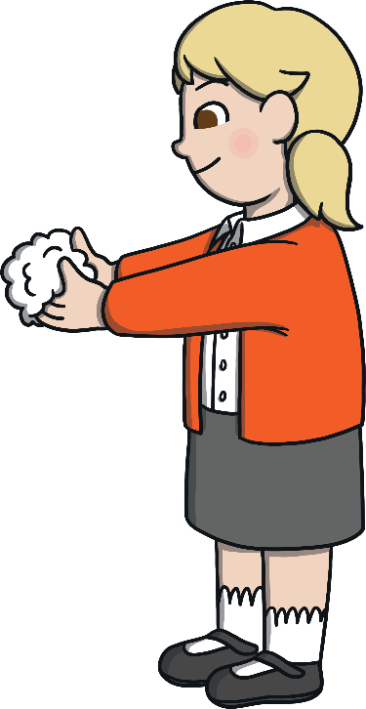
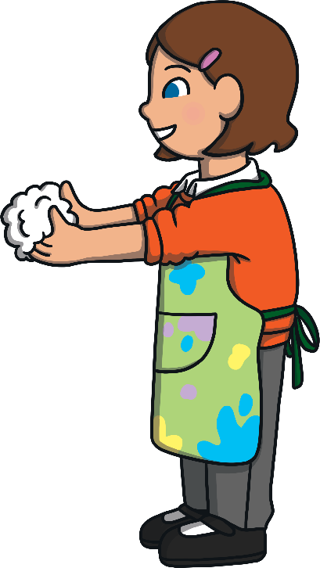



Washing Our Hands
Try singing this song while you wash your hands.
(Sing to the tune of ‘Here We Go Round the Mulberry Bush’.)
This is the way we wash our hands,
Wash our hands, wash our hands.
This is the way we wash our hands,
With lots of soap and water!
This is the way we use the sink,
Use the sink, use the sink.
This is the way we use the sink,
Get lots of nice warm water.

Slide 7
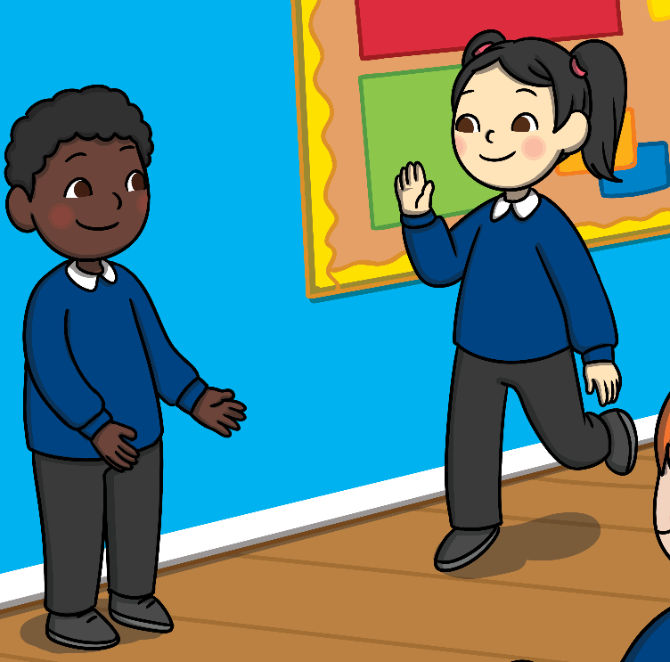
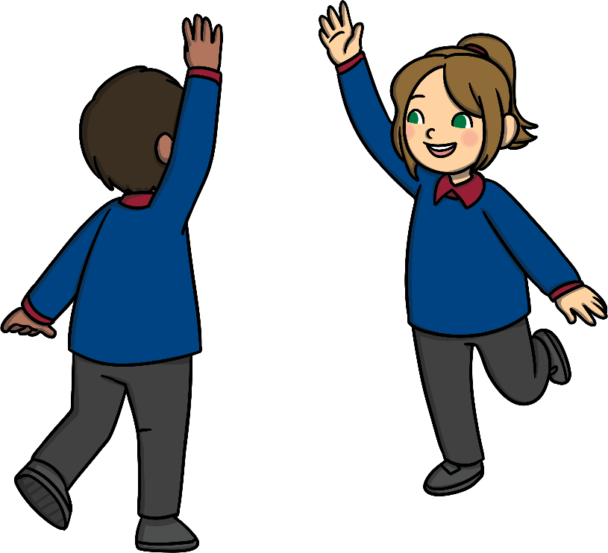
Keeping Our Distance
At school, we are pleased to see our friends again, but it is important to remember to keep a safe distance apart.
We must remember to step aside to allow someone space to pass and to stay 2 metres apart.
We may be in a group called a ‘bubble.’ Even in our bubble, we must stay 2 metres apart from others.

Slide 8
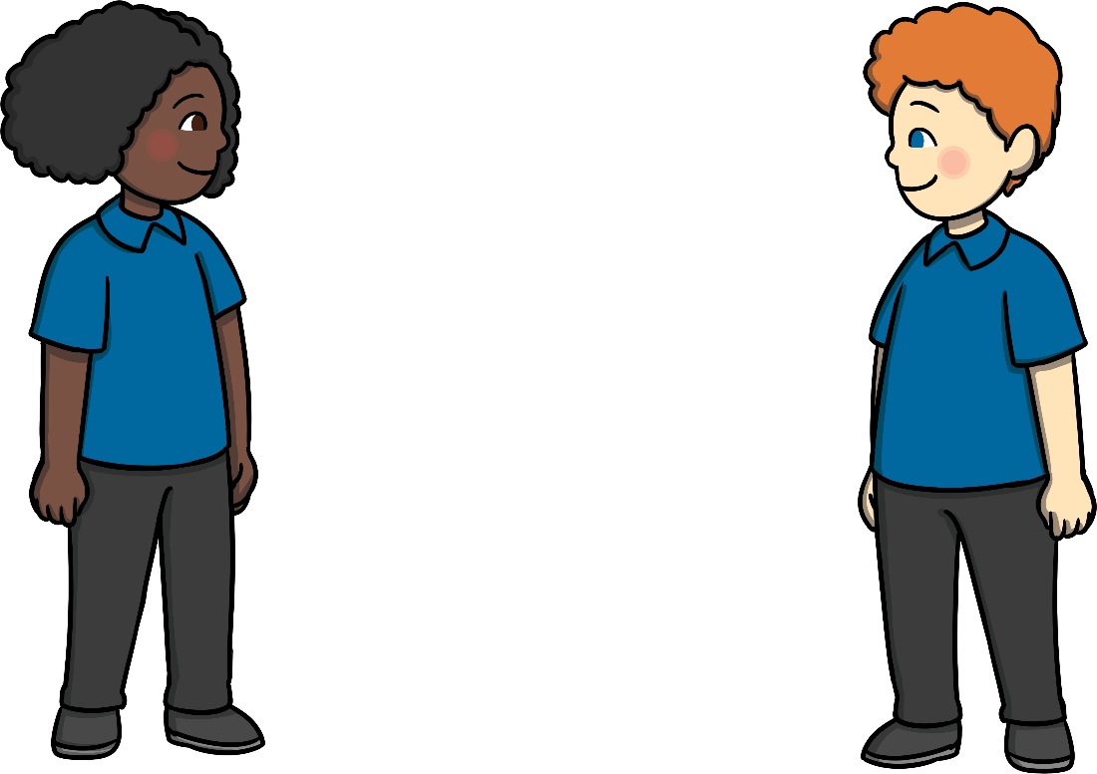
Showing You Care
Even though we cannot hug our friends or go too close, we can still show them that we care.
We can:
air high five
wave
smile
do a thumbs up
air hug
We can still have fun and play with our friends, without getting too close.

Slide 9
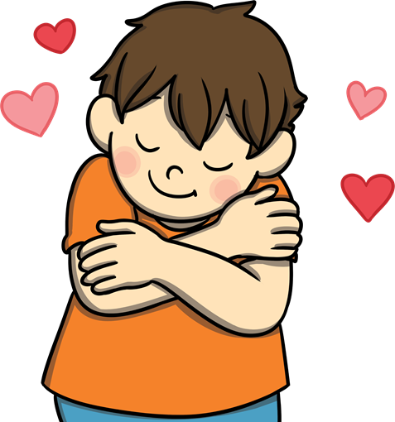
When We Feel Sad
If we fall over and hurt ourselves, we feel upset.
Sometimes we can feel sad and not really know why.
Even though our friends cannot give us a hug to cheer us up, it is important to let someone know how we are feeling. This could be a grown-up or a friend.
If you see someone who is upset, you can help them by smiling, asking them if they are okay, or talking to them.
Have you ever tried giving yourself a hug? Give it a go – it feels good!

Slide 10
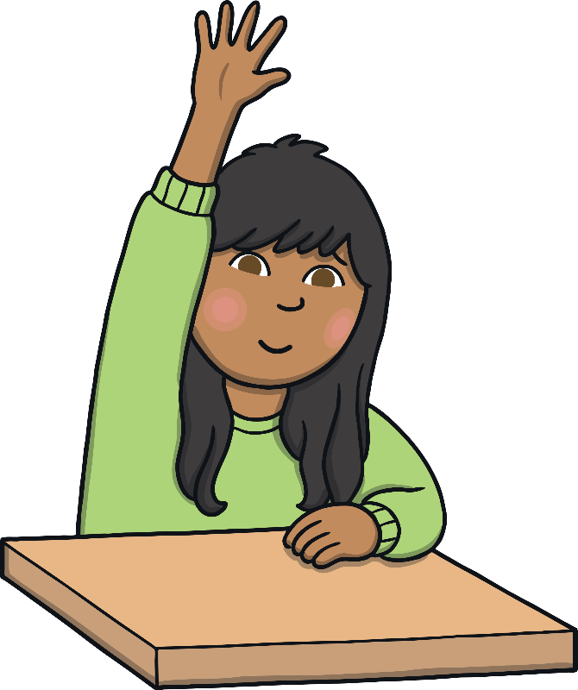
Keeping Equipment Clean
We can stay safe by keeping our tables and equipment clean.
We must clean what we use if we are asked to by our teacher.
We must not share any equipment with our friends.
Washing our hands regularly helps keep our equipment clean.
If we sneeze or cough into a tissue, we must put it in the bin.
If we need to ask for equipment or help, we must remember to stay in our seat and put our hand up.

Slide 11

Stay Safe, Stay Happy
It will take a bit of getting used to, but by remembering the rules, we can stay safe and be happy at school.
Keep your distance.
Wash your hands.
Don’t share equipment.
Show someone you care.
Stay Safe.

