Slide 1
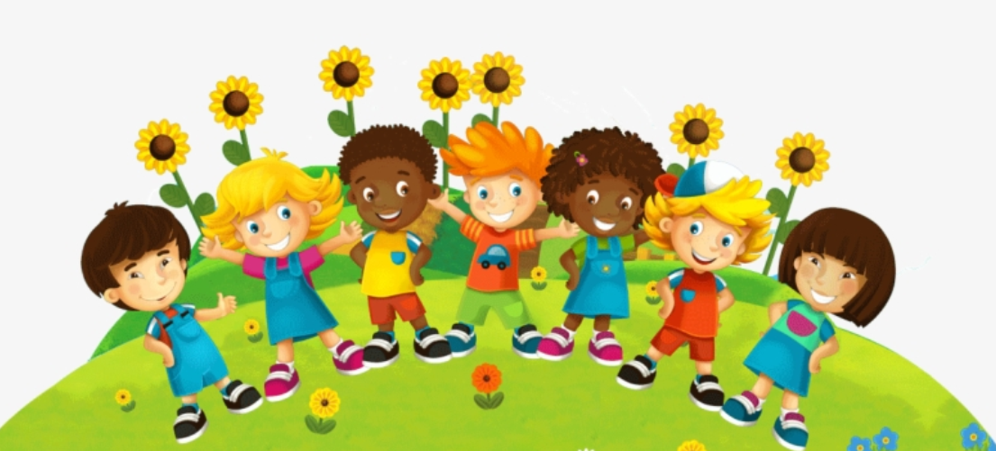
Whilst You Are At Home
We are going to stay in touch
2nd February 2021

Slide 2


Slide 3

Positive Message of the Week
Hello Everyone, we are into the 4th week of the national lockdown and you are all doing very well.
This week we are going to be looking at being kind to one another, and when possible be there for our friends if they are not happy or feeling upset.
We know it is difficult being away from friends and family but we can stay in touch via social media.
In our presentation this week there will be a few activities to get involved with.
If you are worried about anything please remember
to talk to someone you trust.

Slide 4
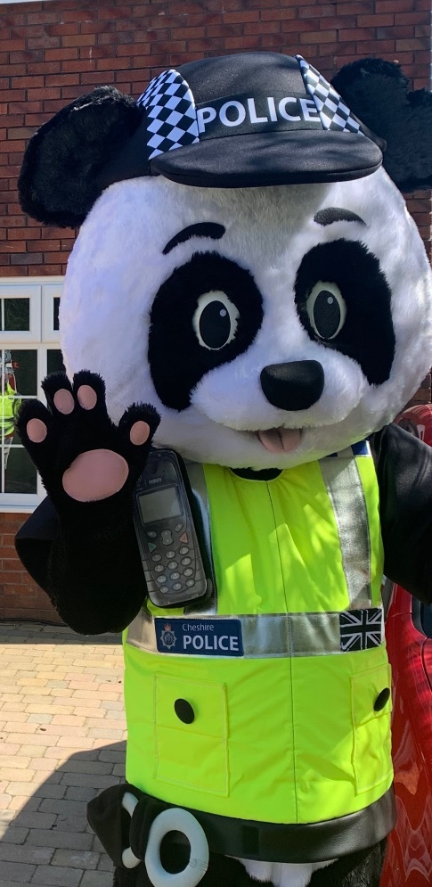

Messages from PC Panda
.
“feeling a bit down, please speak to a
trusted adult”
“Please be kind to your class mates”
“If your friends feel sad ask them how
they are”
“Try and include everyone”

Slide 5



Online Safety-Online Bullying
This weeks online safety message is going to be about Online Bullying/Cyberbullying and how we can help stop this.
What is Online/Cyberbullying?
Stop this by……..
Cyberbullying is any form of bullying which takes place online or through smartphones and tablets. Social networking sites , messaging apps, gaming sites and chat rooms

Slide 6


Here is a colouring sheet,
You could colour and
put up in your schools

Slide 7






Worried
Confused
If you are feeling…..
Sad
Upset
We all need to talk at times, look out for each other

Slide 8
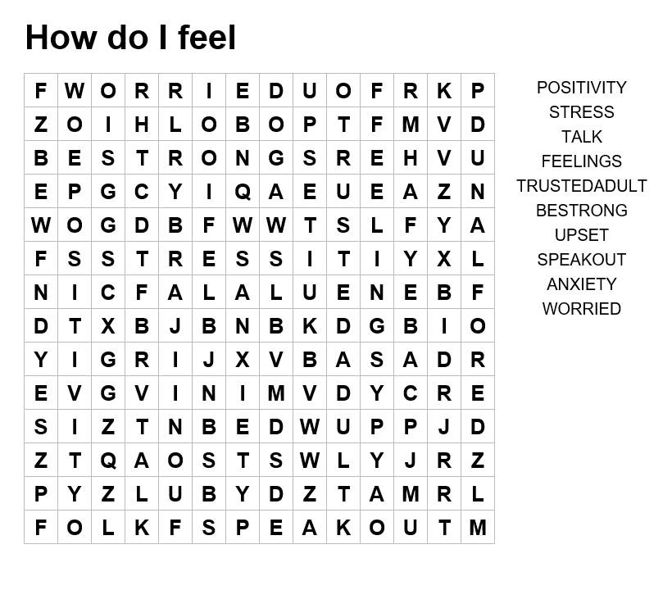






This weeks activity
Word search

Slide 9


Useful Services for you,
your Parents and Teachers.
GP’s Service
NSPCC Helpline
0808 800 5000
Wellbeing officer in school
NHS - 111
Childline | Childline
https://www.childline.org.uk
Get help and advice about a wide range of issues, call us on 0800 1111, talk to a counsellor online, send Childline an email or post on the message boards
https://www.o2.co.uk/help/nspcc/helpline

Slide 10

We would also like to send our very best wishes to the amazing
Sir Tom Moore
while in hospital.

Slide 11

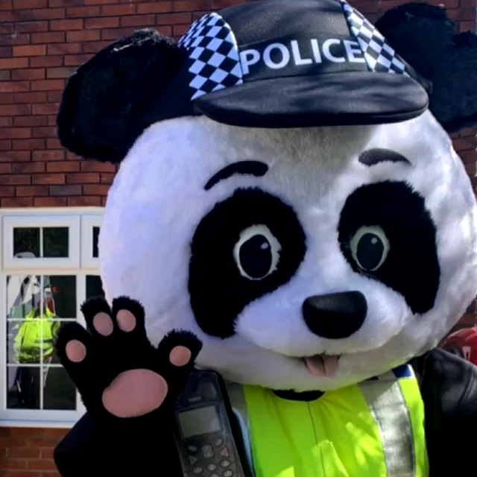
Until next Time 9th February 2021
Keep washing your hands, remember Hands, Face and Space.
If you are feeling upset, worried or confused please speak to someone
Keep positive, by reminding yourself, You are an Amazing Child.
Cheshire Police on Facebook
@CheshireSSYP on Twitter
www.cheshire.police.uk

