Slide 2
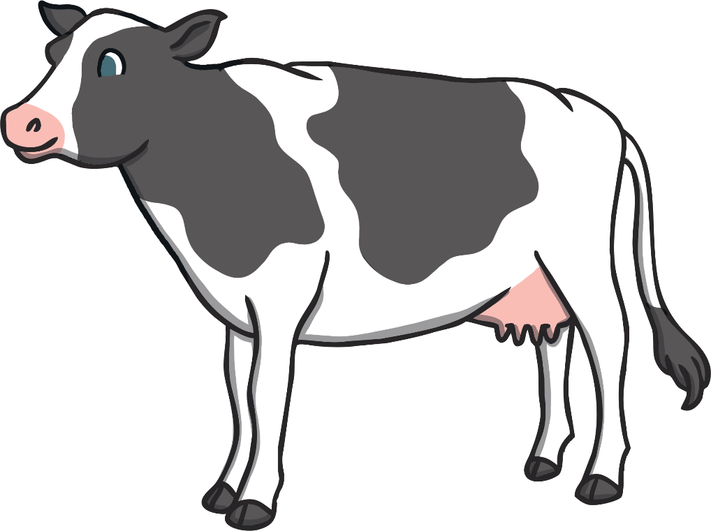
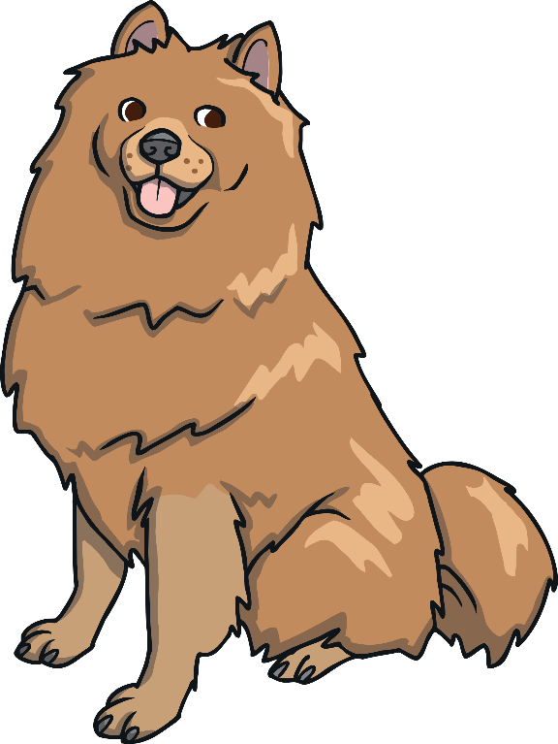
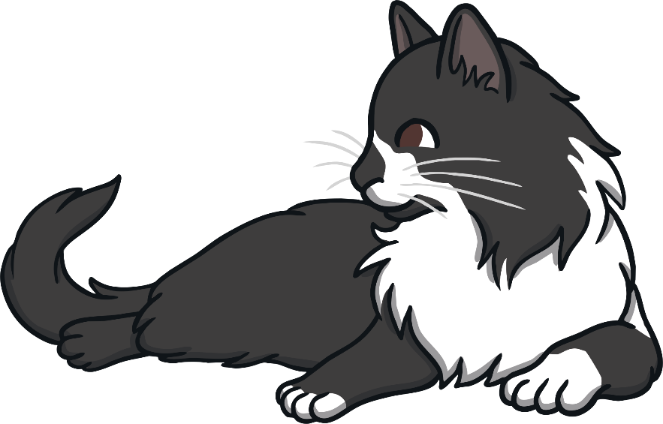
What’s That Sound?
Can you choose the correct animal that makes this sound…?
Click the letter above the picture to make your choice.
A
B
C

Slide 3
Well Done!
It’s a cow.
Can you make the sound?
A
B
C

Slide 4
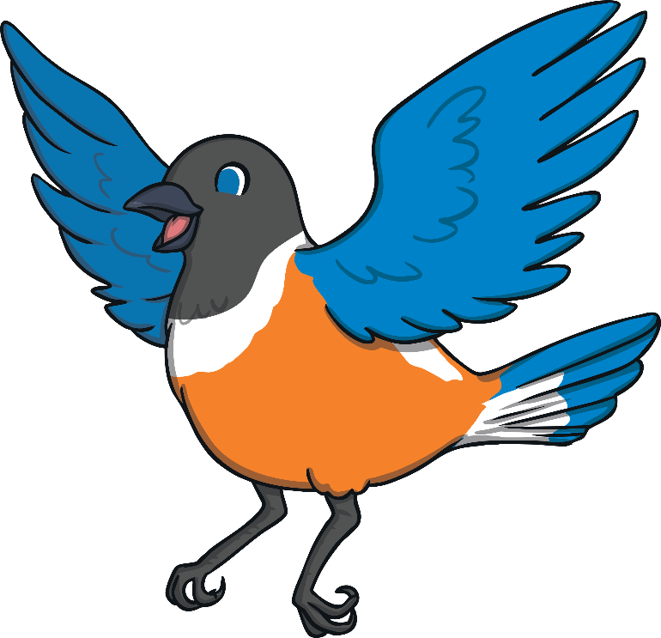
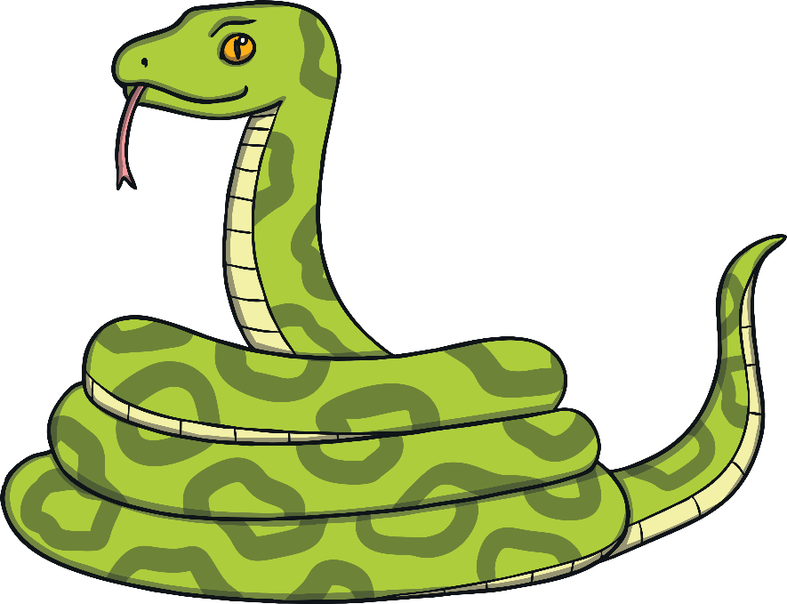
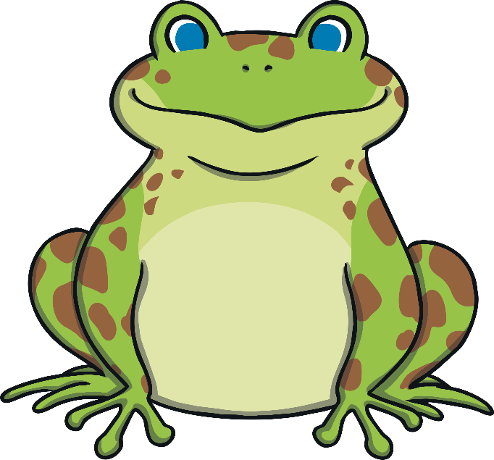
What’s That Sound?
Can you choose the correct animal that makes this sound…?
A
B
C

Slide 5
Well Done!
It’s a snake.
Can you make the sound?
A
B
C

Slide 6
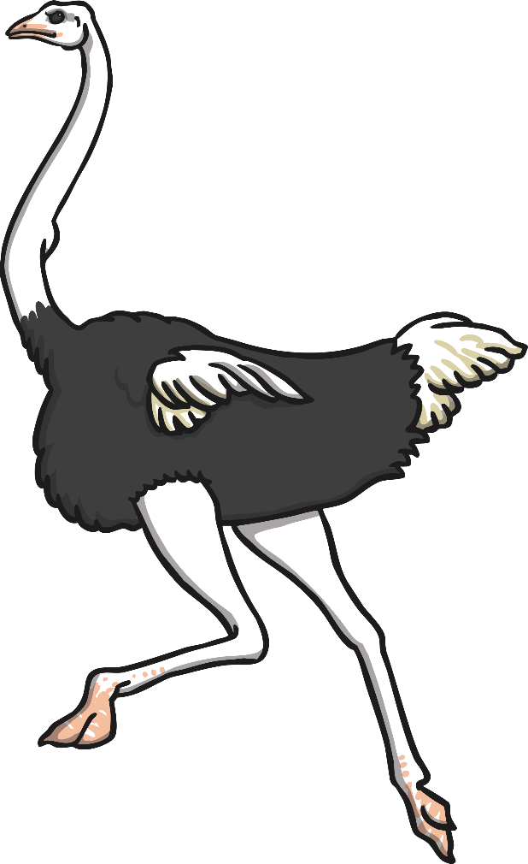
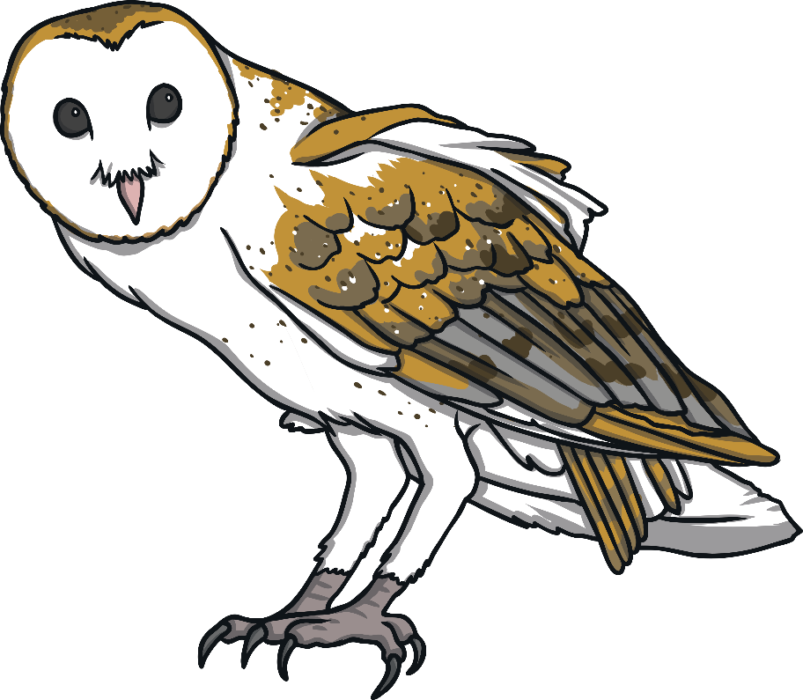
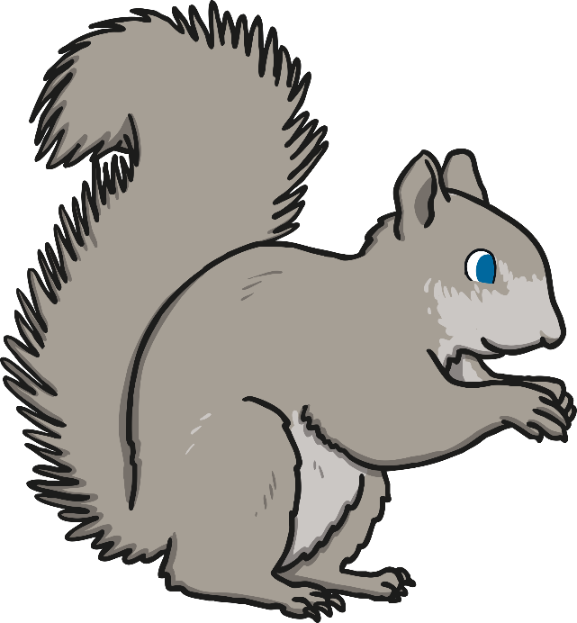
What’s That Sound?
Can you choose the correct animal that makes this sound…?
A
B
C

Slide 7
Well Done!
It’s an owl.
Can you make the sound?
A
B
C

Slide 8
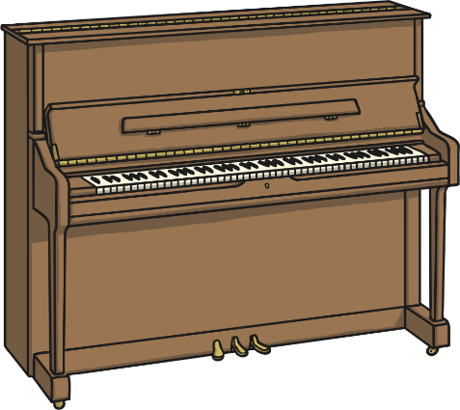
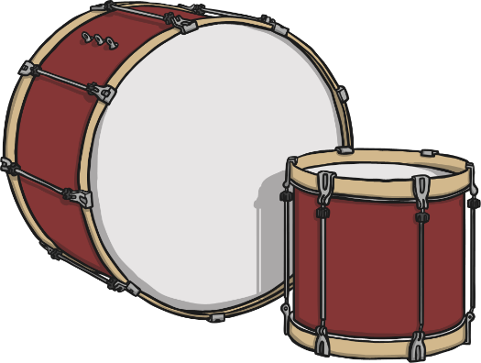
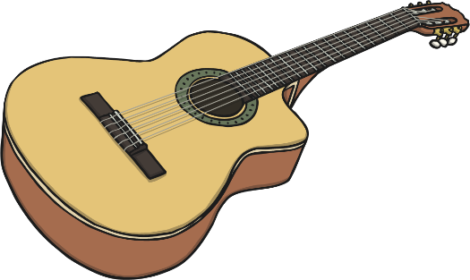
What’s That Sound?
Can you choose the correct instrument that makes this sound…?
A
B
C

Slide 9
Well Done!
It’s a drum.
Can you make the sound?
A
B
C

Slide 10
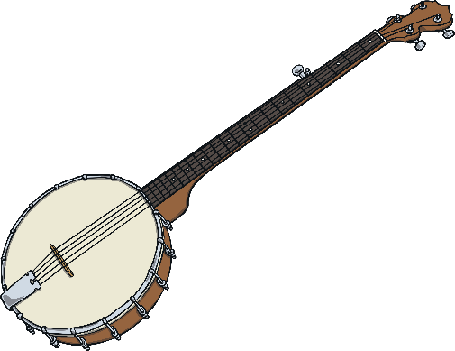
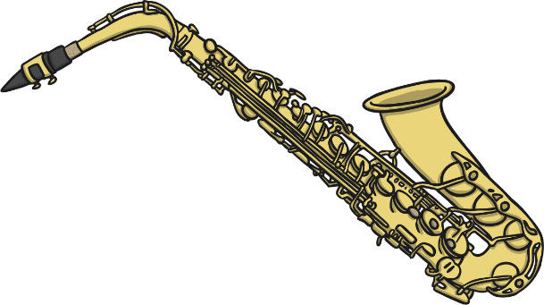
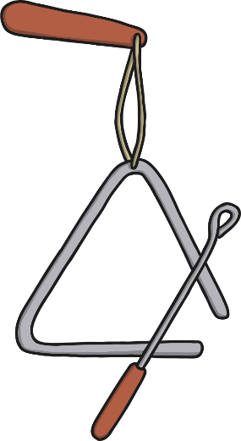
What’s That Sound?
Can you choose the correct instrument that makes this sound…?
A
B
C

Slide 11
Well Done!
It’s a saxophone.
Can you make the sound?
A
B
C

Slide 12
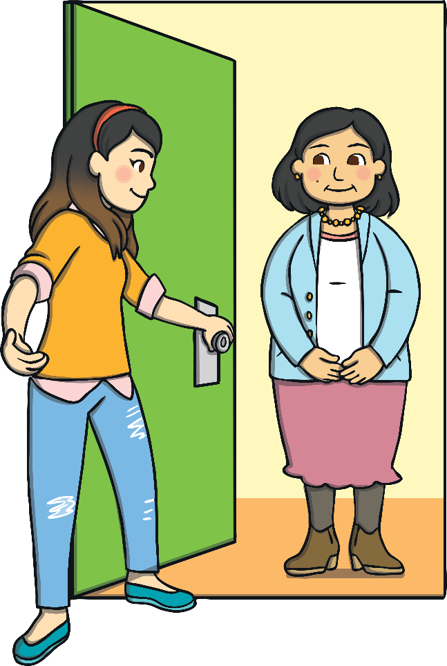
What’s That Sound?
Can you choose the correct option that makes this sound…?
A
B
C

Slide 13
Well Done!
It’s a doorbell.
Can you make the sound?
A
B
C

Slide 14
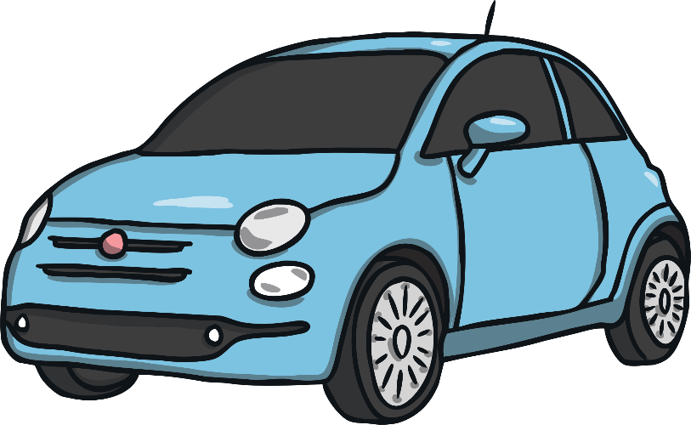
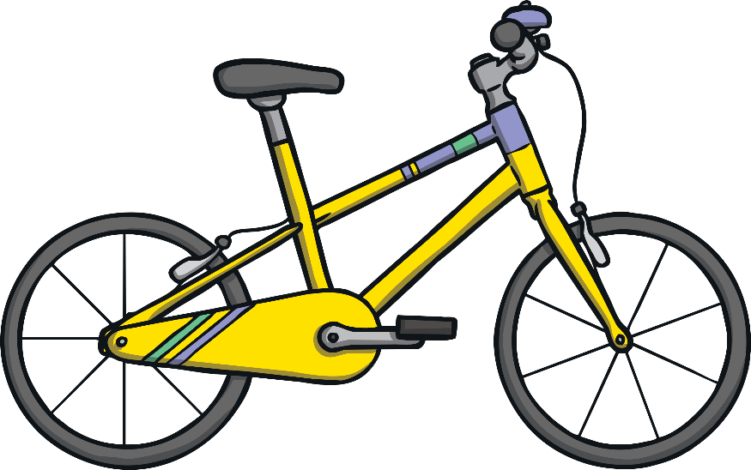
What’s That Sound?
Can you choose the correct vehicle that makes this sound…?
A
B
C

Slide 15
Well Done!
It’s a car.
Can you make the sound?
A
B
C

