Slide 1
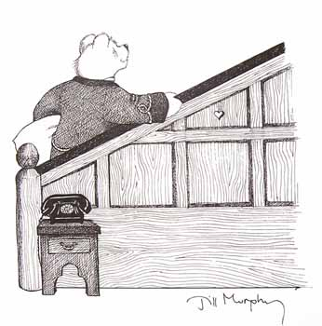
Peace at last
True or false?

Slide 2
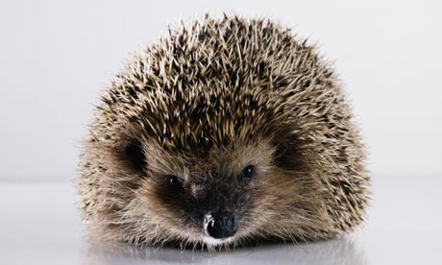
The Author of the
book is Jill Murphy.
True

Slide 3
There were three
bears in the story.
True

Slide 4
The story was set
at night time.
True

Slide 5
Baby Bear fell asleep
straight away.
False

Slide 6
Mr Bear could not sleep
because of Mrs Bear’s
loud snoring.
True

Slide 7
Mr Bear tried to
sleep in the car.
True

Slide 8
Mrs Bear made Mr Bear
some hot chocolate.
False

