Slide 2
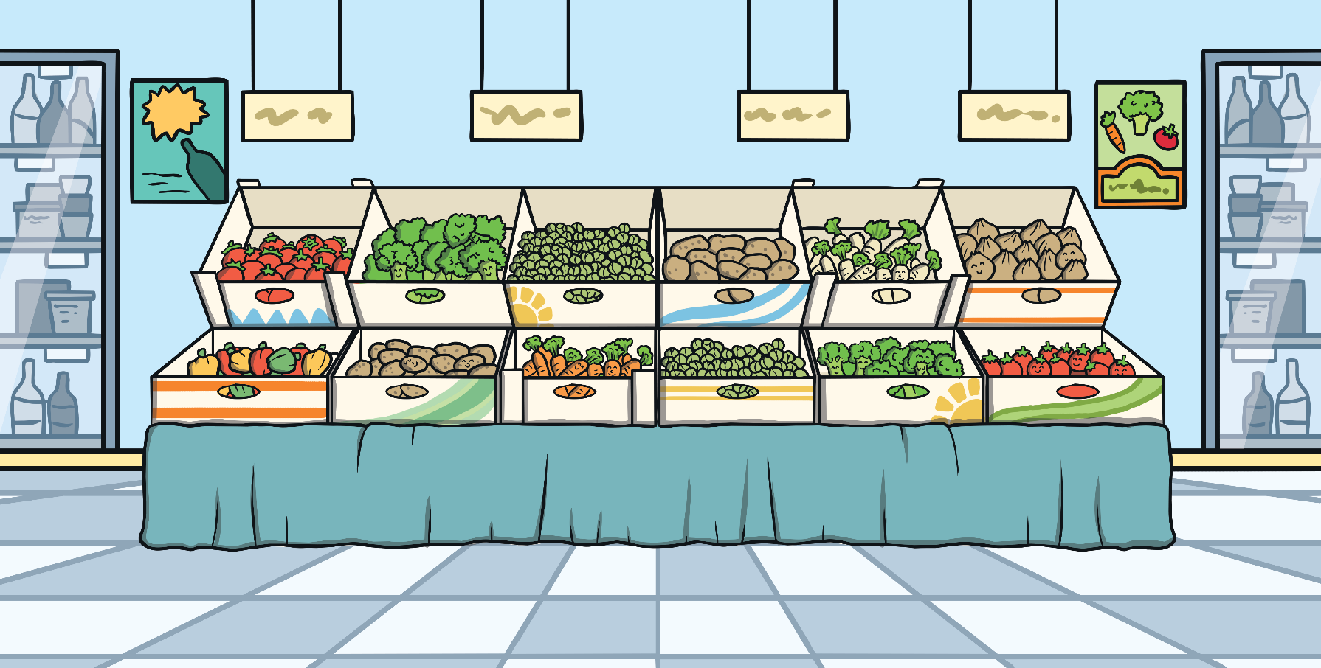
How and Where Do Fruits and Vegetables Grow?
People often buy fruits and vegetables from the supermarket.
But have you ever wondered how and where they grow?

Slide 3
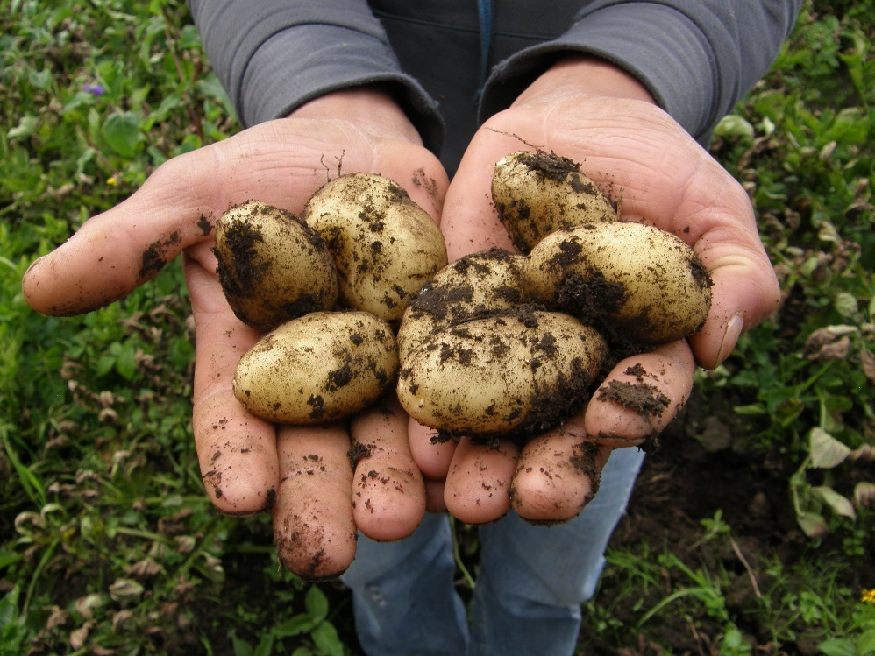
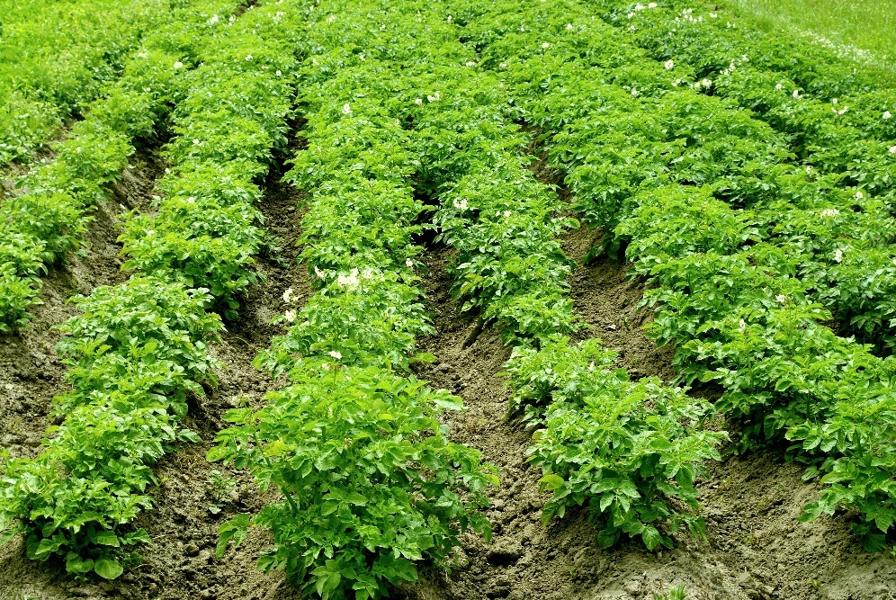
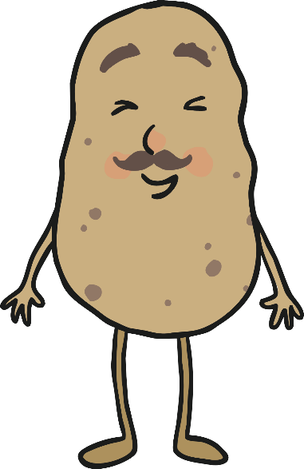
How Do Potatoes Grow?
Potatoes grow under the ground.
The leaves grow above the ground.
Many potatoes grow from each plant.

Slide 4
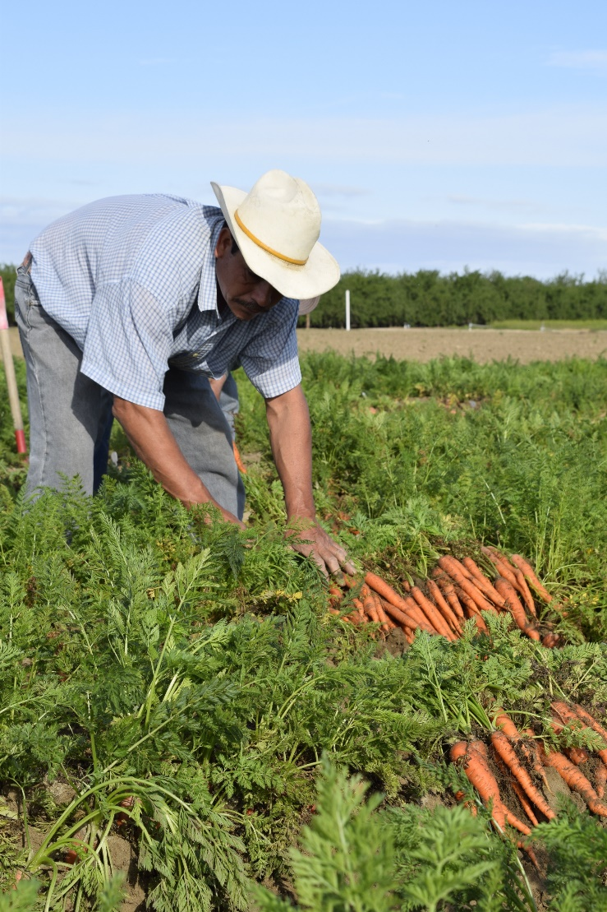
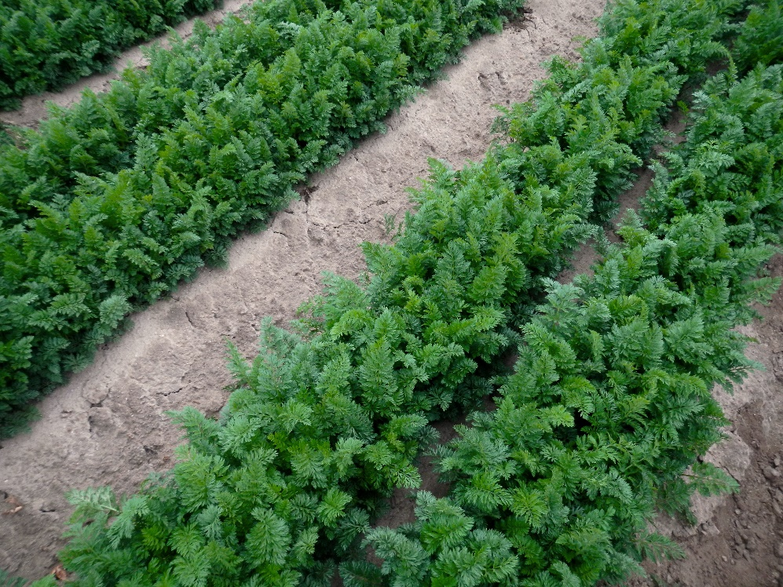
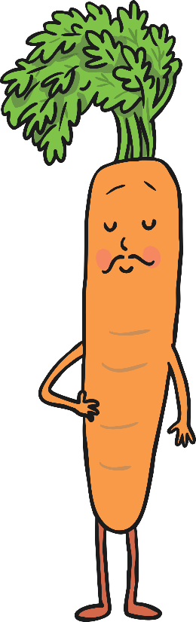
How Do Carrots Grow?
Carrots grow under the ground.
The leaves grow above the ground.
Carrots are a type of root vegetable.

Slide 5
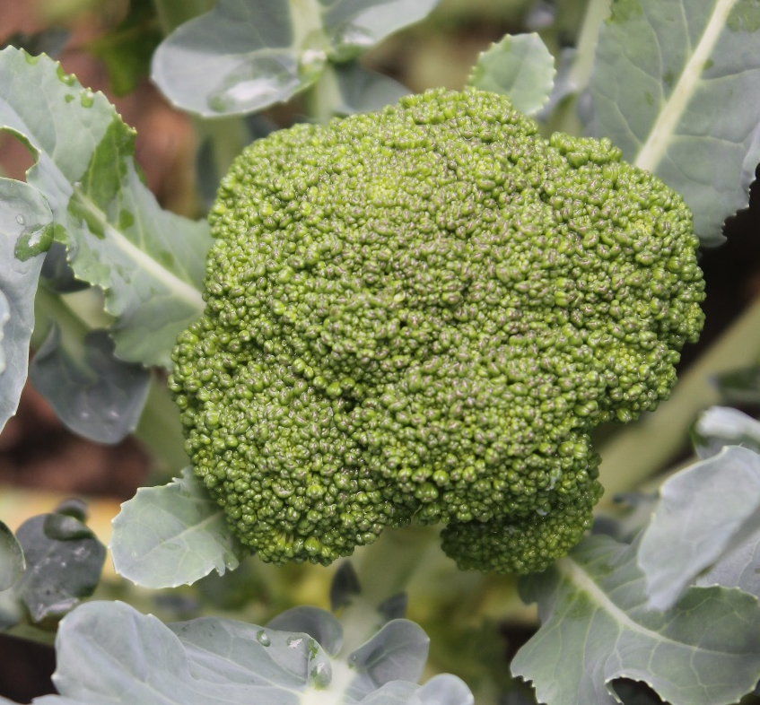
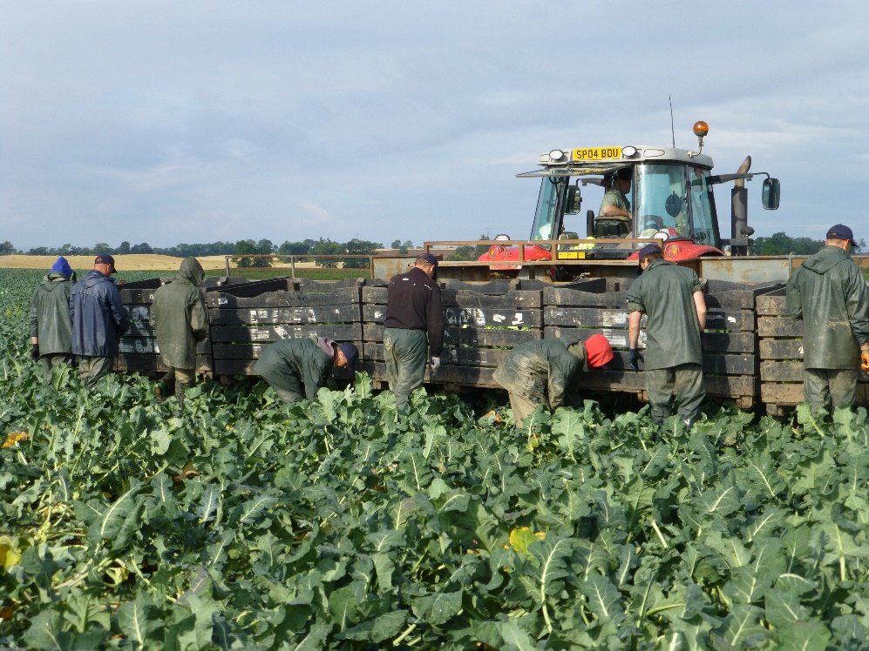
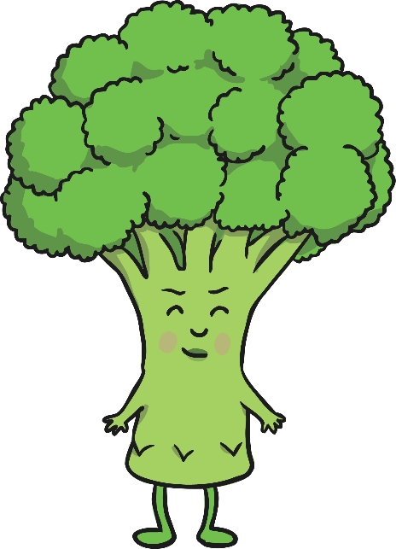
How Does Broccoli Grow?
Broccoli grows above the ground.
The main part of the plant that we eat is the flower.

Slide 6
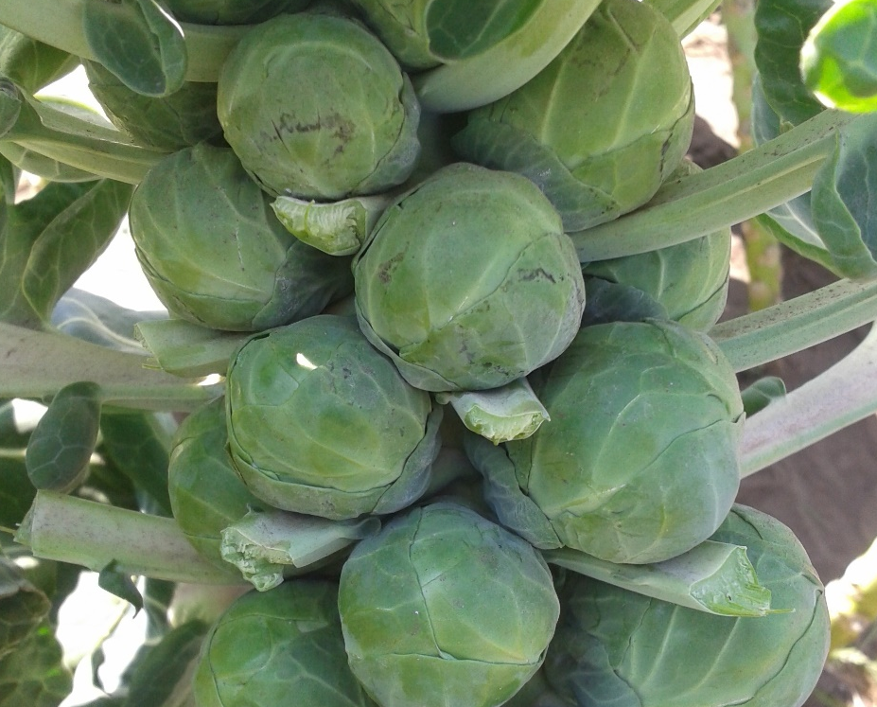
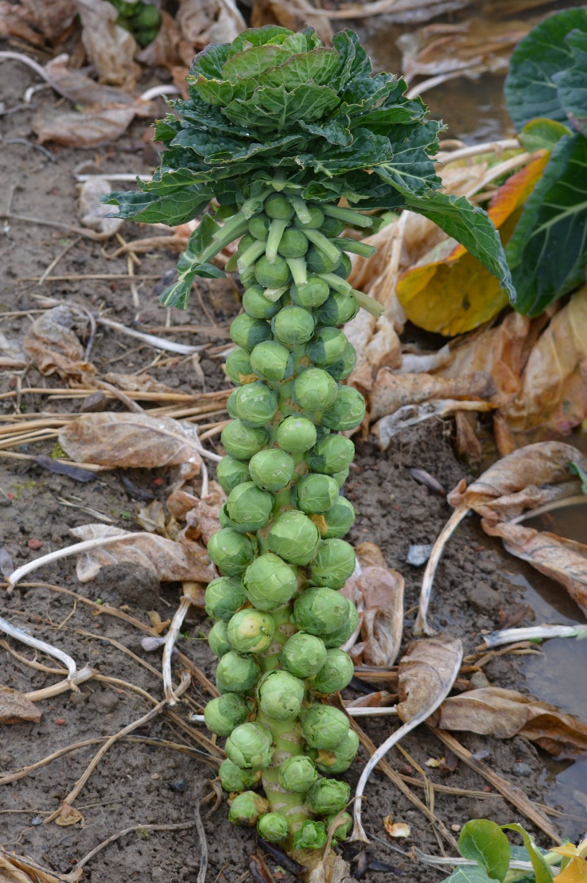

How Do Brussels Sprouts Grow?
Brussels sprouts are leafy green vegetables.
The plants grow above the ground.
Brussels sprouts are like mini cabbages and they grow on the stems of the plant.

Slide 7
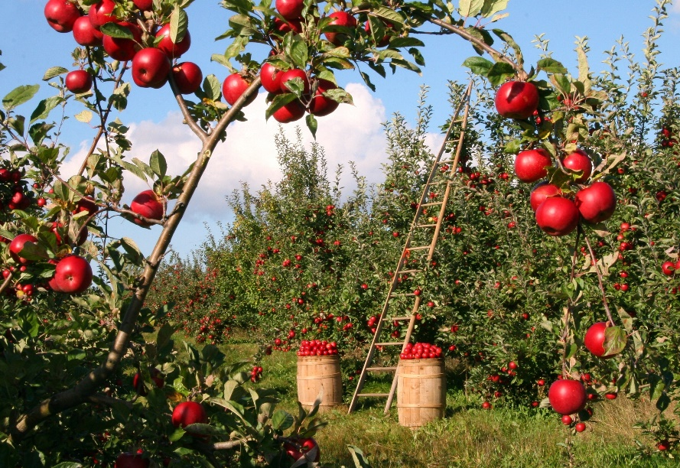
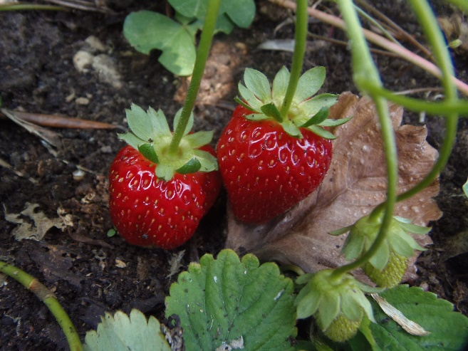
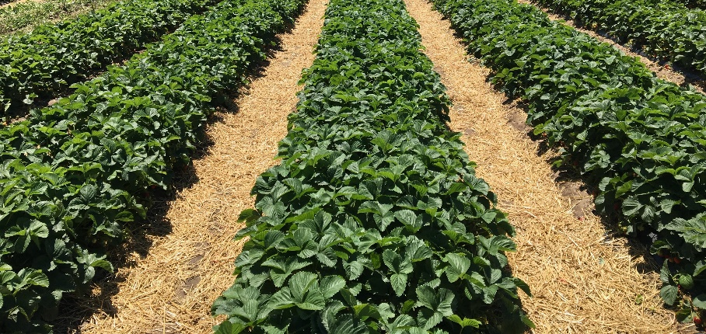
How Does Fruit Grow?
Strawberries grow on small plants, just above the ground.
They need warm weather to grow.
Apples grow on trees.
They grow best in places with cold winters and warm summers.

Slide 8
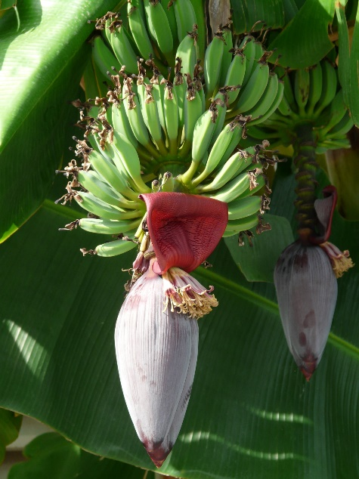
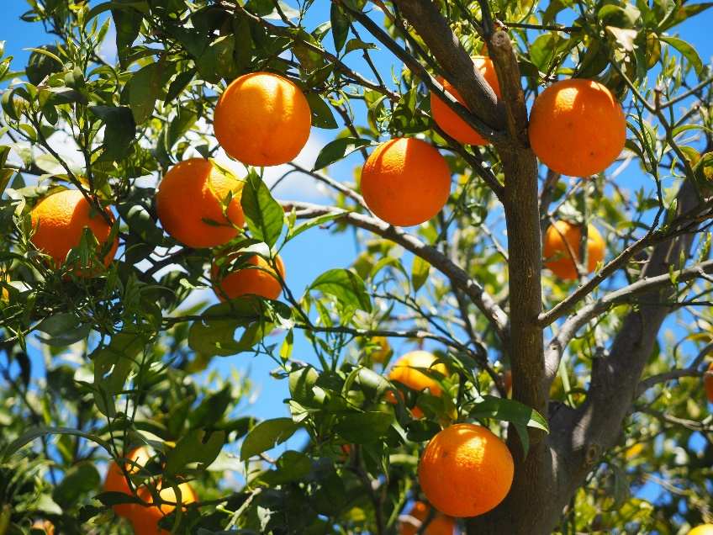
Where Do Fruits and
Vegetables Grow?
Some fruits and vegetables are grown in the United Kingdom.
Many are grown in other countries around the world,
where the weather is different.
Fruits like oranges and bananas are grown in hot countries.

Slide 9
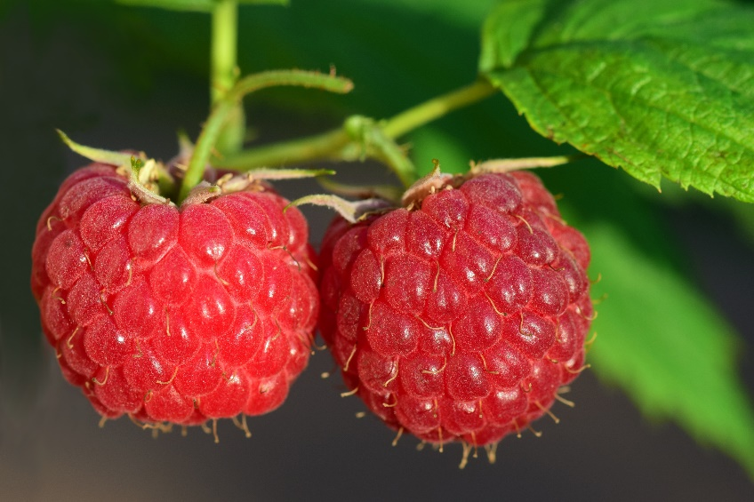
Where Do Fruits and
Vegetables Grow?
Some fruits and vegetables can only be grown in the United Kingdom during the summer, when it is warm.
If customers want to eat these fruits and vegetables all year round, shops have to transport them from warmer countries, so that people can still buy them.
If people from the UK buy
raspberries from the supermarket
in the winter, they will have been
grown in warmer countries,
like Spain.

Slide 10
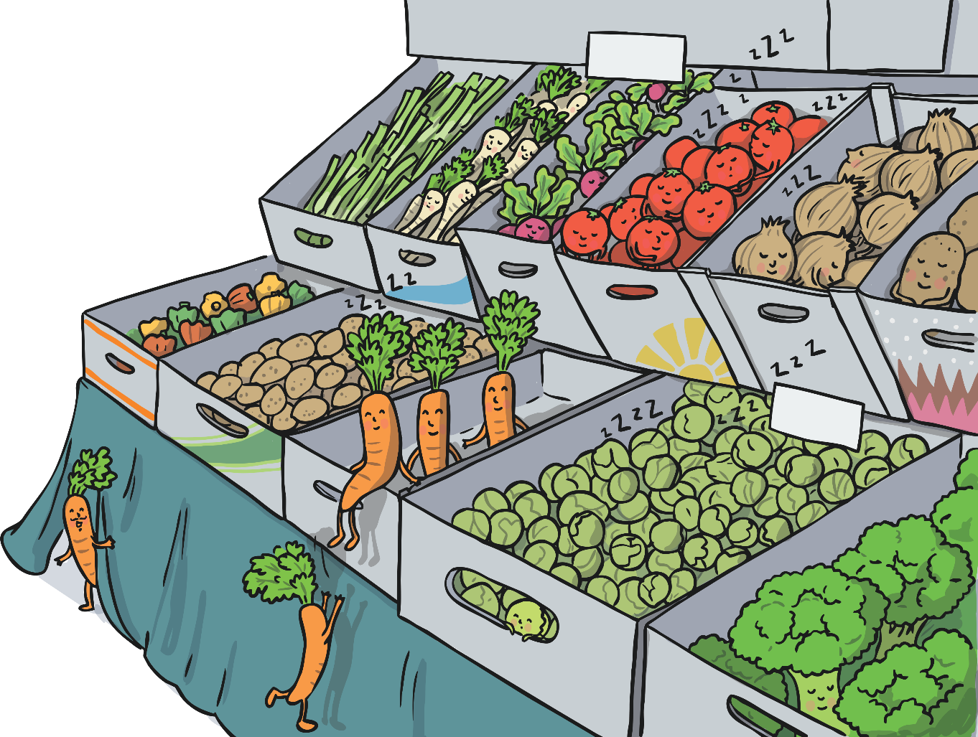
Check It Out!
Have a look at the labels on fruits and vegetables next time you are in the supermarket.
Can you find out where they were grown?

