Slide 2
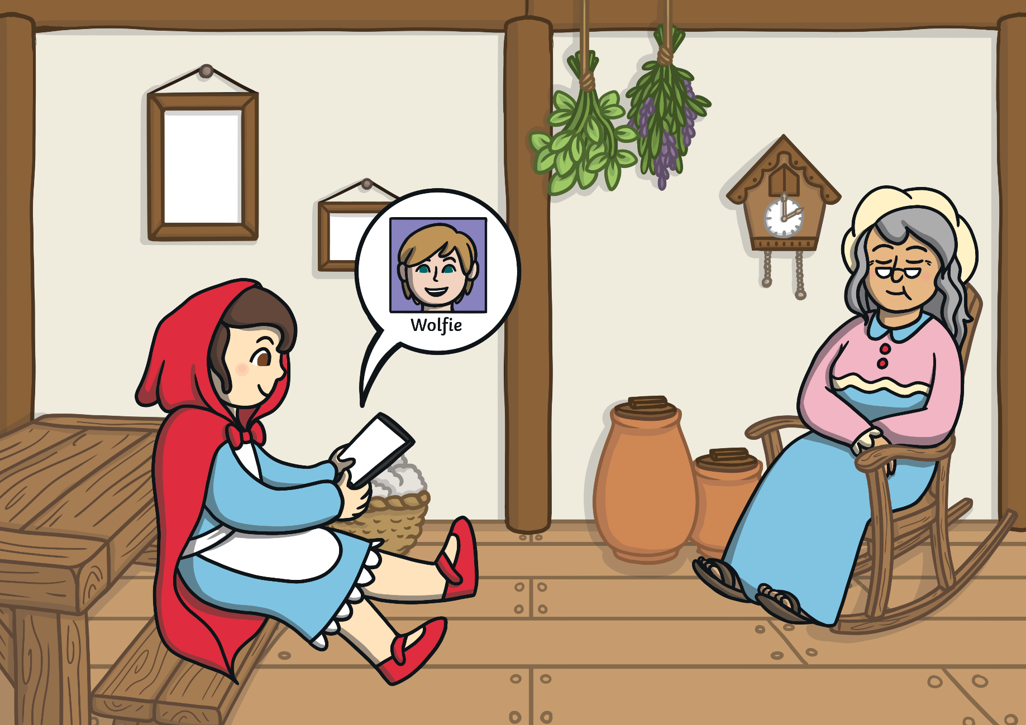
Little Red Riding Hood has been chatting to someone on an internet game. His name is Wolfie and he says he is a boy the same age as her. He has asked her to go and play in the woods near her home. What should Little Red Riding Hood do?
next

Slide 3
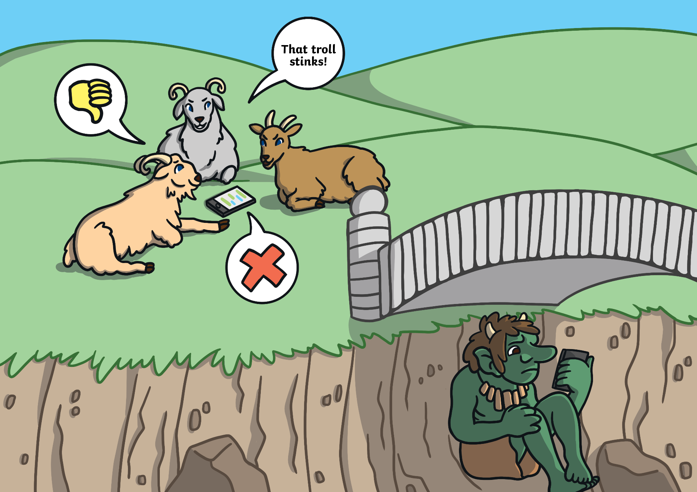
The billy goats are saying mean things about the troll online and sending unkind messages to him. Is it OK to do this? What should the troll do?
back
next

Slide 4
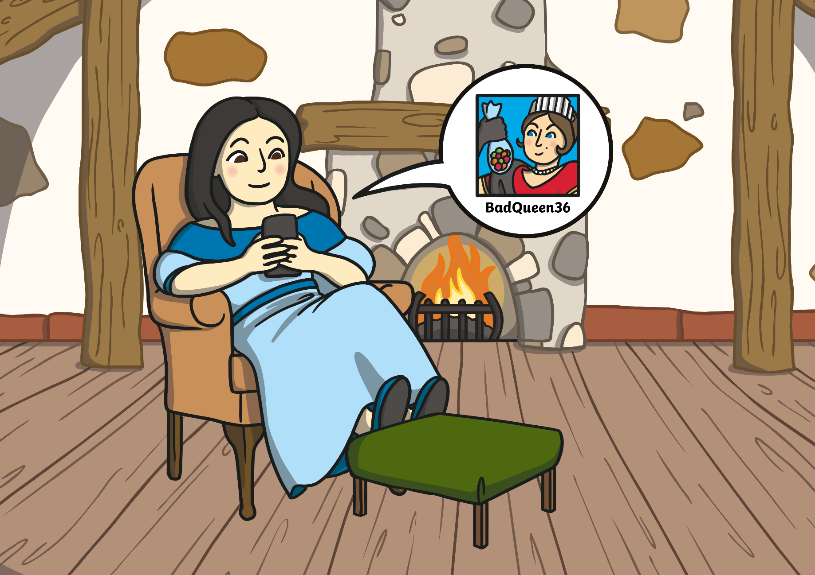
back
next
Snow White is playing an online game against a player called BadQueen36. BadQueen36 says she really likes Snow White and wants to meet her in person and bring her some sweets. She asks for Snow White’s real name and address. What should Snow White do?

Slide 5
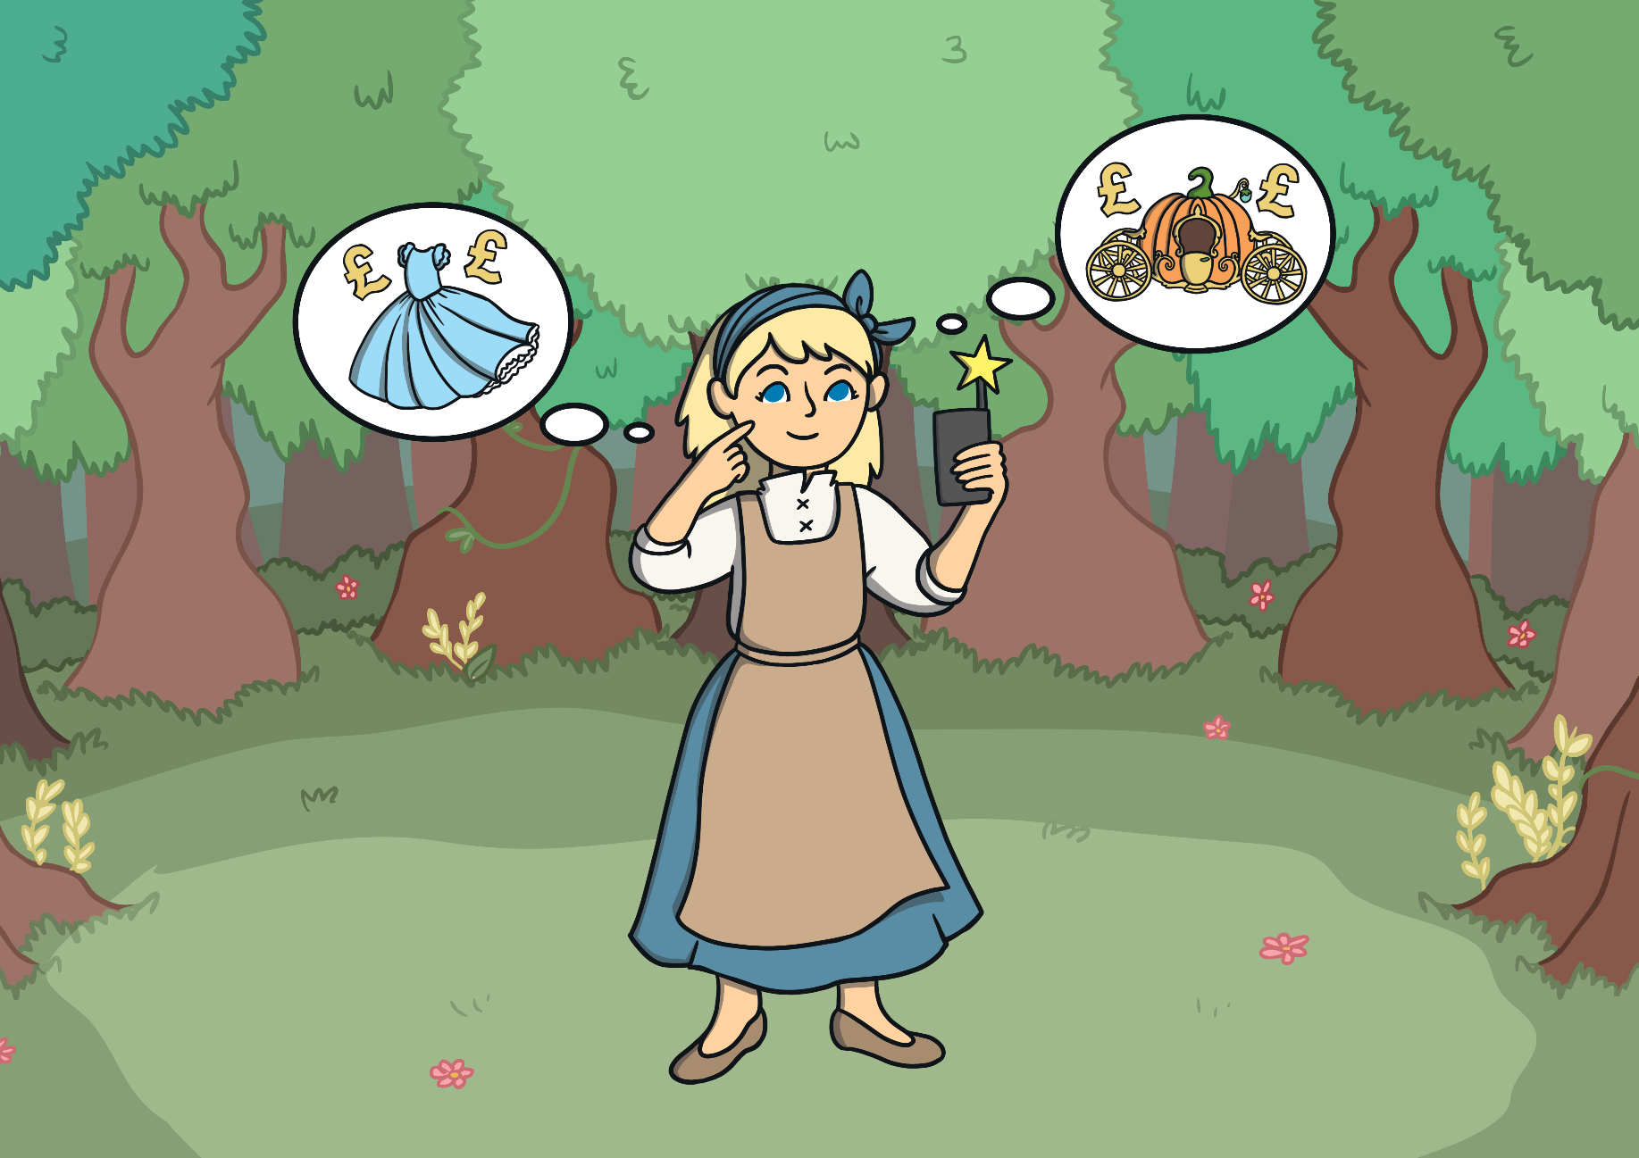
The fairy godmother has left behind her magic phone wand. Cinderella finds it and sees that it is open on a website called ‘Party Delights’, which sells dresses, shoes and tiaras. Cinderella wants to buy herself another beautiful dress. What should she do?
back
next

Slide 6
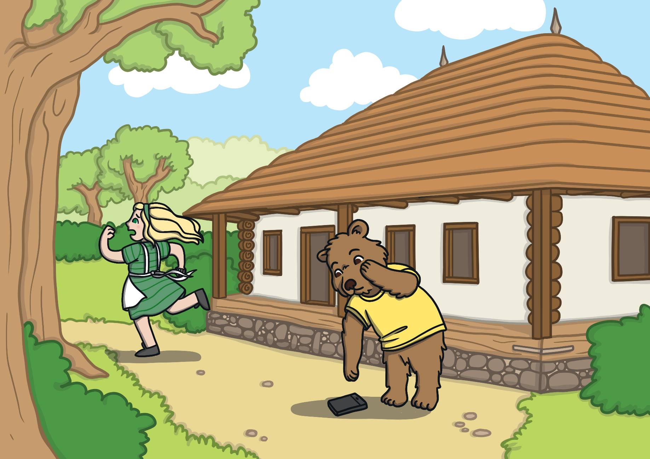
Goldilocks drops her phone as she's running away from the three bears' cottage. Baby Bear finds it and notices that it is open on a website with some scary pictures on it. What should Baby Bear do?
back
next

Slide 7
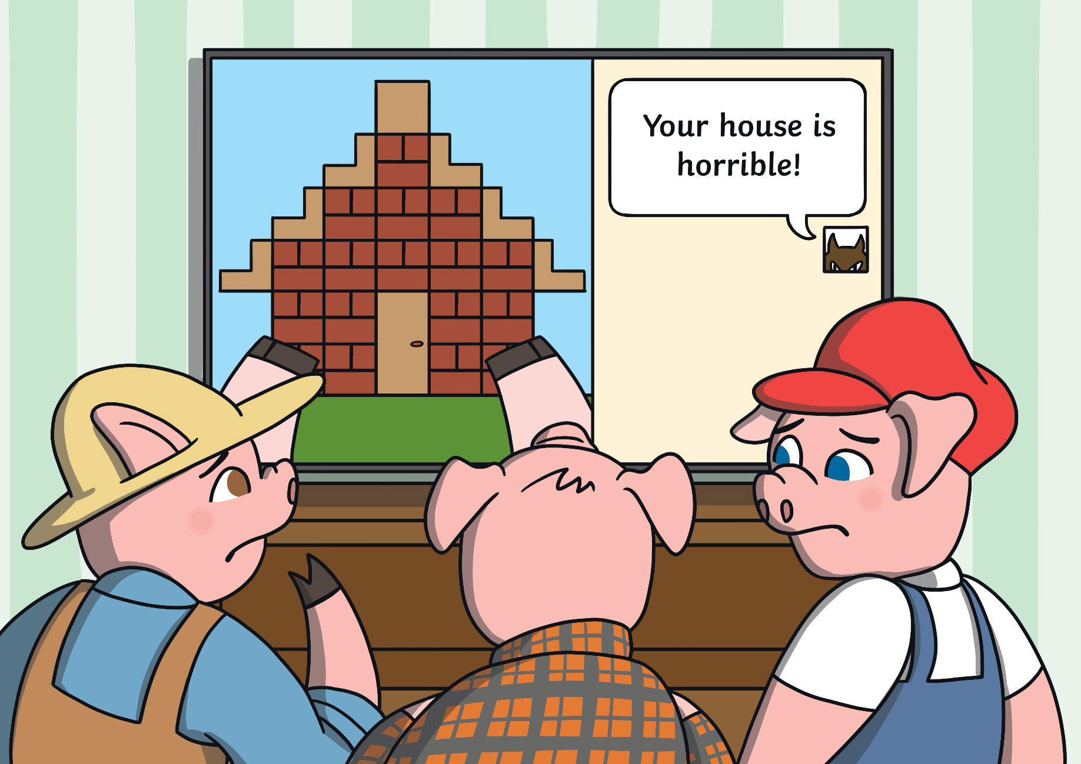
back
end
The three little pigs are playing their favourite game. Suddenly, they get a message from another player called BigBad100 saying horrible things about the house they are building. What should they do?

