Slide 2
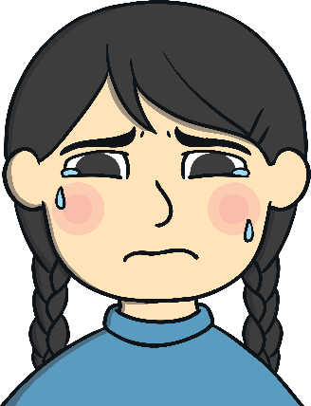
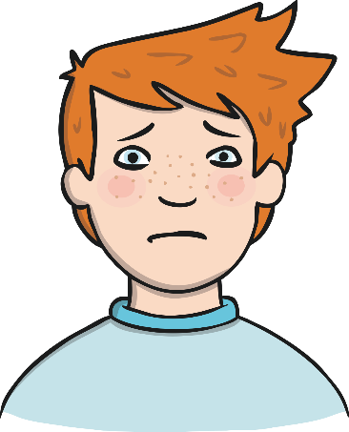
Feelings
Sad
Scared
Happy
Angry

Slide 3
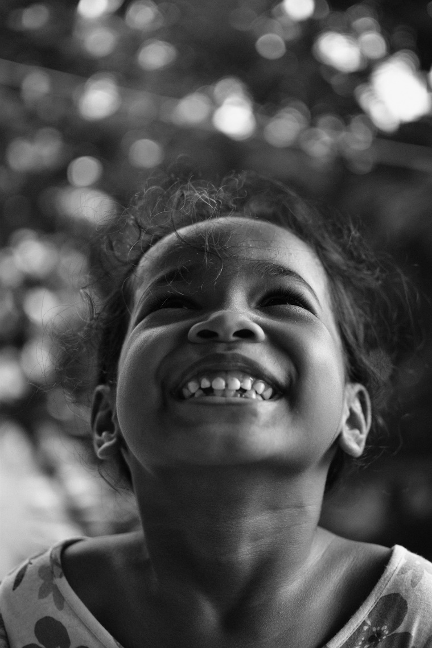
How does this
girl feel?
Why do you think she feels like this?

Slide 4
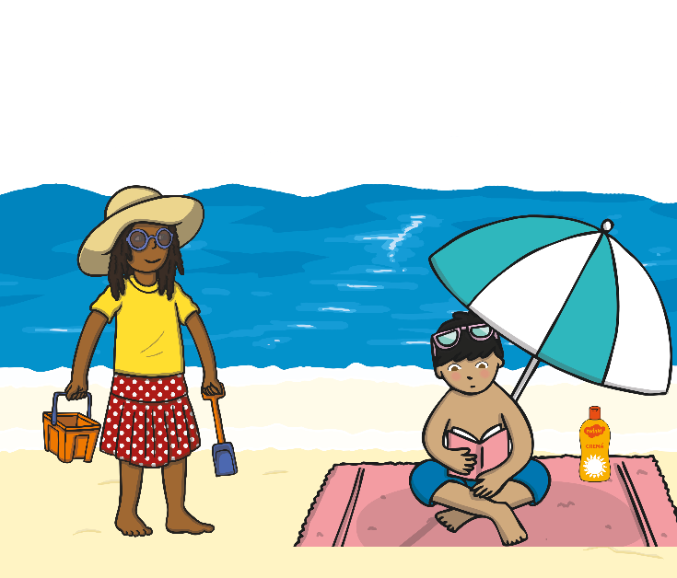
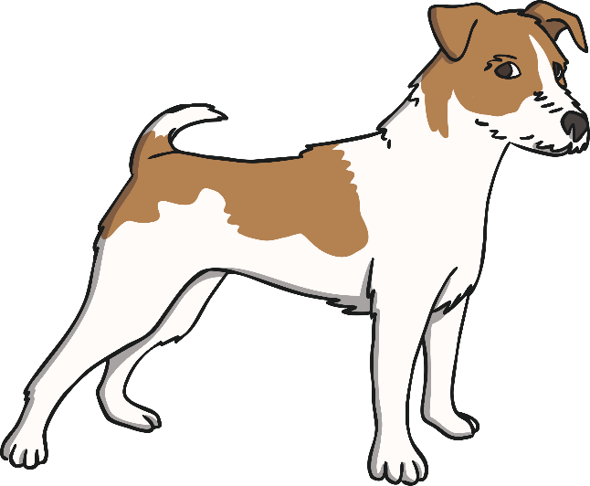
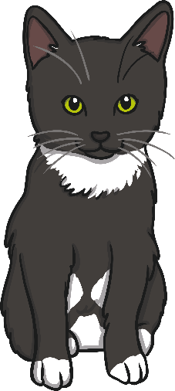
Which of these things make you feel happy?
Going to the seaside
Your pets
What other things make you happy?

Slide 5
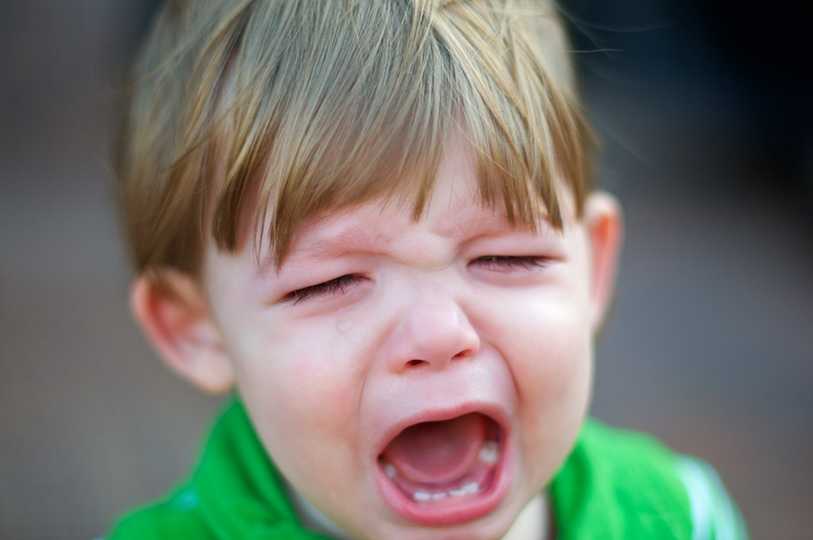
How does this
boy feel?
Why do you think he feels like this?

Slide 6
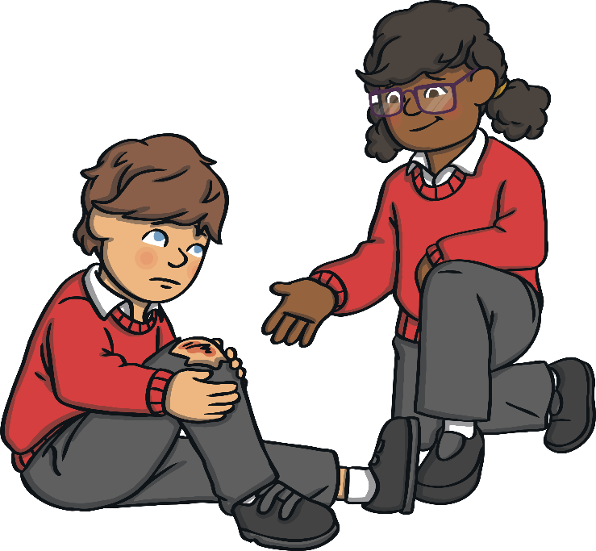
Which of these things make you feel sad?
Hurting yourself
Rainy days
What other things make you sad?

Slide 7
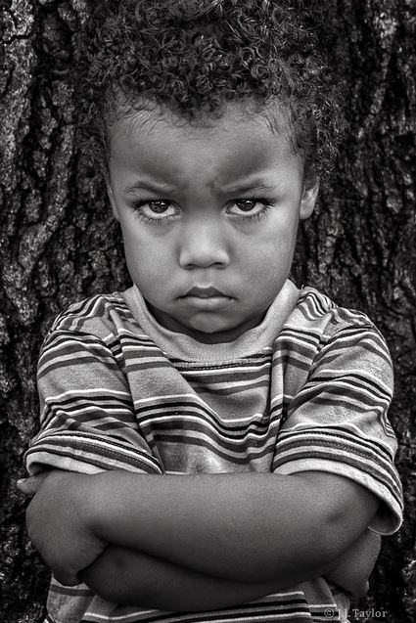
How does this
boy feel?
Why do you think he feels like this?

Slide 8
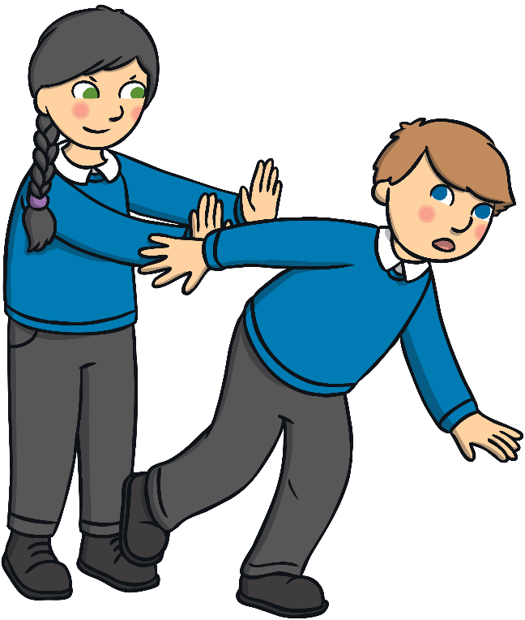
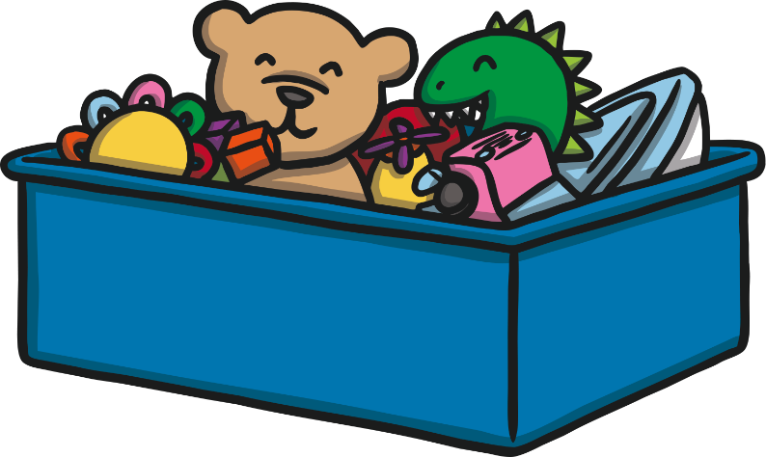
Which of these things make you feel angry?
People not sharing toys
People being unkind
What other things make you angry?

Slide 9
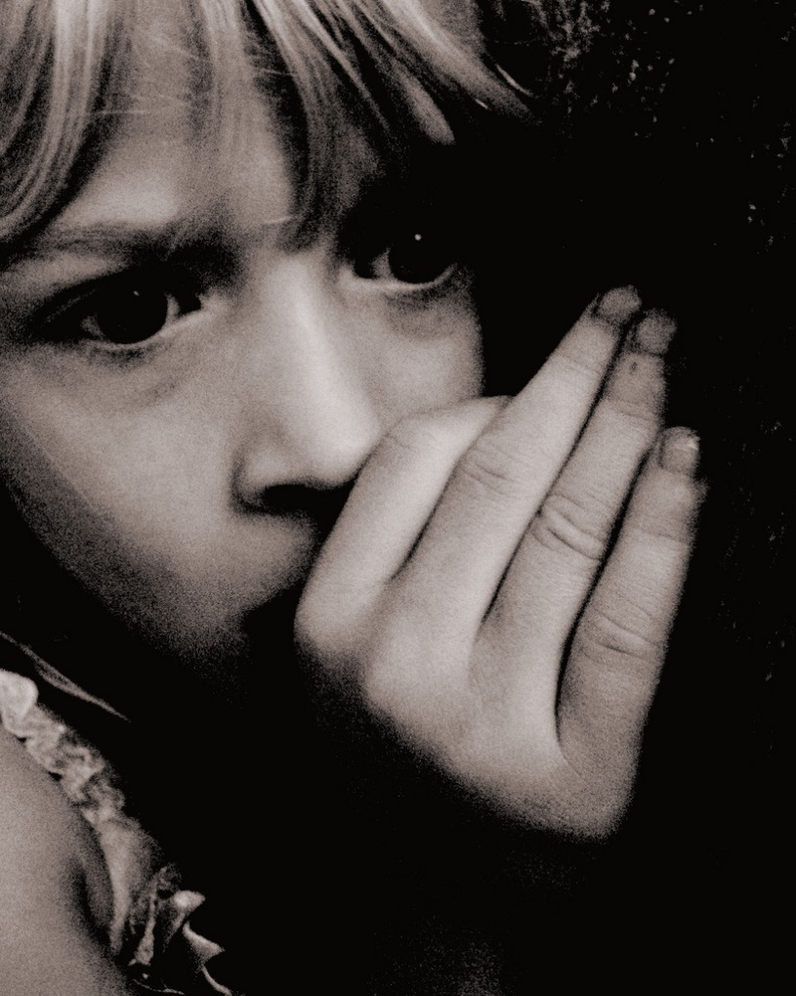
How does this
girl feel?
Why do you think she feels like this?

Slide 10
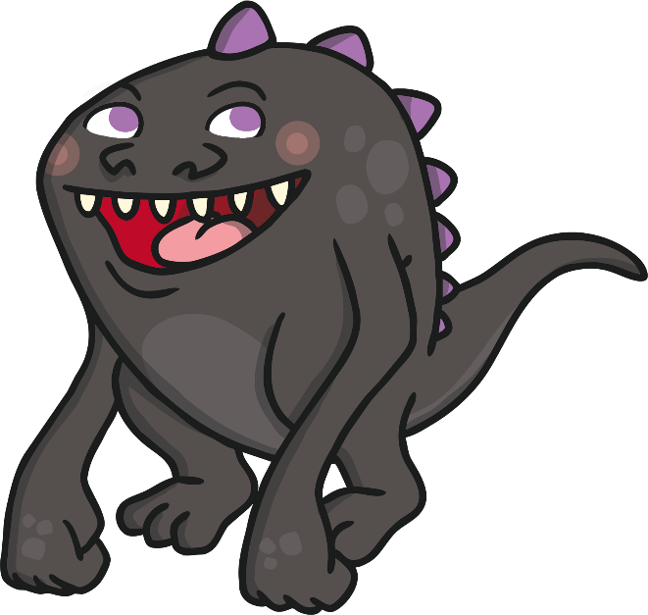
Which of these things make you feel scared?
Monsters
Minibeasts
What other things make you scared?

Slide 11
How do you feel right now?
Sad
Happy
Angry
Scared
Are there any other emotions you feel?
Draw a happy, sad, angry and scared face.

