Slide 2




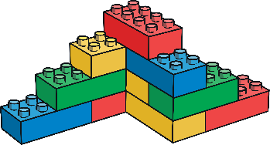
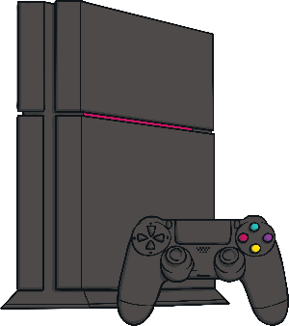



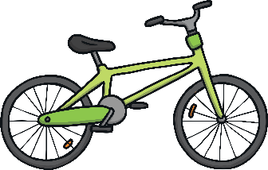
New Toys
There are lots of different toys in the world. Can you name any?
doll
puppets
building bricks
figures
tablet
games console
cuddly toy
electronic toy
bike
football

Slide 3
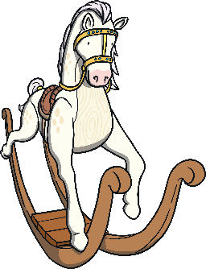











Old Toys
Can you name any old toys?
rocking horse
ragdoll
train set
tin robot
doll’s house
toy soldiers
teddy bear
pull-along toy
marbles
spinning top
roly-poly toy

Slide 4

What Are the Differences?
Old and new toys have lots of differences. Can you think of any?
What are they made from?
How are they made?
How do they move?

Slide 5


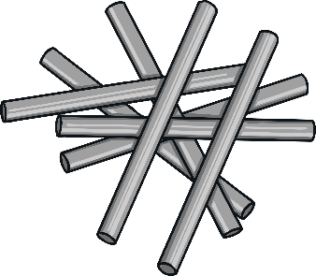



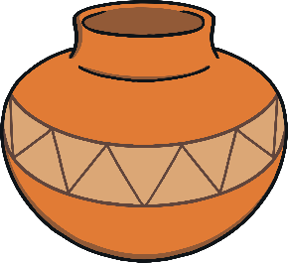
What Are They Made From?
Old and new toys are usually made from different materials.
Can you name any materials?
wood
metal
plastic
fabric
cotton
glass
ceramic

Slide 6
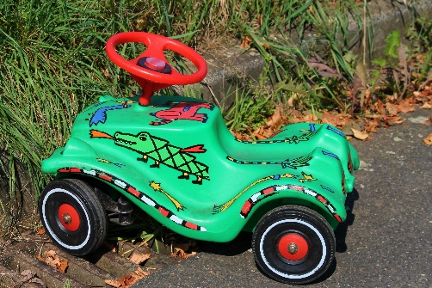
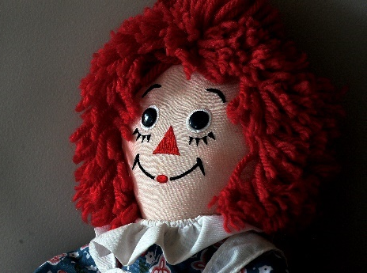
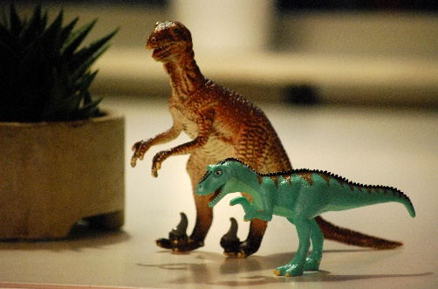
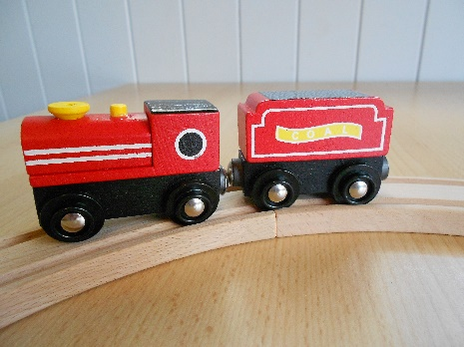
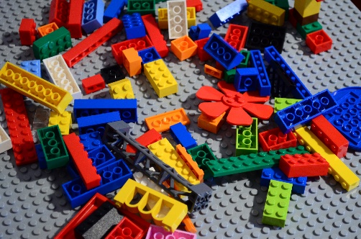
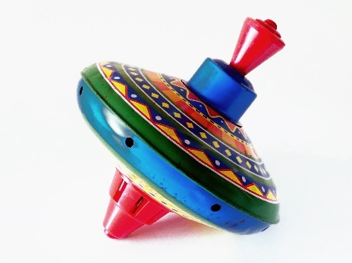
What Are They Made From?
Old toys were usually made from materials such as wood, metal, glass and fabric.
New toys are usually made from plastic.

Slide 7
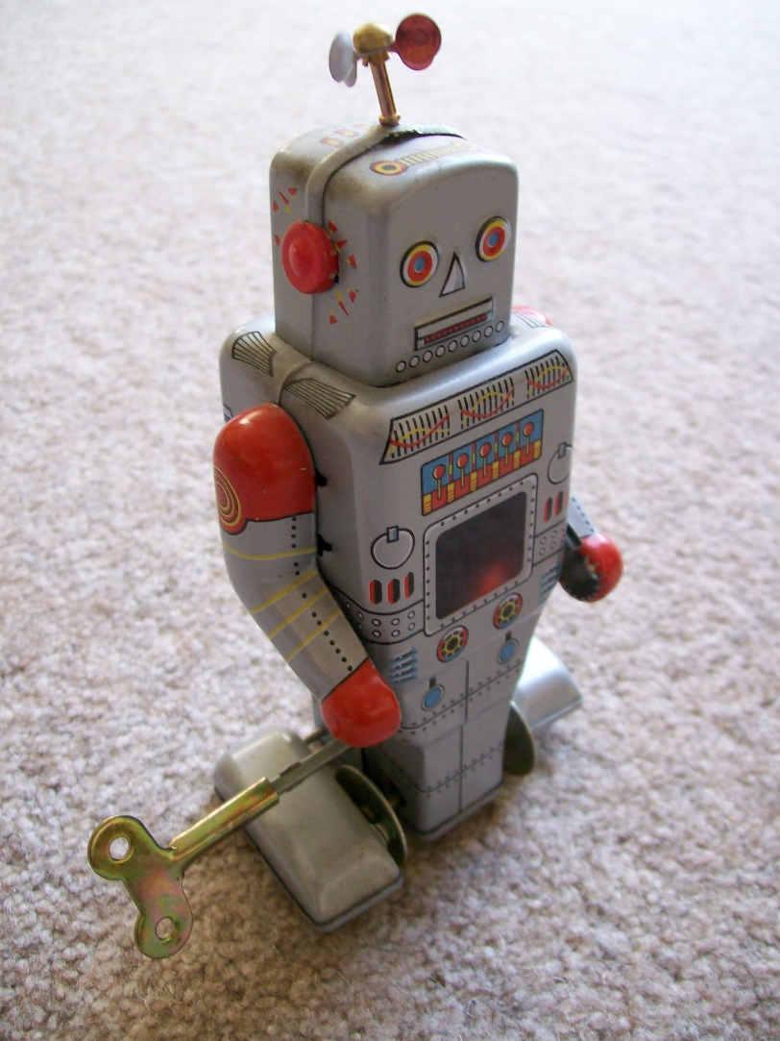
How Do They Move?
Lots of old and new toys can move in some way. They may even make sounds.
Many old toys moved by clockwork or ‘wind-up’. This was usually a small metal key which attached to the toy and you turned lots of times. This would make small wheels (or gears) inside the toy turn and make the toy move.
“Wind-up Robot" by [Lydia_shiningbrightly] is licensed under CC BY 2.0

Slide 8

How Do They Move?
Many new toys use electricity or batteries to move, make noise or light up.
These toys may have lots of different parts, made from lots of different materials.
A tablet computer has a glass screen, a plastic cover and metal parts inside to make the electric parts work.

Slide 9
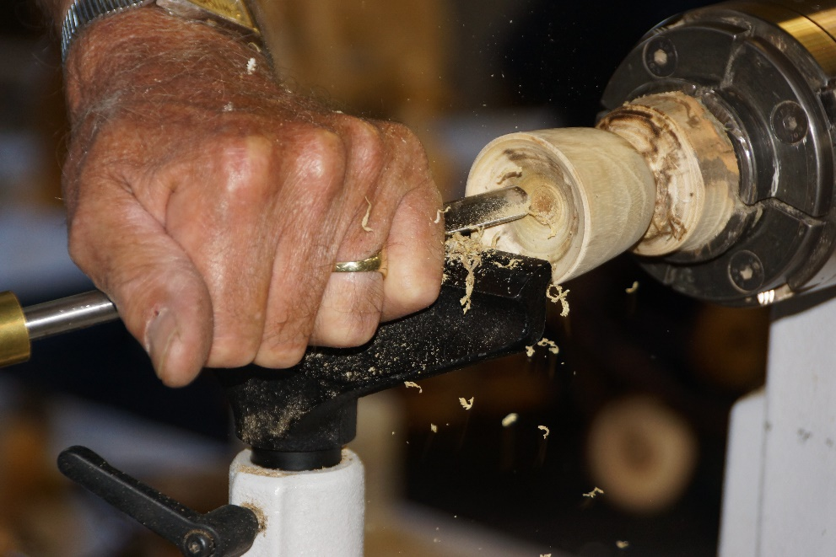

How Are They Made?
Old toys were made differently to how toys are made today.
Lots of old toys were made from wood. These toys were all handmade. This meant that they took a long time and cost a lot of money to make. It also meant that fewer toys could be made.

Slide 10
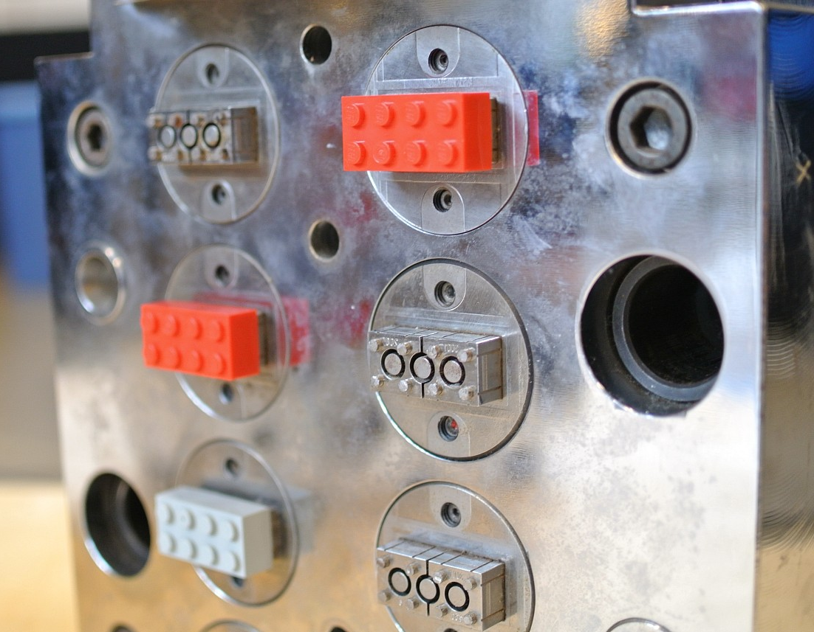
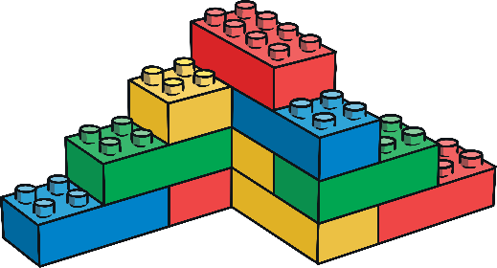
How Are They Made?
Lots of new toys are made from plastic.
Plastic is much cheaper to use. It can be melted and poured into moulds so lots of toys can be made at the same time. This makes the toys much quicker to make too.
Toys are mostly made by machines in factories now.
“LEGO World 2013 production area” by [Brickset] is licensed under CC BY 2.0

Slide 11
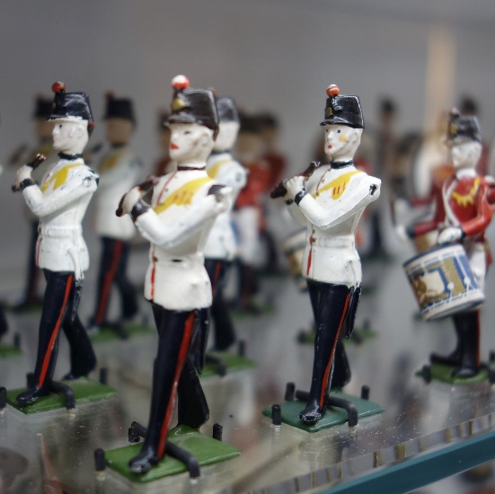
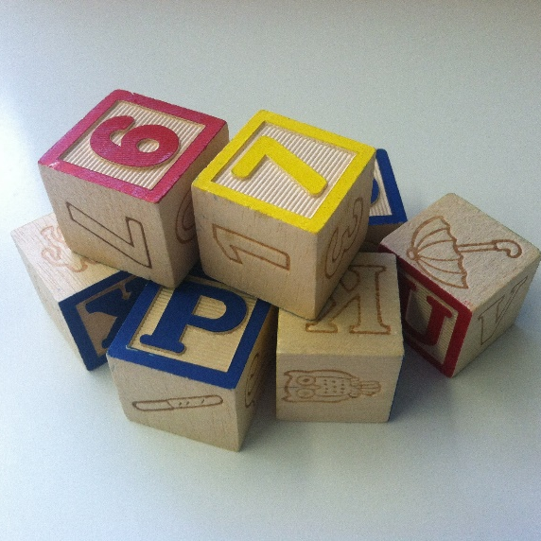
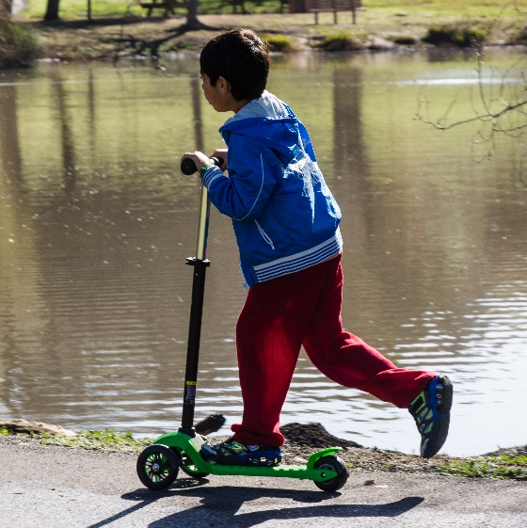

Old or New?
Can you work out which of these toys are old and which ones are new?
“Scooting by Spring Valley Pond” by [donjd2] is licensed under CC BY 2.0

