Slide 1
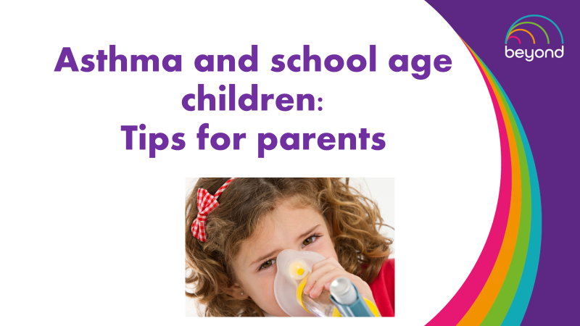

Slide 2
Asthma Friendly schools accreditation
Your child’s school has signed up to become an asthma friendly school
What does this mean for you and your child?
Staff will be trained and updated on asthma and management
An asthma policy in place
Storage of medication and accessibility
Communicating with you around your child’s asthma in school
Please ask to read the asthma school’s policy if you would like more
information

Slide 3
About 1 in every 10 school-age children has asthma. If asthma
is not well controlled, the symptoms can keep your child from
being active or even from going to school. In fact asthma is one
of the most common reasons for missing school. Planning ahead can
help your child stay healthy and active in school. Here are some tips
to help you and your child:
Ensure your child has an up to date asthma action plan to share with your child’s school, this should include:
A list of medicines when to be taken
A list of the things called triggers that make your child’s asthma worse
What to do when asthma symptoms get worse
What to do during an asthma attack
When your child is due another review
Asthma nurse contact number

Slide 4
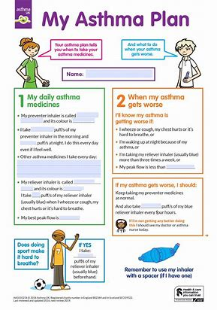
2. Talk with school staff
At the start of each school year talk with your child’s teacher /school
nurse about your child’s asthma and action plan
Give them copies of the action plan and review it with them
Talk about how your child can safely join in on physical education and
activities

Slide 5
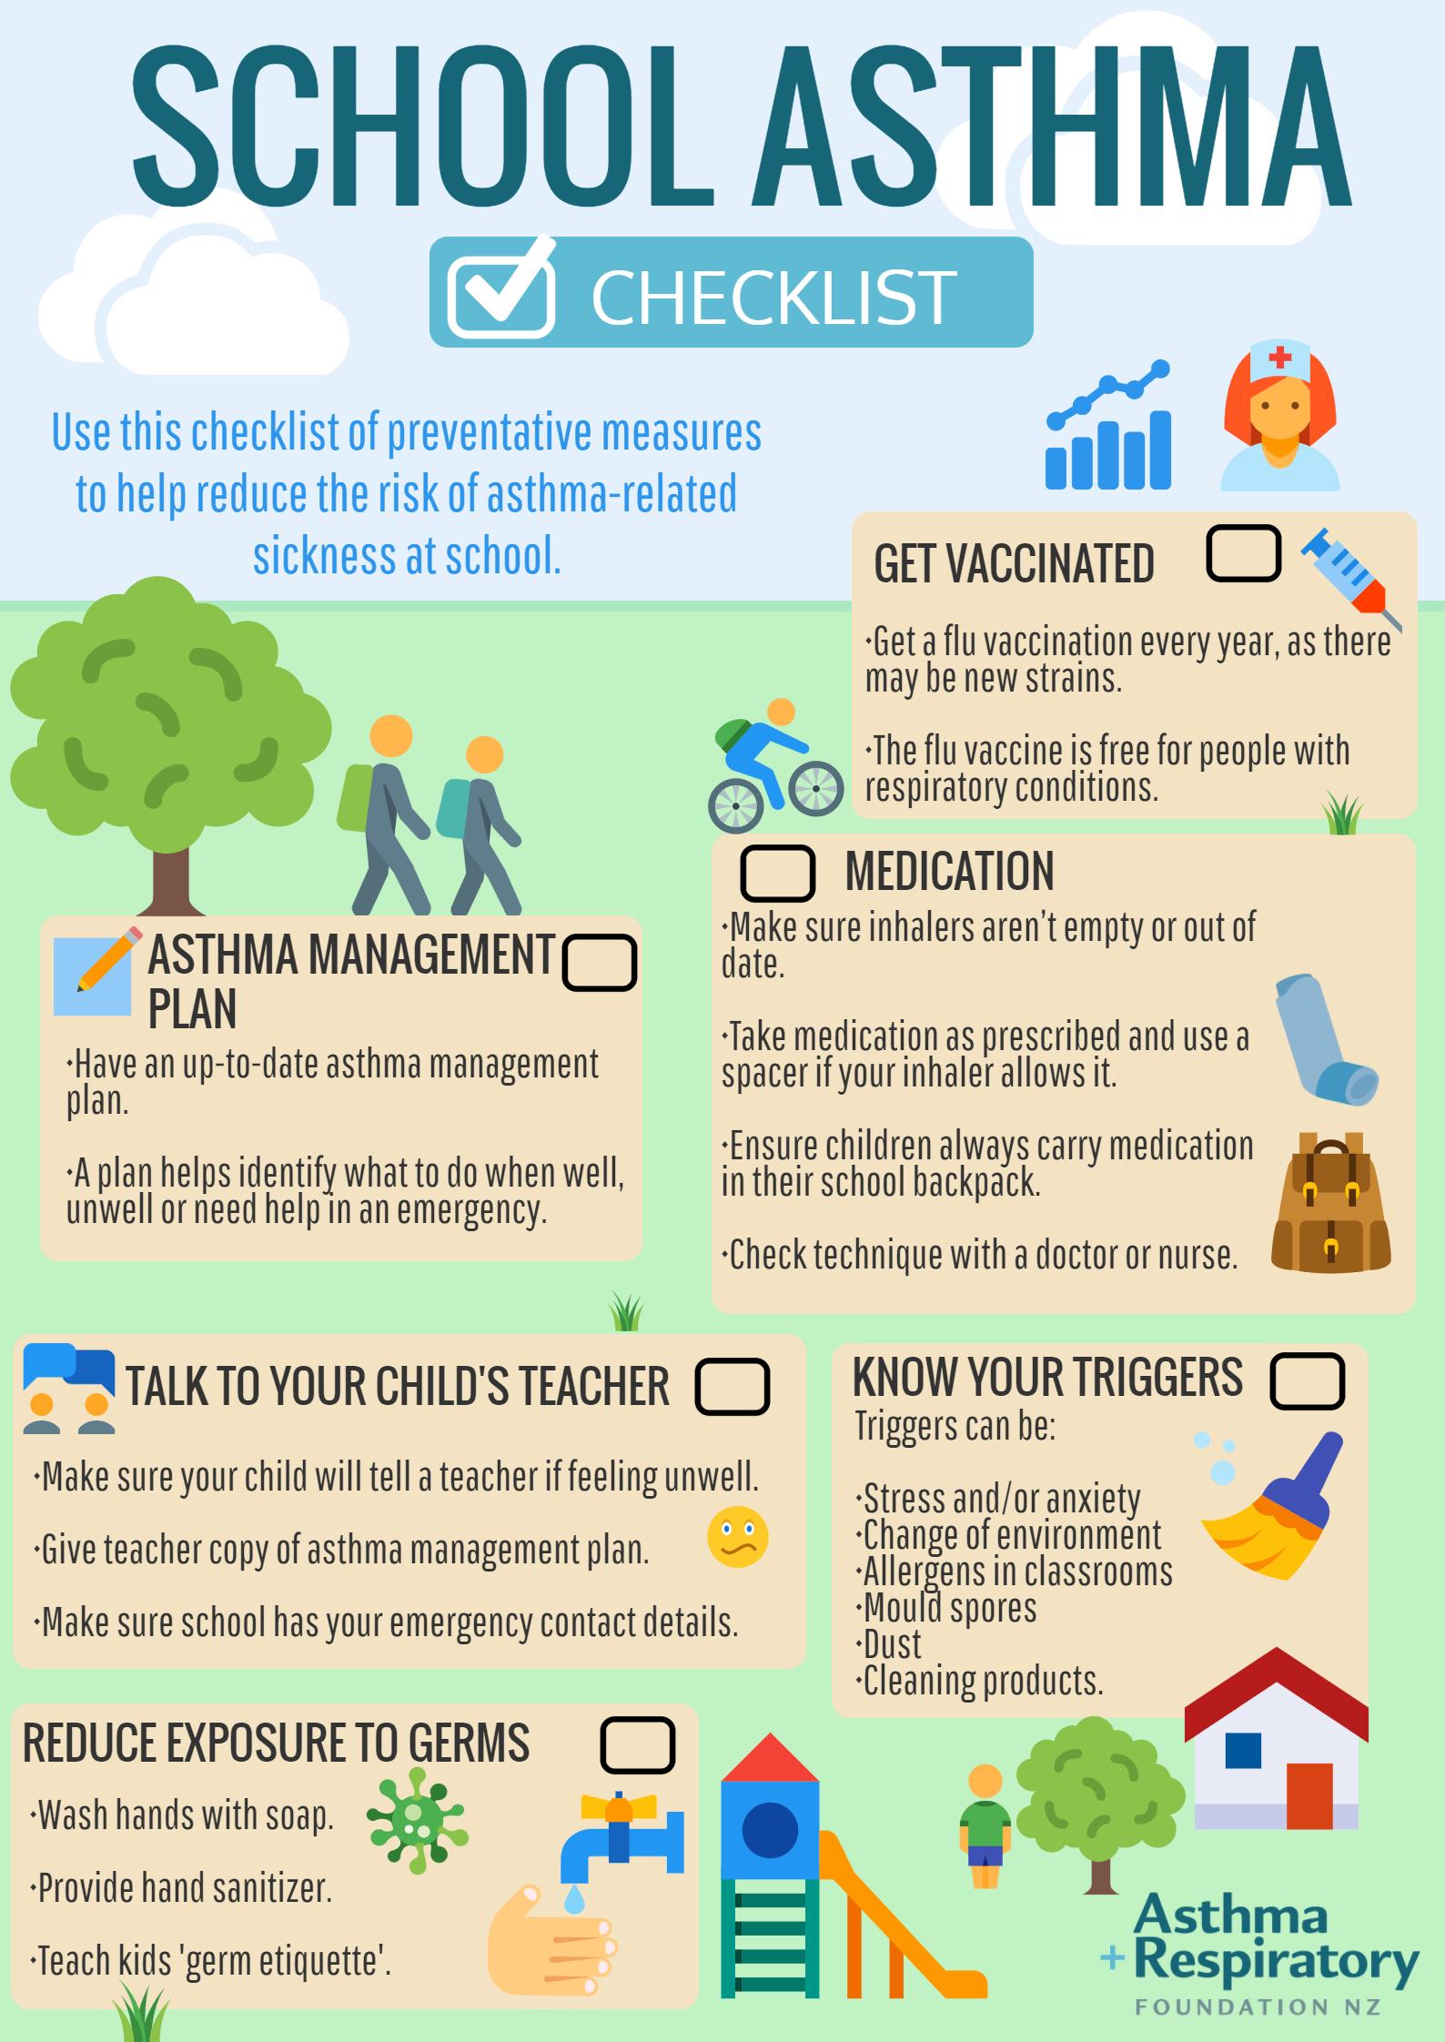
3.Find out about your school’s asthma policies.
Each asthma friendly school has a asthma policy in place
which includes:
A plan to help children with asthma
A medication policy
Management of emergency treatment
A procedure of Informing you are when
your child has needed to use their
reliever

Slide 6
Talk with your child about his or her asthma.
Make sure your child knows:
Many other kids have asthma too
How and when to safely use medication
Takes their preventer every day as directed
How to avoid triggers
Healthy habits like getting enough sleep, being active, eating
well and washing hands which is important for staying healthy

Slide 7
For further training on asthma, parents can
access elearning for health Tier 1 on the link
below:
Asthma (Children and young people) - elearning for healthcare (e-lfh.org.uk)

