Slide 1

Whilst You Are At Home
We are going to stay in touch
26th January 2021

Slide 2


Slide 3

Positive Message of the Week
Hello Everyone 3rd week of this 3rd lock down and we are yet again very proud of you all. Keep up the Great work. As you are all aware we are able to leave our home for exercise. Therefore we thought we would give you some exercise ideas and safety tips. There are lots of things we can do outside, go for a long walk, go on a bike ride, walk the dog. Or maybe do some activity in our back garden.
Last week we told you about the BBC bitesize programs, we hope you have been able to watch it.
A lot of you are working from home along with some of your parents, which means we all have to be patient with one another.
If you are worried about anything please remember to talk to someone you trust.

Slide 4
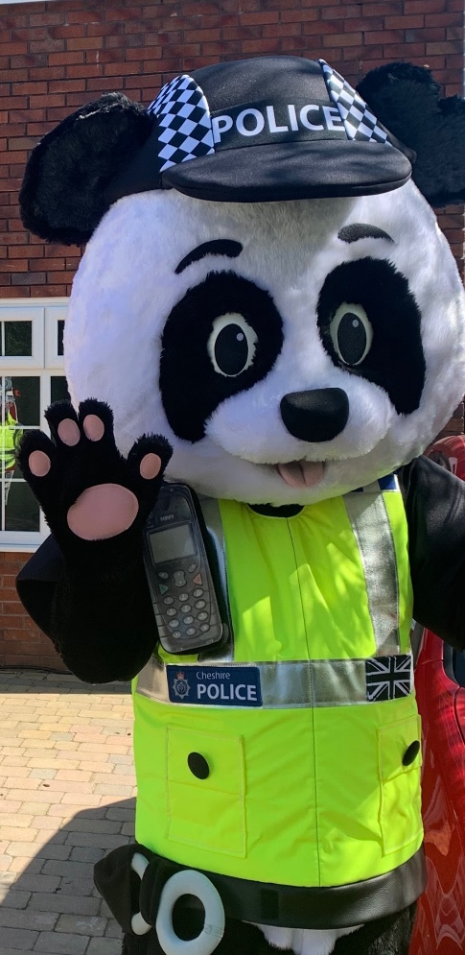
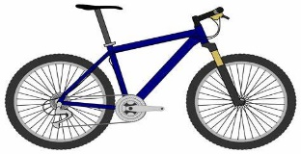



Messages from PC Panda
“Don’t forget your bike helmet.
“Remember no playing outside with your friends at the moment, this won’t be forever”.
“Don’t forget to make sure you bike is safe and has lights”
“Don’t touch other people dogs, they might not be as friendly as yours”

Slide 5

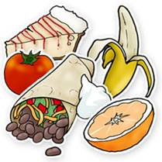



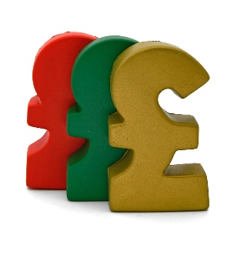




Online Safety
You are all smart children and we want you to remember the Online Safety messages.
Lets follow our Golden Rules.
This week we are going to focus on what we should and should not share with people.
Gossip
Share
Don’t Share

Slide 6

Wear your helmet every time you get on anything with wheels
Use your bell
Helmet
Wear light or bright coloured clothing and shoes that cover your toes
Listen for vehicles and others on the road, leave your headphones at home
Bike-lock
Lights
Check your tyres for air before each ride and make sure your brakes work properly
Be bright, be seen

Slide 7

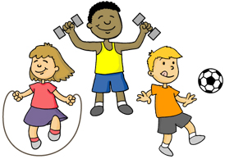
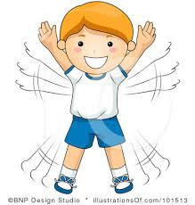
Things to remember
when going Outdoors
Always tell our trusted adults where we are going
Don’t go out on your own in the dark
Be careful crossing the road, STOP LOOK LISTEN THINK
Never run across the road
Be respectful and polite to people HANDS FACE SPACE
Make sure you’re wearing the appropriate clothing to keep you warm and dry.

Slide 8
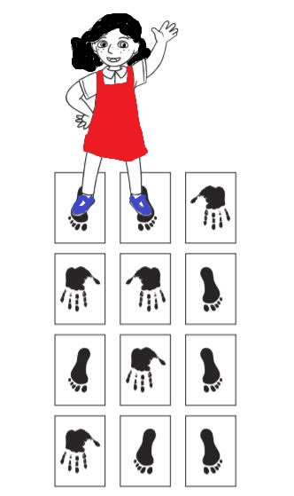

This weeks activity
This activity involves some art work and physical activity
Hands and Feet HOPSCOTCH
You will need 21 sheets of paper or card i.e. from a cereal box, big enough for your hand or foot to fit onto.
Get a pencil or crayon and create 10 pictures of hands and 11 pictures of feet on your paper or cardboard.
Now using some sticky tape, stick your hands and feet pictures to the floor in rows of 3 as in the image opposite where the girl in the red dress is.
Play Hopscotch, have a go at getting all the way to the end without falling over, most people fall over lots of time!

Slide 9

Useful Links for you,
your Parents and Teachers.
The BBC are assisting with home schooling. The link is below:
https://www.bbc.com/mediacentre/2020/bbc-launches-biggest-education-offer-ever?fbclid=IwAR0ifLYSI531vBMt9X8cVq5yDQn7hO2JIGee6uYs2G-wLAcZIkhHrLxxc4k
You can watch it on TV every week day 1pm to 2pm
NSPCC Helpline
0808 800 5000
https://www.o2.co.uk/help/nspcc/helpline
Childline | Childline
https://www.childline.org.uk
Get help and advice about a wide range of issues, call us on 0800 1111, talk to a counsellor online, send Childline an email or post on the message boards

Slide 10

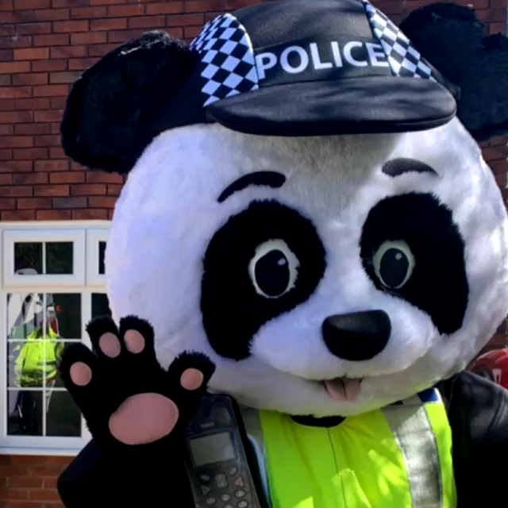
Until next Time 2nd February 2021
Keep washing your hands, remember Hands, Face and Space.
Stay healthy by doing a bit of exercise every day.
Keep positive by reminding yourself, You are an Amazing Child.
Carry On Doing Your Bit for Great Britain and the NHS
Cheshire Police on Facebook
@CheshireSSYP on Twitter
www.cheshire.police.uk

