Slide 1
Welcome

Slide 2
Information Website www.brookfieldsschool.com
School day starts at 9.00am-3.15pm. If you are dropping your children off the school doors will not be open until these times.
On the first day please bring nappies and wipes (if applicable).
Spare clothes to be kept at school. Please ensure names are in everything even shoes, coats, hats and scarfs. EVERYTHING!
For a school bag it might be a good idea to use a ruck sack rather than book bag, this holds everything and promotes independence.

Slide 3
Swimming and PE Swimming: towel swim nappy trunks/costume PE: Nothing needed unless you are told differently for your class

Slide 4
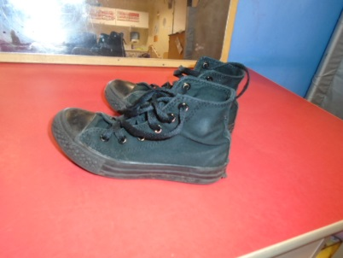
Uniform
Red jumper or cardigan (do not need to have logo).
White shirt/polo shirt.
Grey skirt or pants/shorts
If your child takes off his shoes please
Consider high top shoes\boots.
Jumpers and polo shirts with a logo can be ordered from
school or are available off the website via Tesco.
Plain uniform available from supermarkets.
We will get messy!!!!!!!!

Slide 5
If your child is sick please call the office. Even if your children comes on the bus you must call the office and not pass a message with the bus guide.
We cannot give calpol/paracetamol unless you have provided it for your child with a bottle that has been prescribed.
In addition, only prescribed medication can be given and a consent form must be completed.
We will provide you with a home/school
book. Please write in to let us know any useful
information i.e. your child has not slept well, not had breakfast or about some of the lovely things you have been doing. We will let you know about the school day.

Slide 6
Lunch and Snack EYFS / KS1 children will get a free school meal children on packed lunch will also get one and we will place it near to them. Snack is £2.00 per week(pay per term or each week)

Slide 7
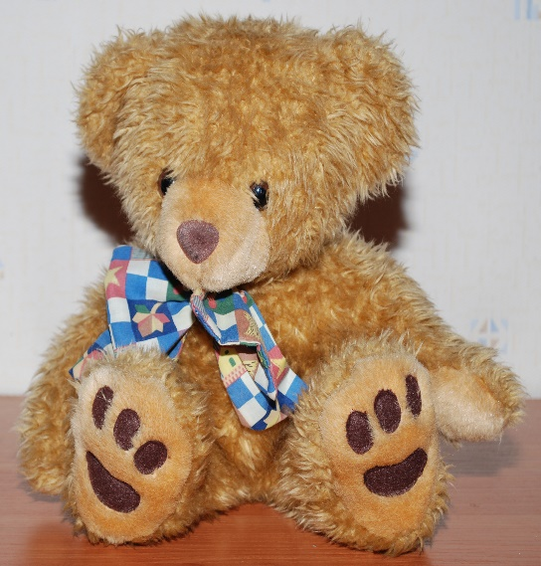
Toys from home.
We understand some children may require some toys/items as a comforter or to help with transition from home to school. If possible try to discourage their favourite toys in case they get lost or damaged.

Slide 8
Paperwork
A member of staff will sit with you and go through the admissions booklet. This is an opportunity for you to tell us everything about your child.

Slide 9
Any questions???

