Slide 1
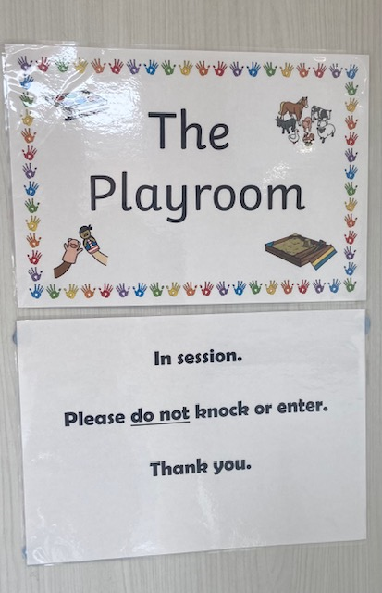
Therapeutic Play Skills at Brookfields School 2022 - 23
By Louise Green.

Slide 2
Therapeutic referral guide.
This intervention / support package involves a child attending a 40 minute session with me in the Playroom for at least 12 weeks.
Separate parent and teacher interviews are held once a referral has been accepted and again at around Week 9 to review their updated SDQ scores and general progress. It is decided upon at this point if 12 weeks remains appropriate or if an extension is needed.
The child must have a cognitive age of at least 5 and their SDQ outcome must score less than 21 (which I score) for a referral to be accepted. The child cannot be receiving support from a Social Worker (unless for Early Help reasons).
As the sessions are non-directive, realistic aims for the outcomes are focussed on benefits for the child rather than ‘improvements’ in their social skills. For example, the Hopes and Expectations for a child participating in Therapeutic Play sessions might be things like:
Experiences problem solving opportunities in a safe environment.
Develops a therapeutic relationship with an adult.
Experiences decision making situations in a non-demand environment.
Experiences full autonomy.
Receives time and space to communicate through play and process emotions.
At the end of the child’s sessions, a full report will be written to summarise their journey. This is shared with the referrer and parents.
I receive external Clinical Supervision once a fortnight to support me in processing my experiences in the Playroom with each child. I report any Safeguarding concerns directly to Sara if necessary.

Slide 3
Playroom resources
Each session includes the same resources with full availability for the child to use as they wish.
A range of resources are available to ensure an Integrative and Hollistic approach to the sessions.
Every child is given the same instruction at the start of the session – “You can use anything in here in any way you want to, as long as we keep you safe, me safe and all the resources safe.”

Slide 4
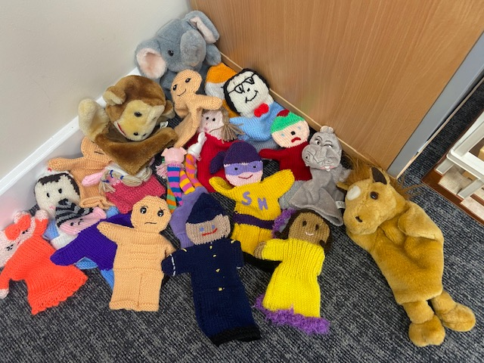
Puppets
Children can project their feelings and thoughts onto the puppets. They feel safe using a play therapy puppet to express themselves.
Puppets can take on different roles; they can be held, talked to and enable children to explore difficult themes at a safe distance through interacting imaginatively with them.
In symbolic play they might be a friend or someone the client has a difficult relationship with. The can also be used for story-telling that is based on fantasy or reality. Children are then able to work through problems and find strategies for dealing with them.
The puppets also provide the option for children to try things out that they have not dared to do in real life.

Slide 5
Music
With instruments, a child is free to play out his feelings.
The unstructured aspect of musical instruments allows for exploration of feelings, However, musical instruments, and music itself, also have a strong inherent structure. A child typically soon tires of random exploration and seeks to play a specific melody or rhythmic pattern, or becomes involved in a shared musical relationship with the therapist.

Slide 6
Movement and masks
Movement, rhythm, and sensory play provides children with another medium to express their inner experience while connected to a regulated, attuned therapist, allowing for integration and a renegotiation of implicitly held trauma.
Metaphor is the language of play. Play allows the child to protect the self while projecting experiences onto another object. Masks provide an element of distance and safety to explore metaphors.

Slide 7
Toys
Toys let children explore their experiences through play.
Children use play to work through various themes.
Children choose toys freely. What they choose and how they play provides the therapist with important clues about what the child may be trying to work through.

Slide 8
Art materials, Clay and Water
Creating art provides an emotional distance which can make it easier to express what children want to say.
The use of art and play materials promotes relaxation and reduces anxiety.
Clay involves a very primal mode of expression and communication as it involves touching. It is the sense of touch that enables people to understand the very boundaries of themselves
Water play can be busy or it can be calming. Symbolically, water can represent cleansing or drowning. It’s sensory benefits can help the child to regulate.

Slide 9
Sand tray
Research shows that sand tray therapy can help increase emotional expression while reducing the psychological distress that may come from discussing traumatic events or experiences.
Using the sand tray, children can create a world that represents their internal struggles or conflicts.
There is the option for using wet or dry sand.
The base of the tray is blue. This can represent water and also stimulates the child’s unconscious thought processes.

Slide 10
Sand tray miniatures
A range of miniatures are offered in these categories: people, animals, nature objects, bridges, barriers, the elements (fire and water), vehicles, sacred symbols, mythical creatures, and other metaphoric representations.
The miniatures are what make this such a visual medium. It allows children to work in metaphor and from a third-person perspective.

Slide 11
Dolls
Dolls serve as a way for children to express themselves, learn, role play, and develop relational intelligence.
They help children explore themes such as power, nurture, safety and relationships.
Dolls provide a way for children to discuss complex emotions and relationships without the vulnerability of speaking of themselves or others.

Slide 12
Dolls house
This resource symbolises a viewpoint of past, present and future homes, reflecting the social function of different rooms and human interaction within them. They evoke feelings from around the home and about family relationships.
Some children are initially slower to choose the dollhouse for play since it can lead to direct engagement of family issues. The story play from the use of a dolls house can be very revealing and profound.

Slide 13
After the Playroom.
A Therapeutic Play Skills session can be tiring for a child and sometimes quite emotional. Teachers are sensitive to this as the child returns to class.
After the package of Playroom sessions have finished, I make recommendations for future support and ensure the child’s parents and class team have access to providing this.

